Slide 1
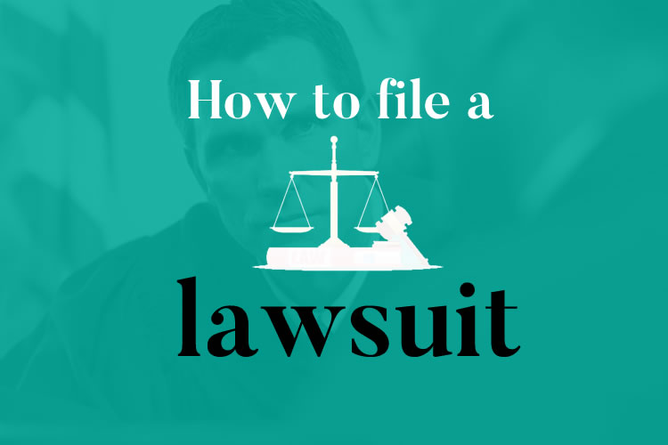
Lawsuit
a claim by one person or organization against another person or organization and filed with a court for hearing.

Slide 2
The lawsuit filing marked the beginning of a legal battle.
Proper documentation is crucial for accurate lawsuit filing.

Slide 3
a lawsuit is the entire legal action, and pleading refers to the written documents used to state the claims and defenses in that action.

Slide 4
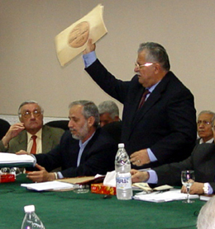
Pleading
Is the beginning stage of a lawsuit in which parties formally submit their claims and defenses.

Slide 5
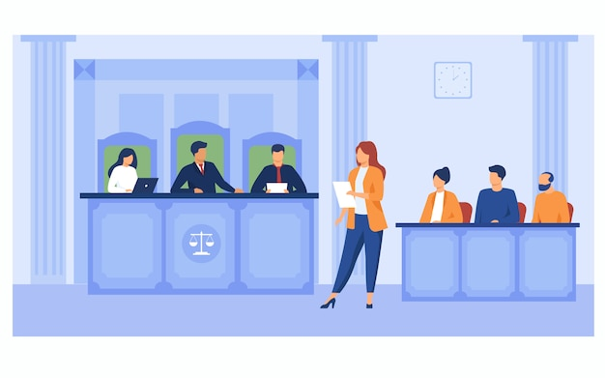
Pleading serves as a formal way to present legal arguments
The judge reviewed the legal pleading before scheduling a hearing.

Slide 6
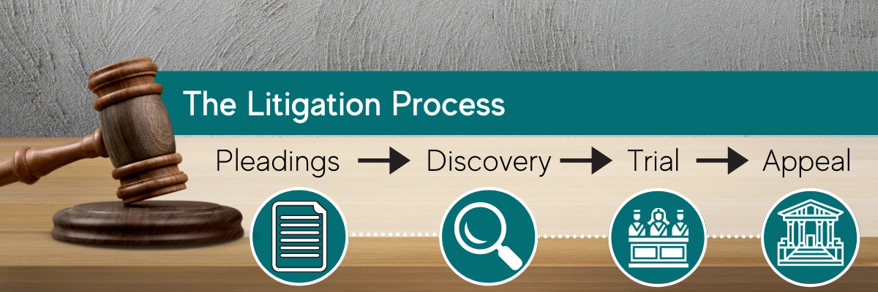

Slide 7

Judgement
Is the court’s decision, spelled out in a court order.

Slide 8
Verdict
Is a decision made by a jury regarding the guilt or innocence of a defendant in a criminal case or the liability of a party in a civil case.

Slide 9
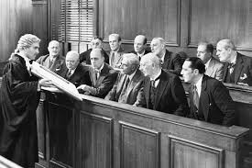
Reach a verdict
The jury are expected to take several days to reach a verdict.

