Slide 1
Bonds Interest
Dr. Munadhil Abdu AL Jabbar Al Salem

Slide 2
There are three cases to determine bonds interest:
The accounting treatment of bond interest as follows:
At the end of period, the accountant calculates bond interest by using the following equation:
A- Issuing a par value
From: bond s interest a/c xxx
To: Cash a/c xxx
Bonds value x Interest percentage x Loan period = Annual interest
Notes:
s

Slide 3

The accounting treatment of bond interest as follow:
The depreciation of (issue premium) or (issue discount) by using straight line method as follows:
B- (Issuing with issue premium):
From: bonds interest a/c xxx
issue premium a/c xxx
To: Cash a/c xxx
$$\frac{\text{(}\text{issue} \text{premium}\text{) }\text{or}\text{ (}\text{issue} \text{discount}\text{) }}{\text{bonds} \text{years} (Periods)}$$
Notes:
s

Slide 4
C- (Issuing with Issue discount):
From: bonds interest a/c xxx
To: issue discount a/c xxx
Cash a/c xxx
When the entries are recorded, and Closing bonds interest account of the profit & loss account , we must prepare the effect for the balance sheet.
Notes:
s

Slide 5
1 - issuing at a par value:
Q:A: On 1/1/2012, AAQ Company issued 1000 bonds on an interest rate of 10% at a par value of $100 each, full value has been paid at the subscription in cash. If you know:
1 - Bond interest is paid at the end of the year.
2 - 5 years of the loan period.
3 - The Company applies the straight-line method
Required:
Record the accounting entries and prepare the balance sheet (partial).
Notes:
s

Slide 6
The par value = 1000 x 100 = 100,000
1/1/2012… From: Cash a/c 100,000
To: Loan Bonds a/c 100,000
_______________________________
At the end of the period, in 31/12/2012, calculate the bond Interest that must be paid in cash:
100,000 x 10% = 10,000
31, Dec… From: bond interest a/c 10,000
To: Cash a/c 10,000
______________________________
31, Dec…From: Profit & loss a/c 10,000
To: bond interest a/c 10,000
_____________________________
Balance sheet . at 31 Dec. 2012
Long-term liabilities
Loan bonds 100,000
Notes:
s

Slide 7
2 - Issuing with issue premium:
Q:B: In 1/1/2012, AAQ Company issued 1000 bonds on an interest rate of 10% at par value of $100 each, the issue price is $120, full value has been paid at the subscription in cash. If you know:
1 - Bond interest is paid at the end of the year.
2 - 5 years of the loan period.
3 - The Company applies the straight-line method.
Required:
Record the accounting entries and prepare the balance sheet (partial).
Notes:
s

Slide 8
Before answering the question, we must compare between issue price and par value
- Issue price = 120
- Par value = 100
In this case, the issue price is more than par value, which means the bonds include issue premium.
Calculate the issue premium:
- Issue price = 120 x 1000 = 120,000
- Par value = 100 x 1000 = (100,000)
___________________________________
Issue premium 20,000
Record the following Accounting entries:
1/1/2012 … From: Cash a/c 120,000
To: Loan bonds a/c 100,000
Issue premium a/c 20,000
Balance sheet (at the beginning period)
Long-term liabilities
Loan bonds 100,000
+ Issue premium 20,000
120,000
Notes:
s

Slide 9
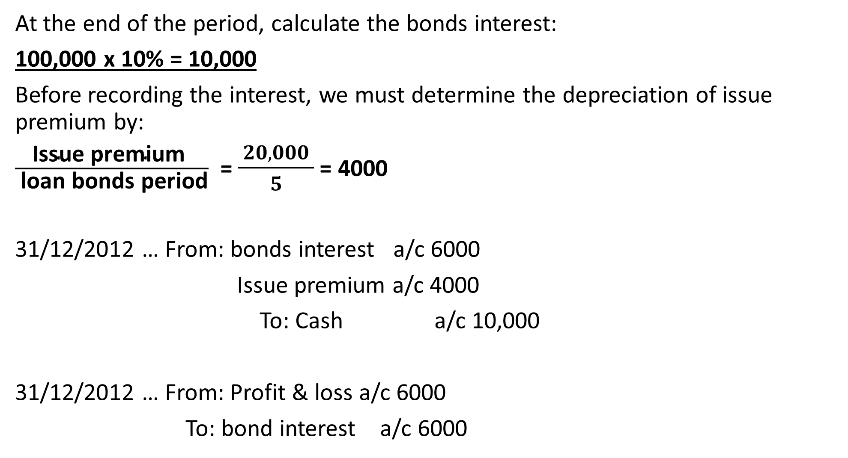
At the end of the period, calculate the bonds interest:
100,000 x 10% = 10,000
Before recording the interest, we must determine the depreciation of issue premium by:
$\frac{\text{Issue} \text{premium} }{ \text{loan} \text{bonds} \text{period}}$ = $\frac{ 20,000 }{5}$ = 4000
31/12/2012 … From: bonds interest a/c 6000
Issue premium a/c 4000
To: Cash a/c 10,000
31/12/2012 … From: Profit & loss a/c 6000
To: bond interest a/c 6000
Balance sheet at 31st Dec 2012
Long-term liabilities
Loan bonds 100,000
+ Issue premium 16,000
116,000
Notes:
s

Slide 10
3 – Issuing with issue discount:
QC: In 1/1/2012, AAQ Company issued 1000 bonds on an interest rate of 10% at a par value of the $100 each, the issue price is $90. Full value has been paid at the subscription in cash. If you know:
1 - Bond interest is paid at the end of the year.
2 - 5 years of the loan period.
3 - The Company applies the straight-line method.
Required:
Record the accounting entries and prepare the balance sheet (partial).
Notes:
s

Slide 11
Before answering the question, we must compare between the issue price and the par value:
- Issue price = 90
- Par value = 100
In this case, the issue price is less than the par value which means the bonds include issue discount.
Calculating the issue discount:
- Issue price = 90 x 1000 = 90,000
- Par value = 100 x 1000 = (100,000)
Issue discount (10,000)
Recording the Accounting entries:
1/1/2012 … From: Cash a/c 90,000
Issue discount a/c 10,000
To: Loan bonds a/c 100,000
Balance sheet (at the beginning period)
Long-term liabilities
Loan bonds 100,000
- Issue discount 10,000
90,000
Notes:
s

Slide 12
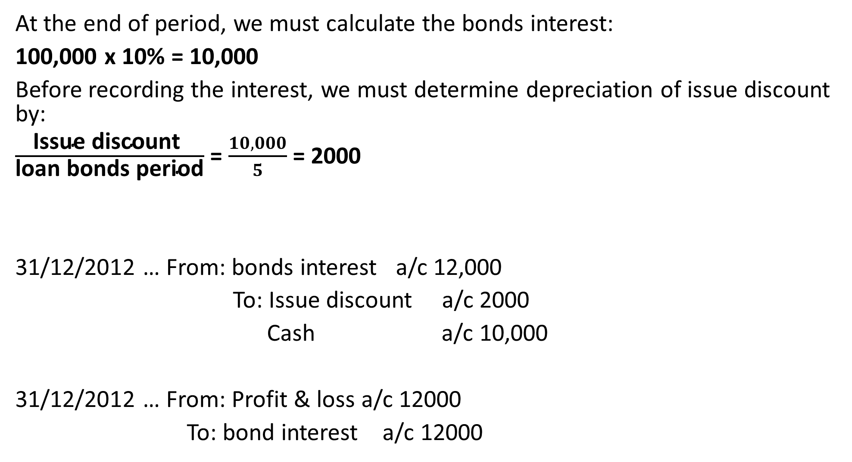
At the end of period, we must calculate the bonds interest:
100,000 x 10% = 10,000
Before recording the interest, we must determine depreciation of issue discount by:
$\frac{\text{Issue} \text{discount} }{\text{loan} \text{bonds} \text{period}}$ = $\frac{10,000}{5}$ = 2000
31/12/2012 … From: bonds interest a/c 12,000
To: Issue discount a/c 2000
Cash a/c 10,000
31/12/2012 … From: Profit & loss a/c 12000
To: bond interest a/c 12000
Balance sheet at 31st Dec 2012
Long-term liabilities
Loan bonds 100,000
- Issue discount (8000)
92,000
Notes:
s

Slide 13
Q (1 ): 1/1/2012, RRQ Company issued 3000 bonds an interest rate of 12% at par value of the $120 each, has been paid full value at the subscription in cash. If you know:
1 - Bond interest paid at the end of the year.
2 - 5 years of the loan period.
3 - The Company applies the straight-line method
Required:
Recording accounting entries and prepare balance sheet (partial).

Slide 14
Q (2): 1/1/2012, RRQ Company issued 3000 bonds an interest rate of 12% at par value of the $120 each, the issue price $140, has been paid full value at the subscription in cash. If you know:
1 - Bond interest paid at the end of the year.
2 - 5 years of the loan period.
3 - The Company applies the straight-line method.
Required:
Recording accounting entries and prepare balance sheet (partial).

Slide 15
Q (3): 1/1/2012, RRQ Company issued 3000 bonds an interest rate of 12% at par value of the $120 each, the issue price $110, has been paid full value at the subscription in cash. If you know:
1 - Bond interest paid at the end of the year.
2 - 5 years of the loan period.
3 - The Company applies the straight-line method.
Required:
Recording accounting entries and prepare balance sheet (partial).

