Slide 1
Accounting Department – Second Stage
Intermediate accounting
Second semester
2025/2026
Depreciation
Dr.Munadhil A. Alsalem

Slide 2
Depreciation : is the process of allocating the cost of tangible assets in a systematic and rational manner to those periods expected to benefit from the use of the asset.
1-Process of cost allocation, not asset valuation.
2-Applies to land improvements, buildings, and equipment, not land.
3-Depreciable, because the revenue-producing ability of asset will decline over the asset’s useful life.

Slide 3
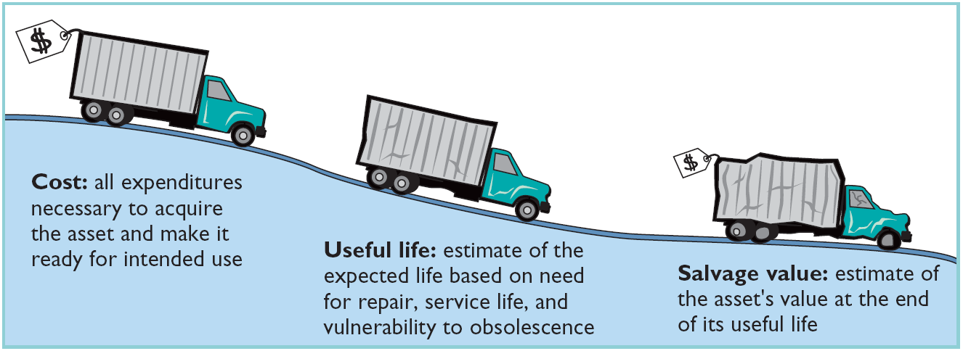
Factors in Computing Depreciation:
Cost Useful Life Salvage Value

Slide 4
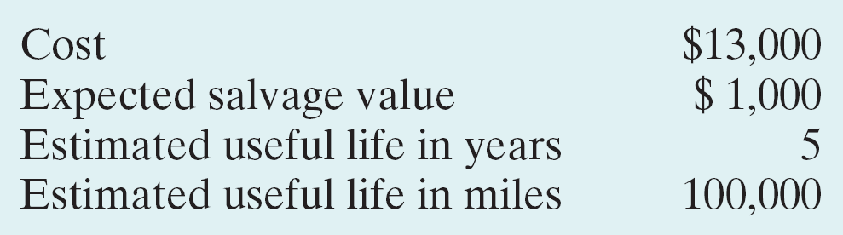
Depreciation Methods:
Objective is to select the method that best measures an asset’s contribution to revenue over its useful life. Examples include:
1- Straight-line method. 2- Units-of-Activity method. 3- Declining-balance method.
Example: Barb’s Florists purchased a small delivery truck on January 1, 2010.
Required: Compute depreciation using the following.
(a) Straight-Line.
(b) Units-of-Activity.
(c) Declining Balance

Slide 5
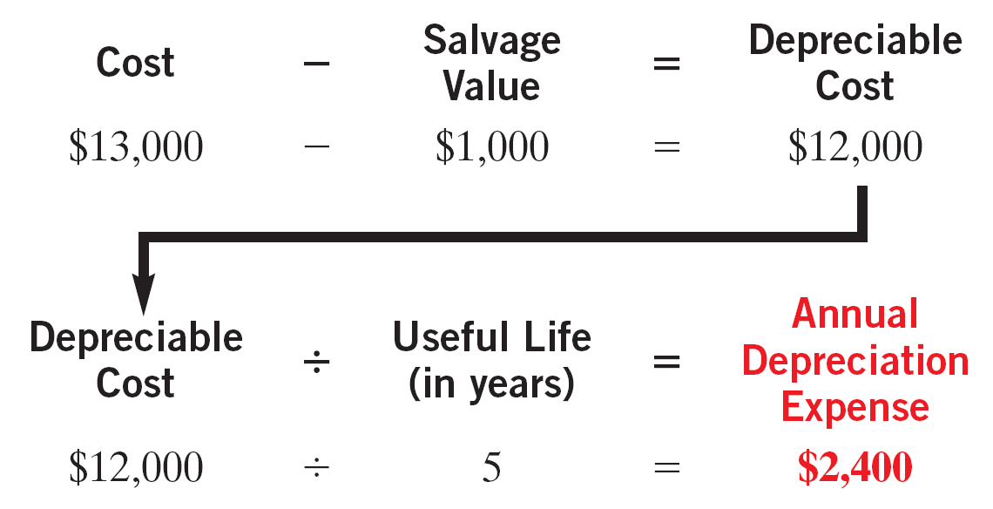
Straight-Line Method:
1-Expense is same amount for each year.
2-Depreciable cost is cost of the asset less its salvage value.

Slide 6
Depreciation
(Straight-Line Method)
2010
$ 12,000
20%
$ 2,400
$ 2,400
$ 10,600
2011
12,000
20
2,400
4,800
8,200
2012
12,000
20
2,400
7,200
5,800
2013
12,000
20
2,400
9,600
3,400
2014
12,000
20
2,400
12,000
1,000
2010 Journal Entry
Depreciation expense 2,400
Accumulated depreciation 2,400
6

Slide 7
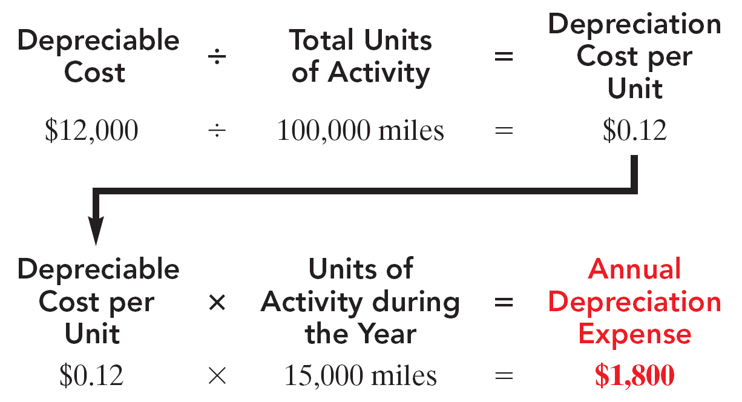
Units-of-Activity Method:
Companies estimate total units of activity to calculate depreciation cost per unit.
Expense varies based on units of activity.
Depreciable cost is cost less salvage value.

Slide 8
Depreciation
(Units-of-Activity Method)
2010
15,000
$ 0.12
$ 1,800
$ 1,800
$ 11,200
2011
30,000
0.12
3,600
5,400
7,600
2012
20,000
0.12
2,400
7,800
5,200
2013
25,000
0.12
3,000
10,800
2,200
2014
10,000
0.12
1,200
12,000
1,000
2010 Journal Entry
Depreciation expense 1,800
Accumulated depreciation 1,800
8

Slide 9
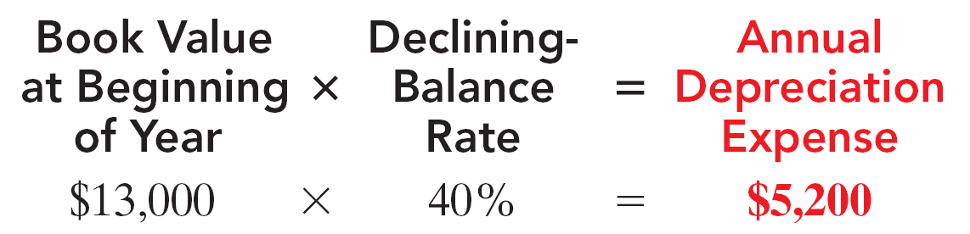
Declining-Balance Method:
Decreasing annual depreciation expense over the asset’s useful life.
Declining-balance rate is double the straight-line rate.
Rate applied to book value.

Slide 10
Depreciation
(Declining-Balance Method)
2010
13,000
40%
$ 5,200
$ 5,200
$ 7,800
2012
7,800
40
3,120
8,320
4,680
2013
4,680
40
1,872
10,192
2,808
2014
2,808
40
1,123
11,315
1,685
2015
1,685
40
685*
12,000
1,000
2010 Journal Entry
Depreciation expense 5,200
Accumulated depreciation 5,200
* Computation of $674 ($1,685 x 40%) is adjusted to $685. 10

Slide 11
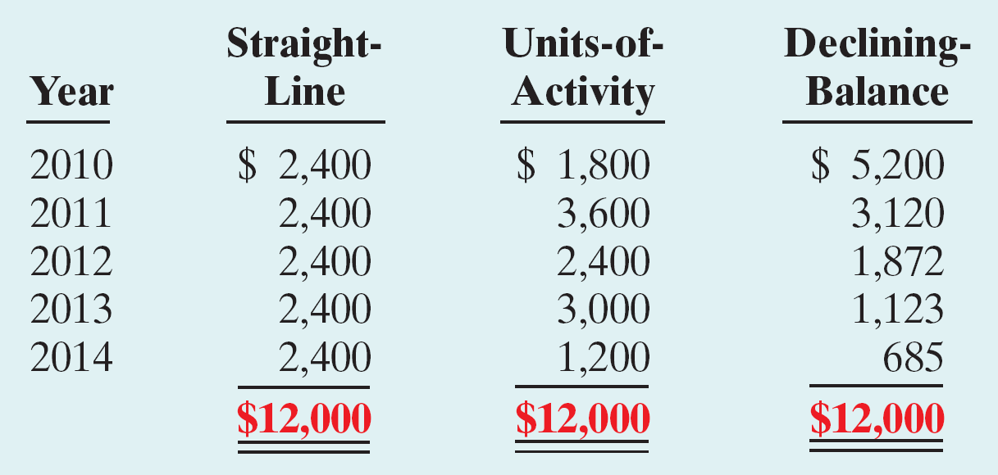
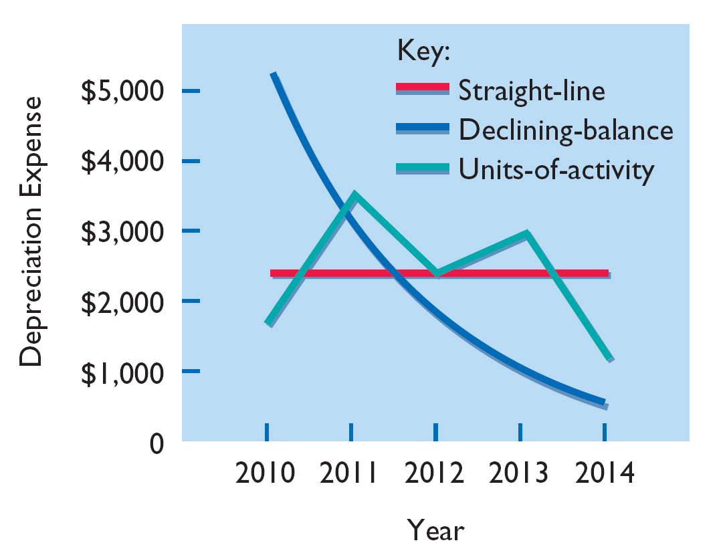
Depreciation
Comparison of Depreciation Methods
11

Slide 12
Example:
DuPage Company purchases a factory machine at a cost of $18,000 on January 1, 2010.
DuPage expects the machine to have a salvage value of $2,000 at the end of its 4-year
useful life.
During its useful life, the machine is expected to be used 160,000 hours. Actual annual
hourly use was: 2010, 40,000; 2011, 60,000; 2012, 35,000; and 2013, 25,000.
Required:
Prepare depreciation schedules for the following methods: (a) straight-line,
(b) units-of-activity, and (c) declining-balance using double the straight-line rate.

Slide 13
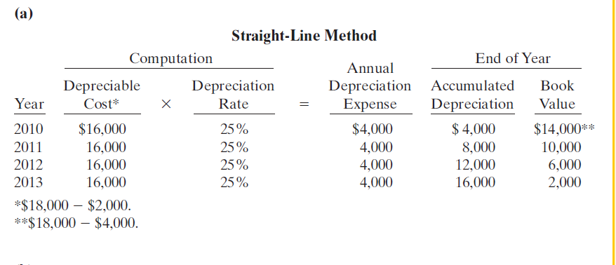

Slide 14
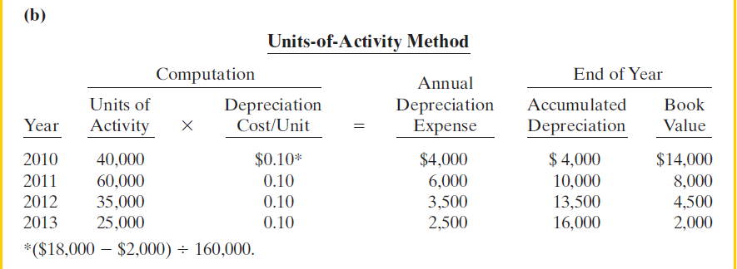

Slide 15
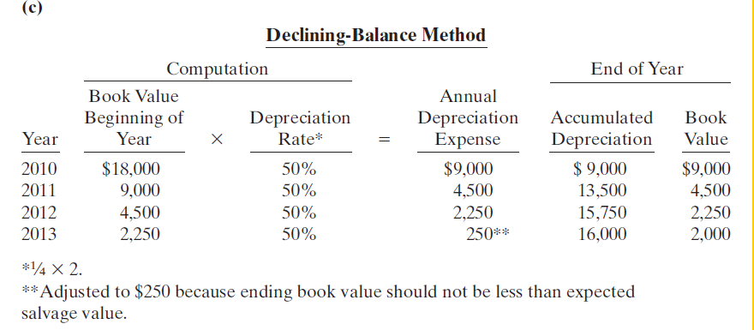

Slide 16
Q1:Reem Company purchased a new machine on JAN. 1, 2010, at a cost of $120,000.The company estimated that the machine will have a salvage value of $12,000. The machine is expected to be used for 20,000 working hours during its 5-year life.
Instructions:
(A)Compute the depreciation expense under the following methods for each life years.(1)Straight-line.(2)Units-of-activity, assuming machine usage was hours:2010,3,000.2011,4,500.2012,5,000.2013, 3,500.2014,4,000
(3) Declining-balance using double the straight-line rate.
(B) Assume that Reem Co. Uses the straight-line method.
(1) Prepare the journal entry to record 2010 depreciation.
(2) Show how the machine would be reported in the December 31, 2010, balance sheet

Slide 17
Q2:Roman Company purchased a delivery truck for $15,000 on JAN. 1, 2010.The truck has an expected salvage value of $1,000, and is expected to be driven 100,000 miles over its estimated useful life of- 4 years. Actual miles driven were 30,000 in 2010 and 25,000 in 2011.and 20,000 in 2012.and 25,000 in 2013.
Instructions:
(A) Compute depreciation expense for each life years, using (1) the straight-line method, (2) the units-of-activity method, and (3) the double-declining balance method.
(B) Assume that Roman Co. Uses the straight-line method.
(1) Prepare the journal entry to record 2010 depreciation.
(2) Show how the truck would be reported in the December 31, 2010, balance sheet.

Slide 18
Q3:SEEB Company purchases machine at a cost of $18,000 on JAN. 1, 2010.
SEEB expects the machine to have a salvage value of $2,000 at the end of its 4-year
useful life.
During its useful life, the machine is expected to be used 26,000 hours. Actual annual hourly use was: 2010, 8,000; 2011, 7,000; 2012, 6000; and 2013, 5000.
Instructions:
(A) Compute depreciation expense for each life years, using (1) the straight-line method, (2) the units-of-activity method, and (3) declining balance method.
(B) Assume that SEEB Co. Uses the declining balance method.
(1) Prepare the journal entry to record 2010 depreciation.
(2) Show how the machine would be reported in the December 31, 2010, balance sheet.

Slide 19
Depreciation for Partial Year:
example: Barb’s Florists purchased a small delivery truck on October 1, 2010
Required: Compute depreciation using the following.
(a) Straight-Line.
(b) Units-of-Activity.
(c) Declining Balance.

Slide 20
1-(Straight-line Method)

Slide 21
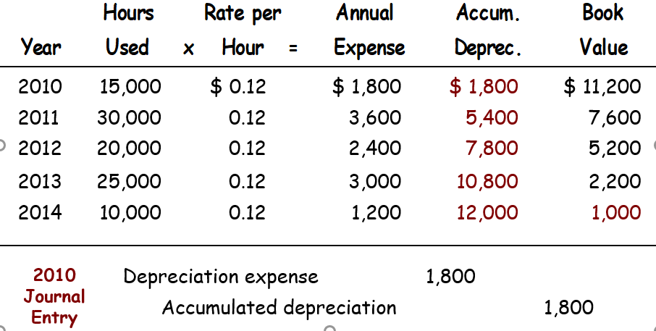
2- (Units-of-Activity Method)

Slide 22
3-(Declining-Balance Method)

Slide 23
Q4:LEEN Company purchased truck for $55,000 on October. 1, 2010. salvage value is expected to be $5,000, and is expected to be driven 100,000 miles over its estimated useful life of- 4 years. Actual miles driven were 26,000 in 2010 and 32,000 in 2011.and 25,000 in 2012.and 17,000 in 2013.
Instructions:
(A) Compute depreciation expense for each life years, using (1) the straight-line method, (2) the units-of-activity method, and (3) declining balance method.
(B) Assume that LEEN Co. Uses the declining balance method.
(1) Prepare the journal entry to record 2010 depreciation.
(2) Show how the truck would be reported in the December 31, 2010, balance sheet.

