Slide 1
Accounting Department – Second Stage
Intermediate Accounting
Second Semester
2025/2026
Inventory
Dr. Munadhil A.Alsalem

Slide 2
Inventory Classification and Systems:
Classification:
Inventories are:
items held for sale, or
goods to be used in the production of goods to be sold
Businesses with Inventory:
Merchandiser or Manufacturer

Slide 3
Type of Business:
1- Merchandiser:
One inventory account
Purchase goods ready for sale

Slide 4
2-Manufacturer:
Three accounts:
Raw materials
Work in process
Finished goods

Slide 5
Control:
Two systems for inventory recording:
1-Perpetual system:
Purchases of merchandise are debited to Inventory.
Freight-in, purchase returns and allowances, and purchase discounts are recorded in Inventory.
Cost of goods sold is debited and Inventory is credited for each sale.
Physical count done to determine Inventory balance.
The perpetual inventory system provides a continuous record of Inventory and Cost of Goods Sold.

Slide 6
2-Periodic system:
Purchases of merchandise are debited to Purchases.
Ending Inventory determined by physical count.
Calculation of Cost of Goods Sold:
Beginning inventory $ 100,000
Purchases, net 800,000
Goods available for sale 900,000
Ending inventory (125,000)
Cost of goods sold $ 775,000

Slide 7
Perpetual System
Periodic System

Slide 8
Inventory Costing:
Unit costs can be applied to quantities on hand using the following costing methods:
Specific Identification
First-in, first-out (FIFO)
Last-in, first-out (LIFO)
Average-Cost
Cost Flow Assumptions

Slide 9
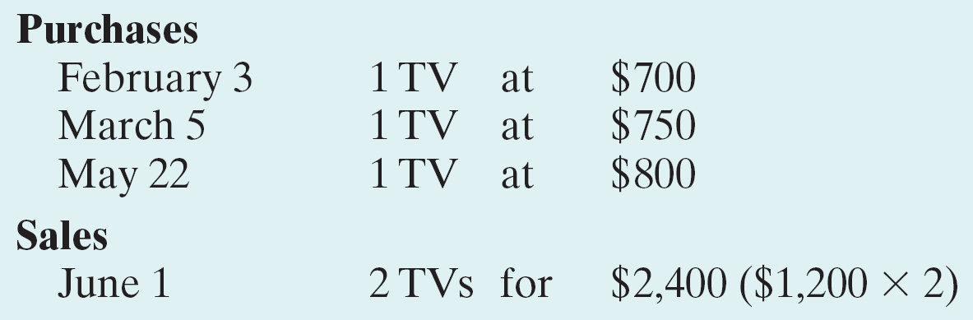
1-Specific Identification Method:
An actual physical flow costing method in which items still in inventory are specifically costed to arrive at the total cost of the ending inventory.
Most companies make assumptions (Cost Flow Assumptions) about which units were sold
Example: Assume that Crivitz TV Company purchases three identical 46-inch TVs on different dates at costs of $700, $750, and $800. During the year Crivitz sold two sets at $1,200 each.

Slide 10
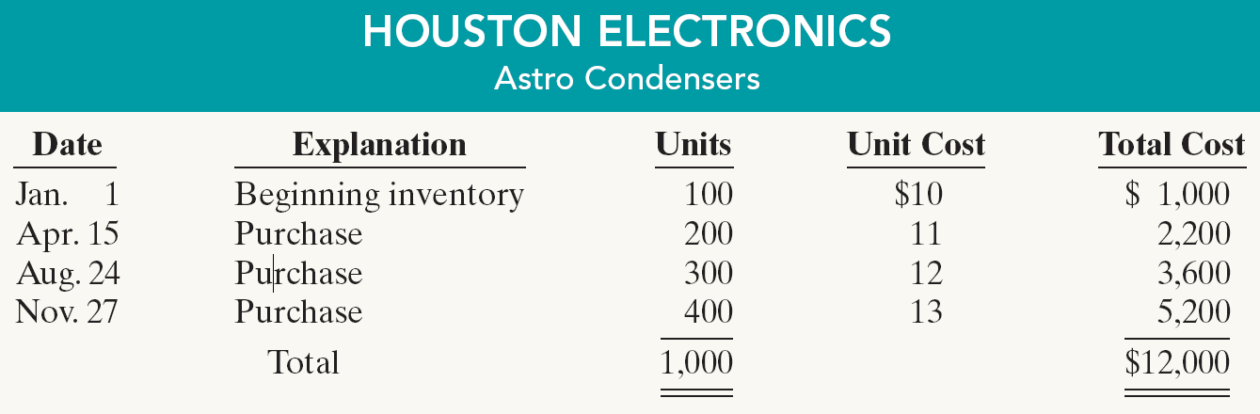
Example: If Crivitz sold the TVs it purchased on February 3 and May 22,
then its cost of goods sold is $1,500 ($700 $800), and its ending inventory is $750.
______________________________________________
First: (periodic Systems):
Example: Assume that Houston Electronics uses a periodic inventory system.
A physical inventory at the end of the year determined that during the year Houston sold 550 units and had 450 units in inventory at December 31.

Slide 11
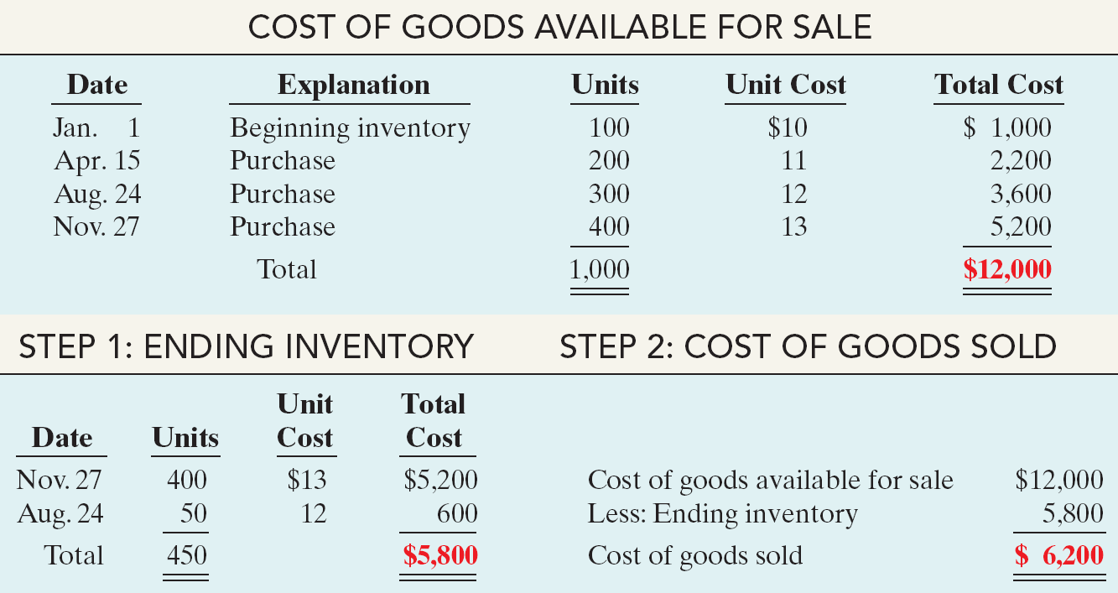
Calculate the Inventory Costing according the following methods
(periodic Systems)
1-First-in, First-out (FIFO):
Earliest goods purchased are first to be sold.

Slide 12
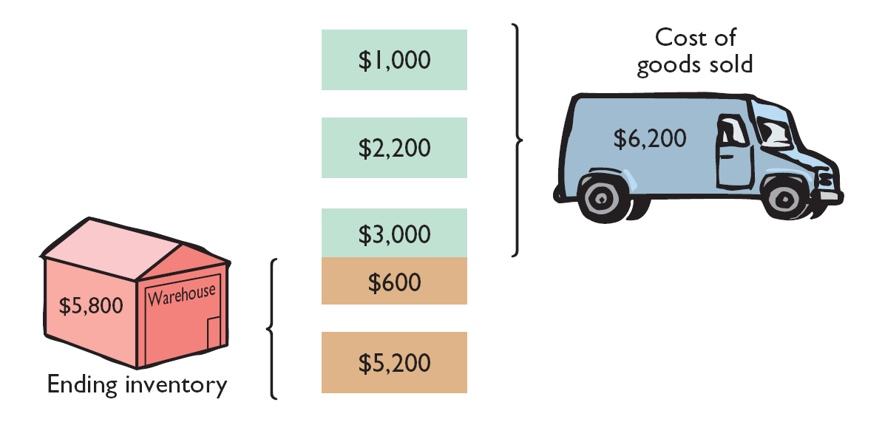

Slide 13
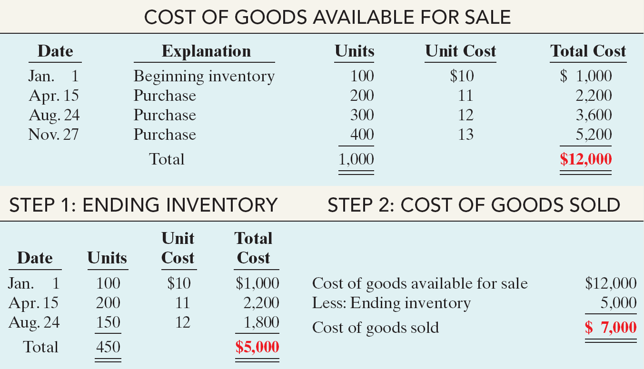
2- Last-in, First-out (LIFO)
Latest goods purchased are first to be sold.

Slide 14
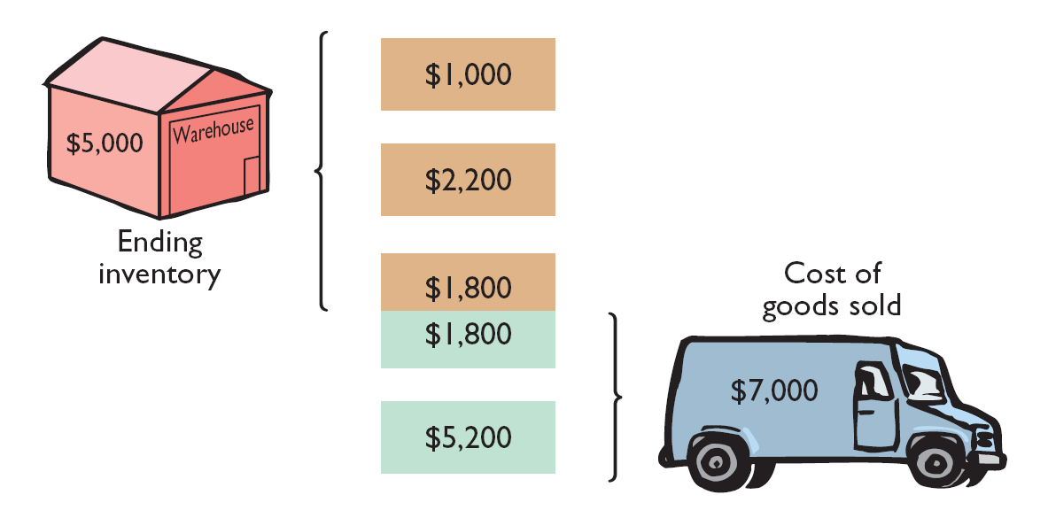

Slide 15
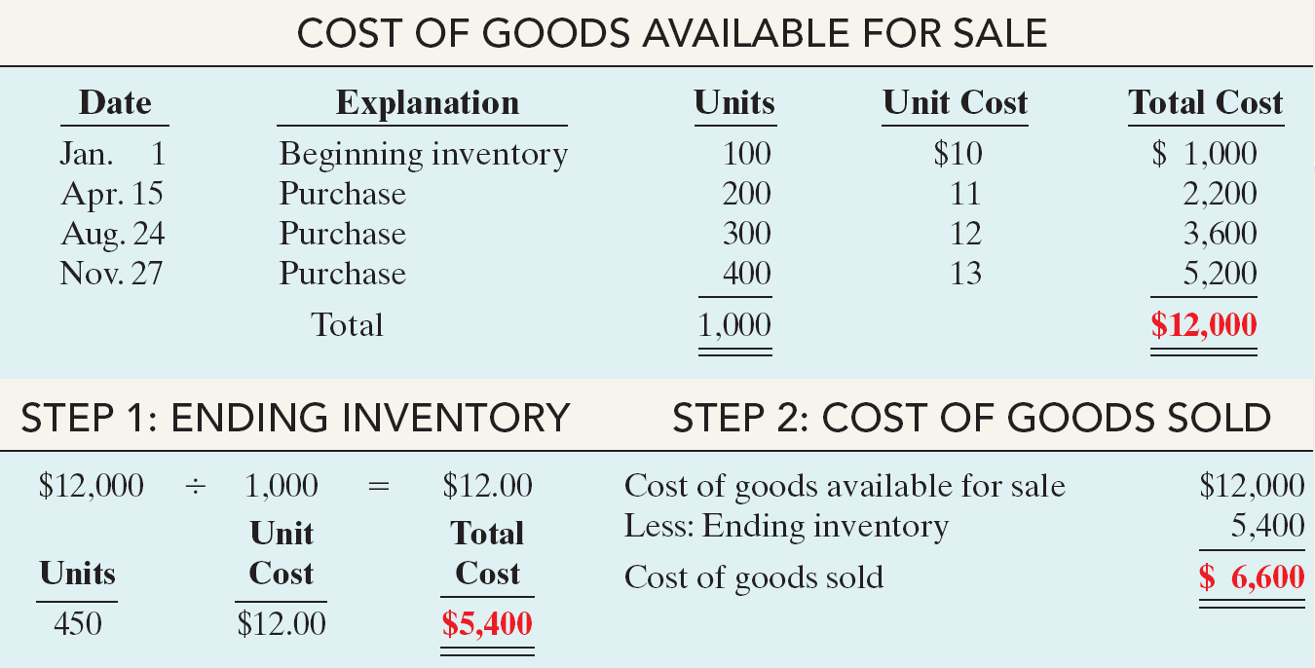
3-Average-Cost:
Allocates cost of goods available for sale on the basis of weighted average unit cost incurred.

Slide 16
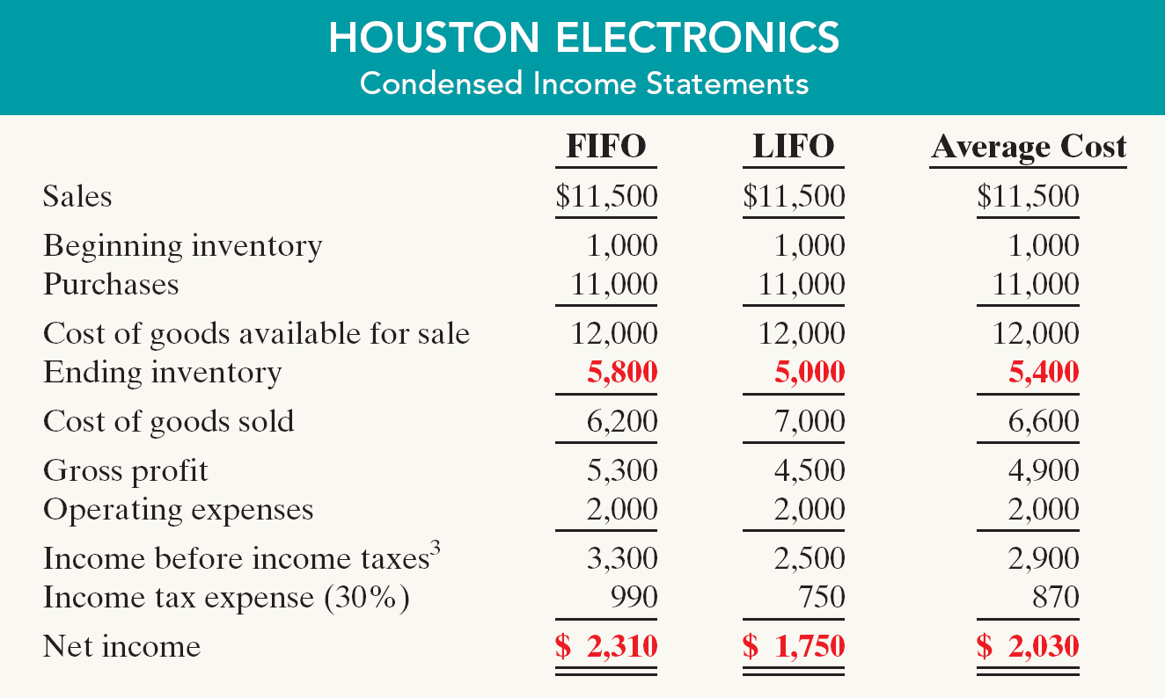
Financial Statement and Tax Effects:

Slide 17
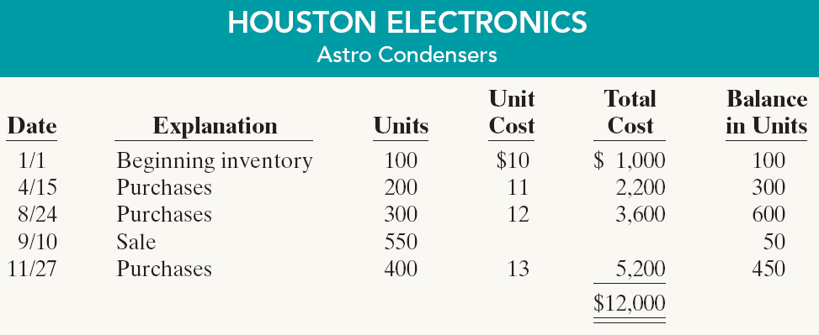
Second: (Perpetual Systems):
Example:
Assuming the Perpetual Inventory System, compute Cost of Goods Sold and Ending Inventory under FIFO, LIFO, and Average cost

Slide 18
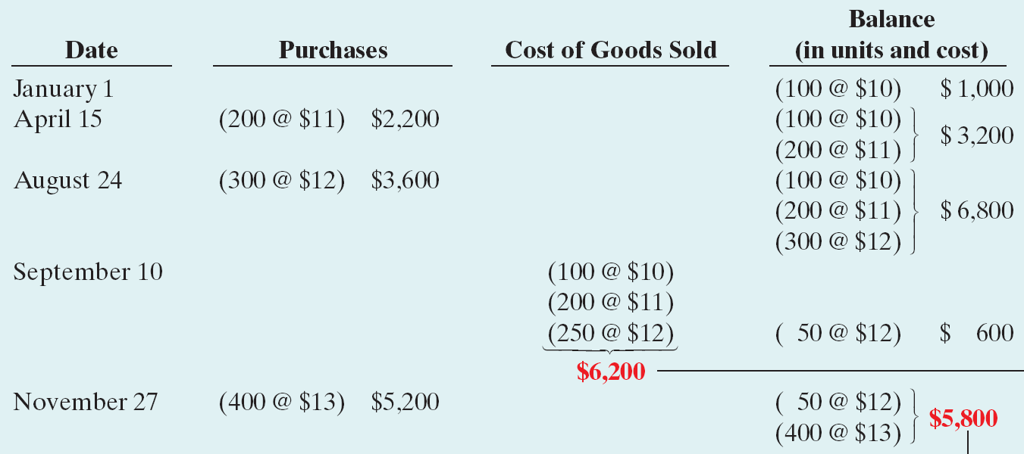
Calculate the Inventory Costing according the following methods
(Perpetual Systems)
1-First-in, first-out (FIFO):
Earliest goods purchased are first to be sold.
Cost of Goods Sold
Ending Inventory

Slide 19
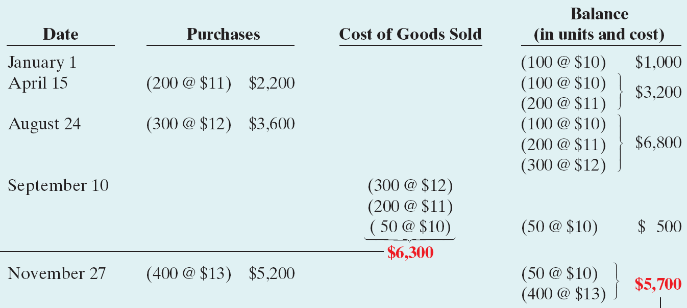
2- Last-in, First-out (LIFO)
Latest goods purchased are first to be sold.
Cost of Goods Sold
Ending Inventory

Slide 20
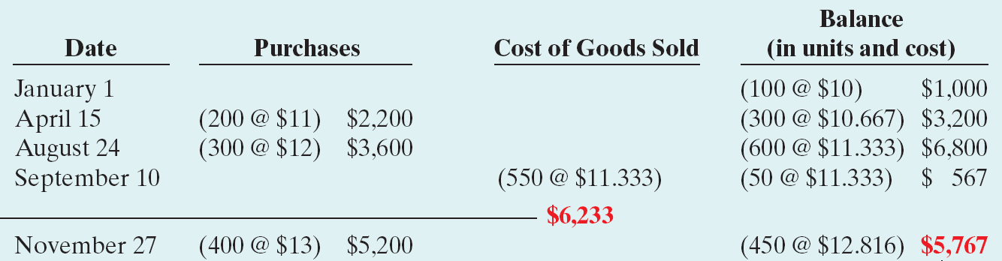
3-Average-Cost:
Allocates cost of goods available for sale on the basis of weighted average unit cost incurred.
Ending Inventory
Cost of Goods Sold

Slide 21
Q1: RAZ Company has the following inventory, purchases, and sales data for
the month of March.
Inventory:
March 1 200 units 4.00 800
Purchases:
March 10 500 units 4.50 2,250
March 20 400 units 4.75 1,900
March 30 300 units 5.00 1,500
Sales:
March 15 500 units
March 25 400 units
The physical inventory count on March 31 shows 500 units on hand.
Instructions
Under a periodic inventory system, determine the cost of inventory on hand at
March 31 and the cost of goods sold for March under (a) (FIFO), (b) (LIFO), and
(c) Average-cost.

Slide 22
Q2: RAZ Company has the following inventory, purchases, and sales data for
the month of March.
Inventory:
March 1 200 units 4.00 2 ,800
Purchases:
March 10 500 units 4.50 2,250
March 20 400 units 4.75 1,900
March 30 300 units 5.00 1,500
Sales:
March 15 500 units
March 25 400 units
The physical inventory count on March 31 shows 500 units on hand.
Instructions:
Under a perpetual inventory system, determine the cost of inventory on hand at March 31
and the cost of goods sold for March under (a) FIFO, (b) LIFO, and (c) Average-cost.

Slide 23
Q2 : Perpetual system – FIFO:
date | purchases | Cost of goods sold | Balance
 |  |  | units | cost
March 1 |  |  | 200 x 4 | 800
March 10 | 500 x 4,5 = 2250 |  | 200 x4 500 x 4,5 | 3050
March 15 |  | 200 X 4 = 800 300 X 4,5 = 1350 | 200 X 4,5 | 900
March 20 | 400 x 4,75 = 1900 |  | 200 x 4,5 400 x 4,75 | 2800
March 25 |  | 200 x 4,5 = 900 200 x 4,75 = 950 | 200 x 4,75 | 950
March 30 | 300 x 5 = 1500 |  | 200 x 4,75 300 x 5 | 2450
 |  | Cost of goods sold 4000 |  | Ending inventory 2450

Slide 24
Perpetual system – LIFO:
date | purchases | Cost of goods sold | Balance
 |  |  | units | cost
March 1 |  |  | 200 x 4 | 800
March 10 | 500 x 4,5 = 2250 |  | 200 x4 500 x 4,5 | 3050
March 15 |  | 500 X 4,5 = 2250 | 200 X 4 | 800
March 20 | 400 x 4,75 = 1900 |  | 200 x 4 400 x 4,75 | 2700
March 25 |  | 400 X 4,75 = 1900 | 200 X 4 | 800
March 30 | 300 x 5 = 1500 |  | 200 x 4 300 x 5 | 2300
 |  | Cost of goods sold 4150 |  | Ending inventory 2300

Slide 25
Perpetual system – Average – Cost:
date | purchases | Cost of goods sold | Balance
 |  |  | units | cost
March 1 |  |  | 200 x 4 | 800
March 10 | 500 x 4,5 = 2250 |  | 700 x 4,357 | 3050
March 15 |  | 500 X 4,357 = 2179 | 200 x 4,357 | 871
March 20 | 400 x 4,75 = 1900 |  | 600 x 4,618 | 2771
March 25 |  | 400 X 4,618 = 1847 | 200 x 4,618 | 924
March 30 | 300 x 5 = 1500 |  | 500 x 4,848 | 2424
 |  | Cost of goods sold 4026 |  | Ending inventory 2424

Slide 26
Assumption the selling price equal 20 per unit
Income statement
Explanation | FIFO | LIFO | C
Sales | 18000 | 18000 | 18000
Beginning inventory Purchases | 800 5650 | 800 5650 | 800 5650
Cost of goods available for sale | 6450 | 6450 | 6450
Ending inventory | 2450 | 2300 | 2424
Cost of goods sold | 4000 | 4150 | 4026
Gross profit | 14000 | 13850 | 13974

