Slide 1
Accounting Department – Second Stage
Intermediate accounting
Second semester
2025/2026
Current Liabilities
Dr.Munadhil A.Alsalem

Slide 2
First : Current liability : is debt with two key features:
Company expects to pay the debt from current assets or through the formation of other current liabilities.
Company will pay the debt within one year or the operating cycle, whichever is longer.
Current liabilities include notes payable, accounts payable, unearned revenues, and accrued liabilities such as taxes payable, salaries payable, and interest payable.

Slide 3
1- Notes Payable:
Written promissory note.
Require the borrower to pay interest.
Issued for varying periods.
Example: On March 1, 2010, Cole Williams borrows $100,000 from National Bank on a 4-month, 12% note.
Instructions
1- Prepare the entry on March 1.
2- Prepare the adjusting entry on June 30, assuming monthly adjusting entries have not been made.
3- Prepare the entry at maturity (July 1).

Slide 4
1- Prepare the entry on March 1
Cash 100,000
Notes Payable 100,000
________________________
2- Prepare the adjusting entry on June 30.
$100,000 x 12% x 4/12 = $4,000
interest expenses 4000
Accrued interest 4000
________________________
3- Prepare the entry at maturity (July 1).
Notes payable 100,000
Accrued interest 4000
Cash 104,000

Slide 5
Example: On April 1, 2012, Kurdistan Co. borrows $600,000 from Cihan Bank.
On April 2, 2012, Cihan bank Written promissory a 4-month, 10% note.
Instructions:
1- Prepare the journal entries.
2- Prepare the adjusting entry on August 1, assuming monthly adjusting entries have not been made.
3- Prepare the entry at maturity (August 2).

Slide 6
2- Sales Tax Payable:
Sales taxes are expressed as a stated percentage of the sales price.
Either rung up separately or included in total receipts.
The seller collects tax from the customer.
Example: The March 25 cash register reading for Cooley Grocery shows sales of $10,000 and sales taxes of $600 (sales tax rate of 6%), the journal entry is:
Cash 106,00
Sales 10,000
Sales Tax Payable 600

Slide 7
3-Unearned Revenue:
Revenues that are received before the company delivers goods or provides services.
Company debits Cash, and credits a current liability account (unearned revenue).
When the company earns the revenue, it debits the Unearned Revenue account, and credits a revenue account
Example: Assume that Superior University sells 10,000 season football tickets at $50 each for its five-game home schedule. The university makes the following entry for the sale of season tickets:
Aug 6. Cash 500,000
Unearned football Ticket Revenue 500,000

Slide 8
As the school completes each of the five home games, it earns one-fifth of the
revenue it would record the revenue earned.
Sep 7 Unearned Revenue 100,000
Ticket Revenue 100,000
_____________________________

Slide 9
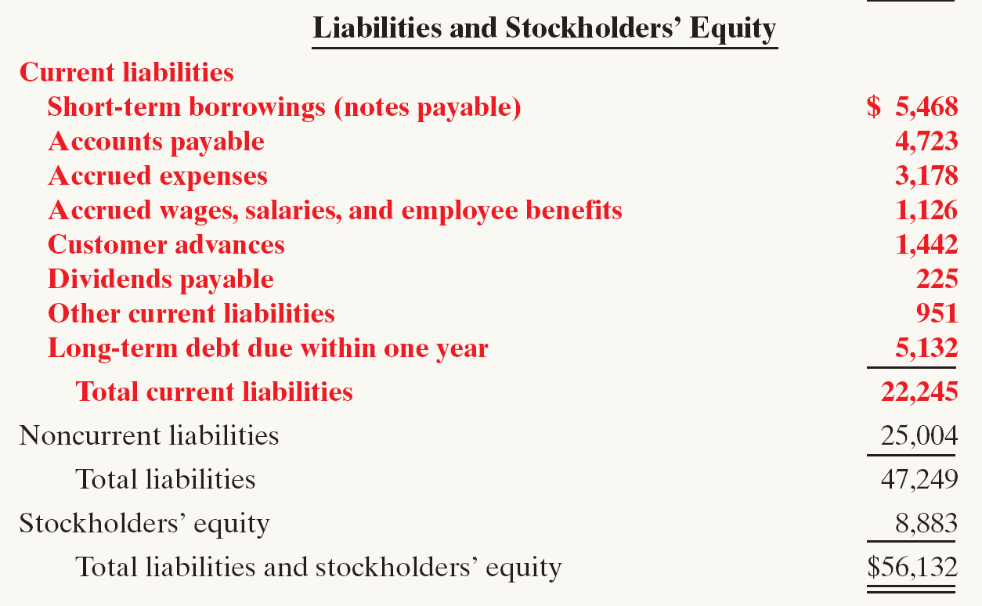
Statement Presentation and Analysis
1-Presentation:

Slide 10
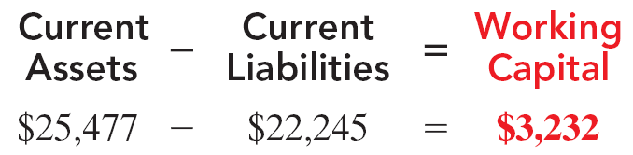
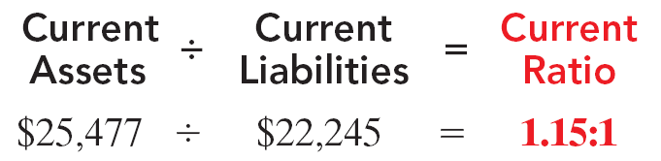
2-Analysis
Liquidity refers to the ability to pay maturing obligations and meet unexpected needs for cash.
The current ratio permits us to compare the liquidity of different-sized companies and of a single company at different times.

Slide 11
Q1:Sierra Sports’ Co. purchase of equipment on August 1. Sierra Sports Co. purchased $12,000 of equipment from a supplier on credit. Credit terms were 2/10, n/30, invoice date August 1. Let’s assume that Sierra Sports was unable to make the payment due within 30 days. On August 31, the supplier agreements with Sierra and converts the accounts payable into a written note, requiring full payment in two months, beginning September 1. Interest is now included as part of the payment terms at an annual rate of 10%. Payable .
Prepare the journal entries .

Slide 12
Q2: BBR Co. purchases equipment from a supplier on February 2 at a quantity of 6,000 unit at $1 per unit. Terms of the purchase are 2/10, n/30. BBR pays half the amount due in cash on February 28 but cannot pay the remaining balance due in four days. The supplier agrees on March 4 and allowed to BBR convert its purchase payment into a short-term note, with an annual interest rate of 6%, payable in 9 months.
Prepare the journal entries.

Slide 13
Q3: Air Compressors Inc. purchases compressor parts for its inventory from a supplier. The following transactions take place during the current year:
A. On April 5, the company purchases 400 parts for $8.30 per part, on credit. Terms of the purchase are 4/10, n/30, invoice dated April 5.
B. On May 5, Air Compressors does not pay the amount due and agreement with the supplier. The supplier agrees to $400 cash immediately as partial payment on note payable due, converting the debt owed into a short-term note, with a 7% annual interest rate, payable in three months from May 5.
C. On August 5, Air Compressors pays its account in full
Prepare the journal entries.

Slide 14
Q4: Lepid Company has the following account balances at December 31, 2010.
Notes payable ($80,000 due after 31/12/ 2011) 200,000
Unearned revenue 75,000
Other long-term debt ($30,000 due in 2011) 150,000
Salaries payable 22,000
Other accrued expenses 15,000
Accounts payable 100,000
Lawsuit liability 38,000
(a) Prepare the current liability section of Lepid’s December 31, 2010, balance sheet.
(b) Lepid’s current assets are $504,000. Compute Lepid’s working capital and
current ratio.

Slide 15
Solution
(a) Current liabilities
Notes payable due in 2011 120,000
Accounts payable 100,000
Unearned revenue 75,000
Lawsuit liability 38,000
Salaries payable 22,000
Other accrued expenses 15,000
Long-term debt due within one year 30,000
Total current liabilities 400,000
(b) Working capital = Current assets - Current liabilities 504,000 - 400,000 = 104,000
Current ratio = Current assets / Current liabilities 504,000 / 400,000 = 1.26:1

Slide 16
Q5: Moth Company has the following account balances at December 31, 2010.
Notes payable (60,000 due after 31/12/2011) 100,000
Unearned revenue 70,000
Other long-term debt (90,000 due in 2011) 250,000
Salaries payable 32,000
Utilities payable 13,000
Accounts payable 50,000
In addition, Moth is involved in a lawsuit. Legal counsel feels it is probable Moth will pay damages of 85,000 in 2011.
(a) Prepare the current liability section of Moth’s 31/12/2010 balance sheet.
(b) Moth’s current assets are 570,000. Compute Moth’s working capital and current ratio.

Slide 17
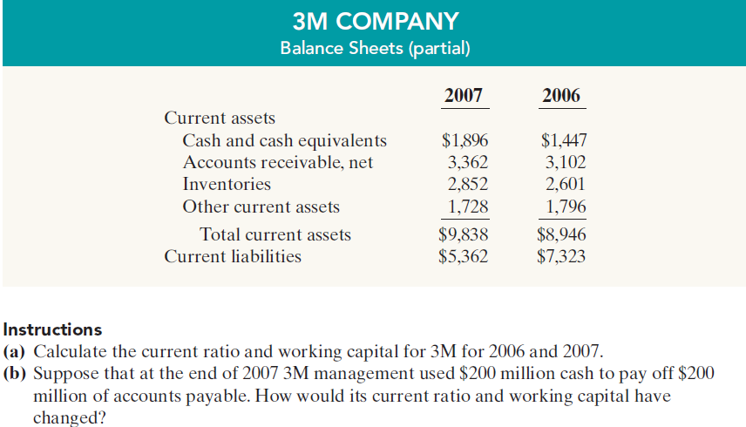
Q6 : The following financial data were reported by 3M Company for 2006 and 2007

Slide 18
Q7: The following are selected transactions of Wins Company. Wins prepares financial
statements quarterly.
Jan. 2 Purchased merchandise on account from Yok Company, $30,000, terms 2/10, n/30.
Feb. 1 Issued a 9%, 2-month, $30,000 note to Yok in payment of account.
Mar. 31 Accrued interest for 2 months on Yok note.
Apr. 1 Paid face value and interest on Yok note.
July 1 Purchased equipment from Kors Equipment paying $11,000 in cash and signing a
10%, 3-month, $40,000 note.
Sept. 30 Accrued interest for 3 months on Kors note.
Oct. 1 Paid face value and interest on Kors note.
Dec. 1 Borrowed $15,000 from the Otago Bank by issuing a 3-month, 8% note with a face
value of $15,000.
Dec. 31 Recognized interest expense for 1 month on Otago Bank note.
Instructions
(a) Prepare journal entries.
(b) Post to the accounts Notes Payable, Accrued Interest, and Interest Expense.

Slide 19
