Slide 1
Law
The body, of general rules and principles regulating human conduct in society, the obedience of which is enforced by a supreme authority.

Slide 2
Legal
legal is a word that pertains to the science of law, its administration, its understanding, and practice.

Slide 3
refers to anything related to the law, how it's applied, understood, and practiced.
legal

Slide 4
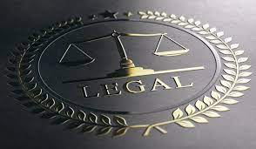
legal
1_ The legal team prepared a strong
defense.
2- Seek legal advice before signing
major contracts.

Slide 5
Words……Terms
A word is any single unit of language, like “cloud" "run," or "happy." It's just a basic building block of language.
A term is a word or a group of words that have a specific meaning in a particular subject, like "hypertension" in medicine or "cloud computing" in technology.
* So, all terms are words, but not all words are terms. Terms are special words used in certain areas or fields to explain things more clearly

Slide 6
Terminology
is the set of special words or phrases used in a particular subject.

Slide 7
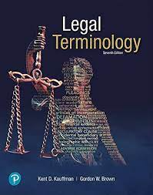
Terminology
1-legal terminology often requires clarification for those not familiar with the law.
2- legal terminology differs from everyday language.

Slide 8
legal terminology
refers to the specialized vocabulary used in the field of law

Slide 9

A moral or legal entitlement, such as the right to freedom
Right

Slide 10
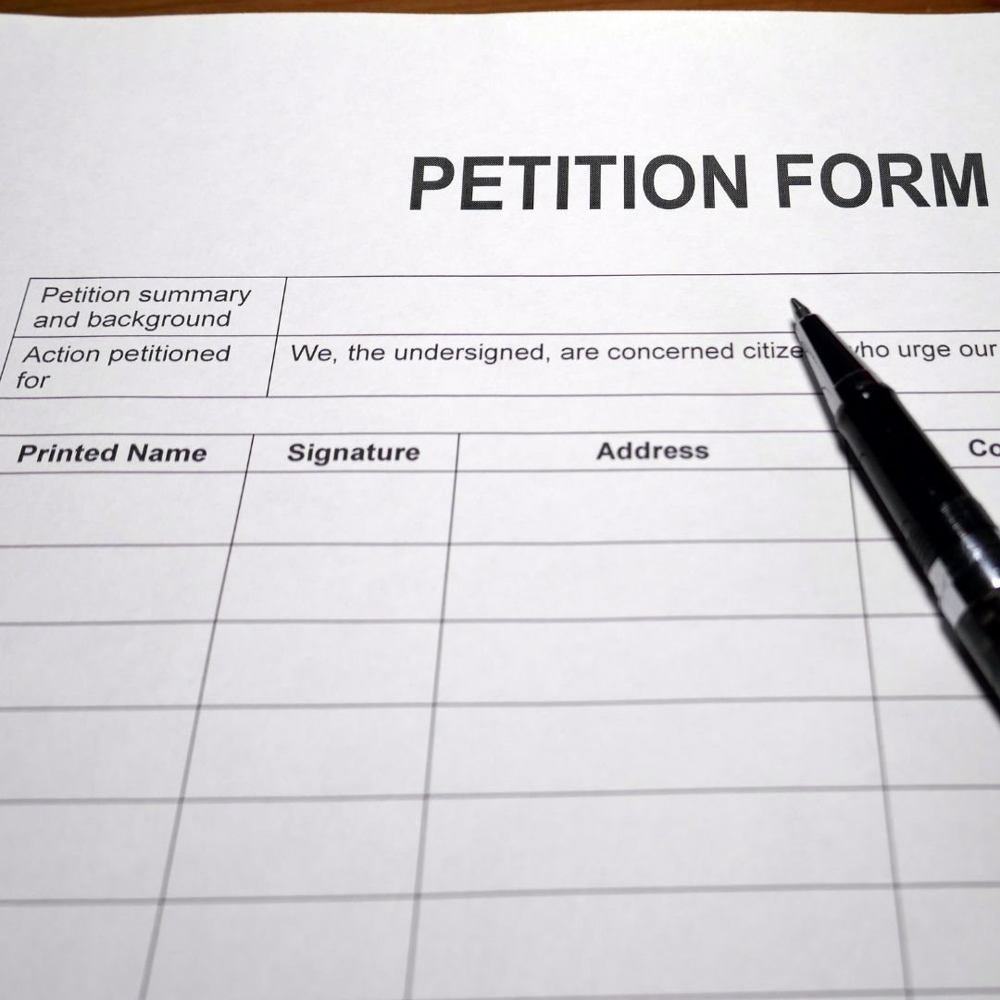
Petition

Slide 11
