Slide 1

Cihan University / Sulaymaniyah
Faculty of Administration and Financial
Sciences / Business Administration Department
Intermediate Accounting
Second Stage
2025/2026
Lecturer: Naz Hiwa
E-mail: naz.hiwa@sulicihan.edu.krd

Slide 2
Definition of Accounting
Accounting is a systematic process of identifying, recording, measuring, classifying, verifying, summarizing, interpreting and communicating financial information.
Accounting called the language of a business communicates accounting information to help various types of users.

Slide 3
Conceptual Framework of Accounting
It is necessary for any science to have an organized framework of rules and foundations that govern and organize the work of this science so that it includes a set of principles and assumptions.
The conceptual framework is comprised of three levels:
First Level = Basic objectives
Second Level = Qualitative characteristics and basic elements
Third Level = Recognition and measurement concept

Slide 4
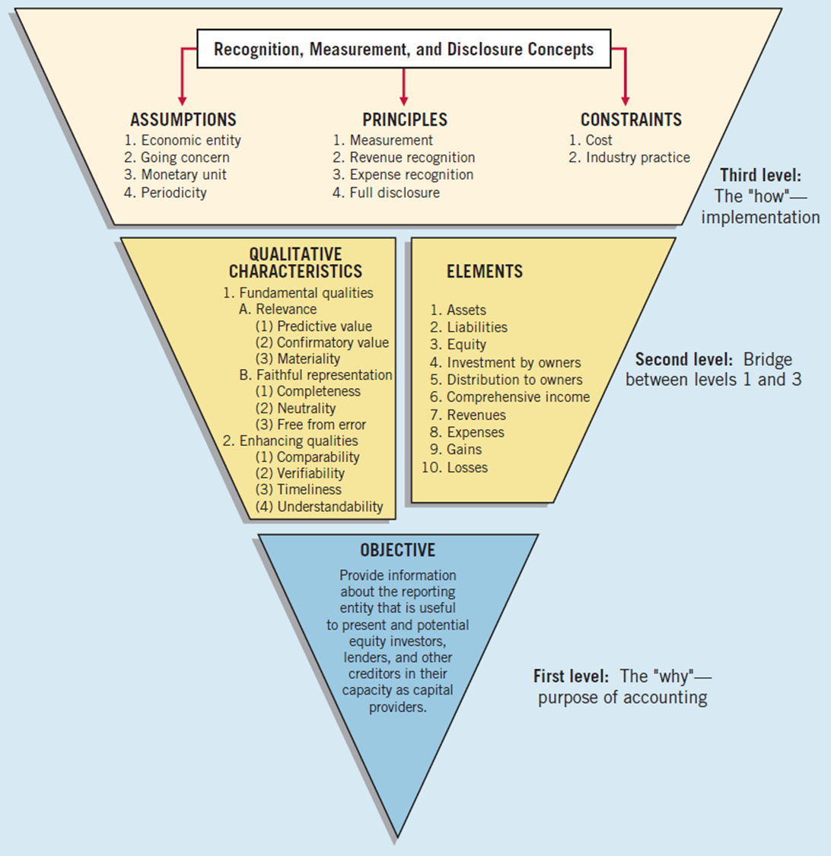

Slide 5
First Level: Objective of Financial Reporting
To provide financial information about the reporting entity that is useful to present and potential equity investors, lenders, and other creditors in making decisions about providing resources to the entity.
The purpose of accounting is to accumulate and report on financial information about the performance, financial position, and cash flows of a business. This information is then used to reach decisions about how to manage the business, or invest in it, or lend money to it.

Slide 6
Second Level: Fundamental Concepts
Qualitative characteristics of accounting information:
Fundamental (Primary) Qualitative characteristics
Relevance
Faithful representation
Enhancing (Secondary) Qualitative Characteristics
Timeliness
Understandability
Comparability
Verifiability
B) Basic elements of financial statements:
Assets
Liabilities
Equity
Revenue
Expenses
Gains
Losses

Slide 7
Third Level: Recognition and Measurement
A) Basic Assumptions:
Economic entity
Periodicity
Monetary unit
Going Concern
B) Basic Principles:
Revenue recognition
Expense recognition
Full disclosure
Measurement
C) Cost Constraint

Slide 8


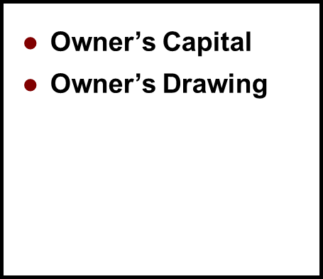
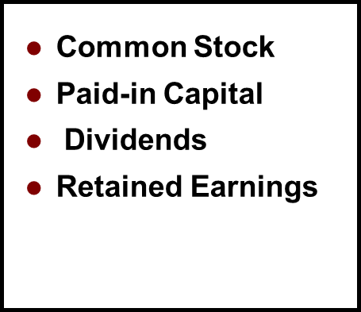
Different Types of Business Organizations
Sole Proprietorships Partnerships Corporations

Slide 9
Financial Statements
Financial statements are formal and structured reports that provide a comprehensive overview of a company's financial performance, financial position, and cash flows during a specific period of time.
There are four main types of financial statements, which are as follows:
Income Statement (Profit and Loss Statement).
Balance Sheet (Statement of Financial Position).
Statement of Changes in Equity.
Cash Flow Statement.

Slide 10
Income Statement
The Income Statement is one of a company’s financial statements that shows their profit and loss over a period of time.
Elements of the Income Statement:
▪ Revenue: What the business has earned over a period (e.g. sales revenue, dividend, interest revenue, rent revenue etc.)
▪ Expense: The cost incurred by the business over a period (e.g. salaries and wages, depreciation, rental charges, cost of goods sold etc.)
▪ Gains: Increases in equity (net assets) from peripheral or incidental transactions.
▪ Losses: Decreases in equity (net assets) from peripheral or incidental transactions.

Slide 11
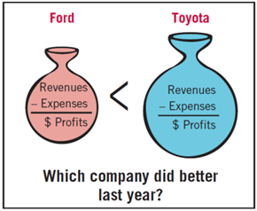
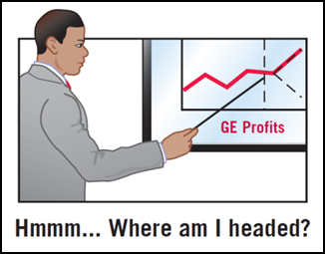
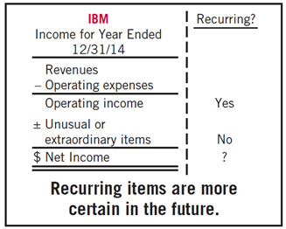
Income Statement
Usefulness of Income Statement:
Evaluate past performance.
Predicting future performance.
Help assess the risk or uncertainty of
achieving future cash flows.

Slide 12
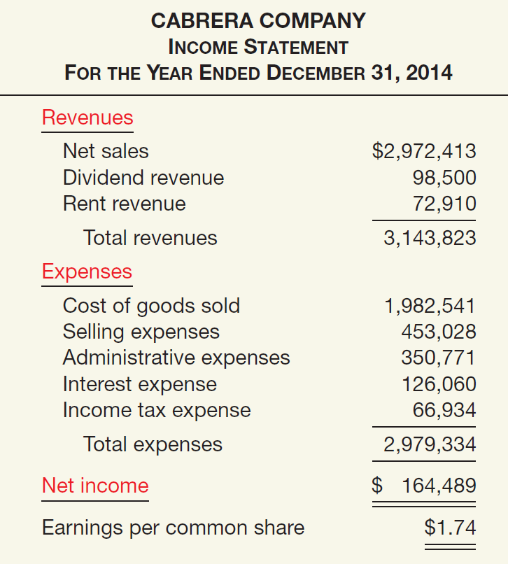
Format of the Income Statement
Single-Step Income Statements
Revenues
- Expense
Net Income
Single- Step

Slide 13
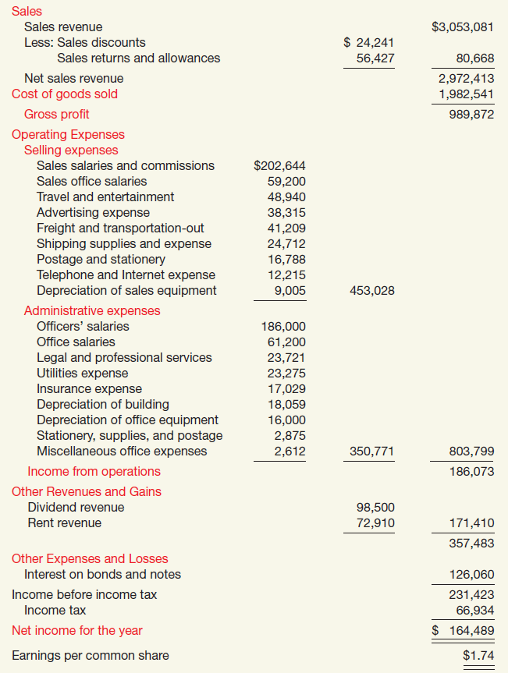

Format of the Income Statement
CABRERA COMPANY
Income Statement
For The Year Ended December 31, 2014
1. Operating Section
2. Non-operating Section
3. Income tax

Slide 14
Equations of Income Statement:
Gross Profit = Net Sales – Cost of goods sold
Net Sales = Sales – Sales returns and allowances – Sales discount
Cost of goods sold = Beginning inventory + Cost of purchases – Ending inventory
Cost of purchases = Net purchases + Direct purchase cost
Net purchases = Purchases – Purchase returns and allowances – purchase discount
Sales = Cost of goods sold + Gross profit
Net Profit = Gross Profit - operating expenses + other revenues and gains – other
expenses and losses - Income tax
Operating expenses = Selling expenses + Administrative expenses

Slide 15
Practical Examples
Ex1: The following information has been extracted from the books of Kaya Company, for the year ended 31 Dec,2015:
Opening inventory | 5200 | Closing inventory | 6000
Purchases | 12900 | Sales | 18000
Sales returns | 400 | Purchase returns | 200
Sales discount | 200 | Purchase discount | 100
Administrative expense | 40 | Selling expense | 30
Other revenues | 750 | Other expenses | 210
Income tax | 667 | - | -
Requirement: From the information above compute the following:
(a) Find cost of goods sold, (b) Prepare income statement for the company.

Slide 16
Ex 2: Starr Co. had sales revenue of $540,000 in 2014. Other items recorded during the year were:
Cost of goods sold $330,000, Salaries and wages expense 120,000, Income tax expense 25,000, Other operating expenses 10,000.
Requirement: Prepare single-step income statement for Starr Co. for 2014.
Ex 3: Brisky Corporation had net sales of $2,400,000 and interest revenue of $31,000 during 2014. Expenses for 2014 were cost of goods sold $1,450,000; administrative expenses $212,000; selling expenses $280,000; and interest expense $45,000. Brisky’s tax rate is 30%.
Requirement:
1) Prepare a condensed multiple-step income statement for Brisky Corporation.

Slide 17
Ex 4: Presented below are certain account balances of Majid Com.:
Ending inventory 48000, Rental revenues 6500, Interest expenses 12700, Purchases allowances 10500, Freight-in 10100, Dividends revenue 71000, Administrative expenses 82500, Sales returns 5800, Sales discounts 21300, Selling expenses 99400, Sales 390000, Income tax 31000, Beginning inventory 45300, Purchases 190000, Purchases discounts 17300.
Requirements:
a) From the foregoing information compute: net sales, cost of goods sold.
b) Prepare income statement.

Slide 18
Ex 5: The following 2012 information related to Waleed Company:
Administrative expense: Officers’ salaries $4,900, Depreciation of office furniture and equipment 3,960
Cost of goods sold 63,570, Rent revenue 17,230, Sales revenue 96,500, Income tax expense 7,580, Interest expense 1,860
Selling expense: Transportation-out 2,690, Sales commissions 7,980, Depreciation of sales equipment 6,480
Requirements:
(a) Prepare an income statement for the year 2012 using the multiple-step form.

Slide 19
Balance Sheet
A balance sheet is a financial statement that reports a company's assets, liabilities and shareholders' equity at a specific point in time.
It is also known as financial position statement that provides a snapshot of what a company owns and owes, as well as the amount invested by shareholders. It is comprised of the following three elements:
▪ Assets: is any resource owned or controlled by a business (e.g. cash, inventory, plant and machinery, etc.)
▪ Liabilities: Something a business owes to someone (e.g. creditors, bank loans, etc.)
▪ Equity: What the business owes to its owners. This represents the amount of capital that remains in the business after its assets are used to pay off its outstanding liabilities. Equity therefore represents the difference between the assets and liabilities.

Slide 20
Classification of Assets, Liabilities and Equity
Assets can be grouped into two major classes:
Tangible assets: tangible assets are typically physical assets or property owned by a business and contain various subclasses, including:
Current assets: Current assets are cash and others that are expected to be converted to cash or consumed either in a year or in the operating cycle. There are 5 major items included into current assets:
- Cash and cash equivalents
- Short-term investments
- Receivables
- Inventory
- Prepaid expense
2. Fixed assets (Non-current assets): these are purchased for continued and long-term use to earn profit in a business. This group includes land, buildings, machinery, furniture, tools, equipment's.
Intangible assets: an intangible asset is a resource controlled by an entity with no physical substance such as goodwill, copyrights, franchises, and trademarks.

Slide 21
Classification of Assets, Liabilities and Equity
Liabilities can be grouped into two types:
Current liabilities: company's obligations or debts that are to be paid within one year are called short-term liabilities or current liabilities. E.g. accounts payable, bills payable, income tax payable, etc.
Non-current liabilities or Long-term liabilities: company's obligations or debts that are to be paid after one or more years. E.g. deferred tax liabilities, etc.
Owners equity or (Capital) is what the owners invest in the business.
The statement of financial position is based on a formula called the accounting equation which states that:
Assets = Capital + Liabilities

Slide 22
Practical Examples
Ex 1: The following information has been extracted from the books of Pioneer Advertising Agency for the year ended Dec,31,2016, prepare Balance sheet for the company.
Cash | 80,000 | Accounts Receivable | 74,000
Equipment | 50,000 | Allowance for doubtful accounts | 1,600
Supplies | 10,000 | Interest payable | 500
Prepaid insurance | 5,500 | Accounts Payable | 25,000
Accumulated depreciation - Equipment | 400 | Salaries and wages payable | 14,000
Note payable | 50,000 | Common stock | 100,000
Retained earnings | 28,000 | - | -

Slide 23
Ex 2: The following information has been extracted from the books of Kelly Corporation at December 31, 2014.
Particulars | Debit | Credit
Cash | 6,850
Supplies | 1,200
Prepaid insurance | 1,000
Equipment | 48,000
Accumulated depreciation- Equipment |  | 4,000
Trademarks | 950
Account payable |  | 10,000
Salaries and wages payable |  | 500
Unearned service revenue |  | 2,000
Bonds Payable (due 2021) |  | 9,000
Common stock |  | 30,000
Retained earnings |  | 2,500
Requirement: Prepare a classified balance sheet as of December 31, 2014

Slide 24
Ex 3: The following Information were taken from Sara Co. on Dec,31,2020: (all in $)
Requirement: Prepare income statement and balance sheet for the year ended Dec,31,2020.
Account payable | 1600 | Telephone | 650
Purchase return | 2500 | Sales | 80000
Account receivable | 1500 | Capital | 10000
Rent | 4600 | Salaries | 9650
Office expense | 1000 | Bank | 9500
Short-term loan | 2500 | Building | 6000
Light and Heat | 1700 | purchases | 62000
Note: There was no opening inventory but, the closing inventory was valued at $4500

Slide 25
Ex 4: Presented below is the partial trial balance of Janat Corporation at December 31, 2016:
Particulars | Debit | Credit
Cash | 277,000
Marketable securities | 153,000
Long - term investments in bond | 546,000
Short - term notes payable |  | 90,000
Accounts payable |  | 475,000
Land | 260,000
Buildings | 1,040,000
Accrued interest on notes payable |  | 232,000
Account receivable | 435,000
Accumulated depreciation – building |  | 152,000
Prepaid expenses | 25,000
Inventories | 597,000

Slide 26
Bond payable due after 5 year |  | 900,000
Machinery and equipment | 600,000
Mortgages |  | 1,100,000
Accumulated depreciation-equipment |  | 40,000
Goodwill | 355,000
Common stock (5.00 par) |  | 1,000,000
Supplies | 191,000
Retained earnings |  | 410,000
Additional paid in capital |  | 80,000
Requirement: Prepare a balance sheet at December 31, 2016.

Slide 27
Ex 5: Presented below is the trial balance for Brakat proprietor:
Particulars | Debit | Credit
Cash | 13,600
Account Receivable | 64,800
Allowance for doubtful accounts |  | 2,000
Inventory, January,1 | 74,000
Land | 40,000
Building | 90,000
Accumulated depreciation of building |  | 14,400
Furniture | 22,000
Accumulated depreciation of furniture |  | 6,600
Prepaid insurance | 7,800
Account Payable |  | 74,200
Notes payable |  | 30,000
Capital |  | 100,000
Retained earnings, January, 1 |  | 24,730

Slide 28
Sales |  | 720,000
Sales returns and allowances | 2,800
Purchases | 540,000
Purchase returns and allowances |  | 9,500
Transportation- in | 14,800
Sales salaries | 54,000
Advertising expense | 9,400
Office salaries | 31,000
Office telephone and telex expense | 16,800
Miscellaneous selling expense | 2,000
Purchase discount |  | 9,600
Sales discount | 5,900
Interest expense | 2,130
Total | 991,030 | 991,030
Requirement: Prepare an income statement and, a balance sheet. Merchandise inventory on hand December 31 was 76000.

