Slide 1

Dermatologic diagnostic tests & Procedures
Dr Soran Othman Mustafa
Consultant Dermatologist

Slide 2
Table Of Contents
The Principles of Dermatologic Diagnosis
The Morphologic Method
The Importance of History
The Diagnostic Algorithm: Step-by-Step
Step 1: History Taking
Step 2: Physical Examination
Step 3: Morphologic Analysis (Primary & Secondary Lesions)
Step 4: Formulating a Differential Diagnosis
Step 5: Selecting Diagnostic Tests
Diagnostic Tests & Procedures: A Deep Dive
Wood's Lamp Examination
Diascopy
Dermatoscopy
Potassium Hydroxide (KOH) Preparation
Mineral Oil Preparation for Scabies
Tzanck Smear
Skin Biopsy: Shave, Punch, Excisional, Incisional
Patch Testing
Cultures (Fungal, Bacterial, Viral)
Summary & Key Takeaways

Slide 3
The Principles of Dermatologic Diagnosis
The Morphologic Method
Dermatology is a visual specialty. Diagnosis begins with a precise description of what we see.
The Morphologic Method involves:
Identify the primary and secondary skin lesions.
Analyse their configuration and distribution on the body.
Correlate these findings with the patient's history.
Quote: "If you can name it, you can diagnose it." - Traditional dermatology teaching.

Slide 4
The Importance of History
Key History Components (OPQRST for Dermatology):
Onset Chief complaint: (progression, duration).
Provocation/Palliation: What makes it worse? Better? (e.g., sun, stress, medications, soap)
Quality: What does it feel like? (Itchy, painful, burning, asymptomatic?)
Radiation: Is it spreading? Pattern of spread?
Site: Where did it first appear?
Time Course: How has it evolved? Chronic, relapsing, or acute?
Past Medical History, Medications, Family History, Social/Occupational History.
Notes:
"The history is not just a formality. The answer to 'Is it itchy?' can differentiate an eczema (very itchy) from a psoriasis (less itchy) or a fungal infection (itchy) from a syphilitic rash (not itchy). Always ask about new medications, including over-the-counter and herbs."

Slide 5
Dermatologic History: The "SOAP" Method
S - Subjective: What the patient tells you.
Chief Complaint (CC): In the patient's own words.
History of Present Illness (HPI): Use the "7 Cs" to characterize the lesion.
Past Medical History (PMH): Chronic diseases, allergies, previous skin conditions.
Social History: Occupation, hobbies, sun exposure, travel.
Family History: Genetic skin diseases, atopy, melanoma.
O - Objective: What you observe.
Physical examination findings.
A - Assessment: Your diagnosis (or differential diagnoses).
P - Plan: Your treatment strategy.

Slide 6
The "7 Cs" for Skin Lesions
Colour: Red (erythema), brown (hyperpigmented), white (hypopigmented).
Configuration: The shape or outline of the lesion. Annular (ring-shaped), linear (straight line), grouped (clustered).
Character: The morphology or type of the primary lesion (e.g., macule, papule, nodule).
Consistency: How it feels to the touch (soft, firm, fluctuant).
Change: Has it changed in size, shape, or colour? This is crucial for suspecting malignancy.
Confluence: Are individual lesions merging together?
Complaints: What symptoms does the patient report? (e.g., pruritus, pain, burning).

Slide 7
The Diagnostic Algorithm
Step 1 & 2: History and Physical Exam
The Algorithm: Steps 1 & 2
Step 1: Comprehensive History Taking
Elicit the chief complaint and history of present illness using the OPQRST framework.
2: Physical Examination
Inspection: Adequate lighting is mandatory. Examine the entire skin surface, including scalp, nails, and mucous membranes.
Palpation: Assess texture, consistency, tenderness, and temperature of lesions.
Notes:
"Never examine only the area the patient points to. A rash on the elbows might be part of a more generalized condition. Always check the nails—pitting can be a clue for psoriasis, and splinter hemorrhages for endocarditis."

Slide 8
Physical Examination: The General Assessment
Initial Impression: Is the patient well, or acutely ill?
Distribution: Is the rash localized, generalized, symmetric, or asymmetric?
Localized: Psoriasis on the elbows.
Symmetric: Psoriasis or atopic dermatitis.
Generalized: Viral exanthems.
Flexural: Atopic dermatitis.
Extensor: Psoriasis.
Sun-exposed: Lupus erythematosus.
Primary Lesions: The original, unadulterated skin lesion. The fundamental unit of dermatologic diagnosis.

Slide 9
The Diagnostic Algorithm
Step 3: Morphologic Analysis
Speaking the Language of Lesions
Primary Lesions: The Building Blocks | Secondary Lesions: What Happens Next
Macule: A flat, non-palpable spot (e.g., freckle). | Erosion: A shallow ulceration involving the epidermis only.
Patch: A large macule (>1 cm). | Ulcer: A deeper loss of tissue, extending into the dermis.
Papule: A small, raised solid lesion (<1 cm) (e.g., molluscum). | Crust: Dried serum, pus, or blood on the surface.
Nodule: A large papule (>1 cm) in the dermis (e.g., cyst). | Scale: Flaking of the outer layer of the skin (e.g., psoriasis).
Plaque: A flat-topped, raised lesion (>1 cm) formed by coalescing papules (e.g., psoriasis). | Fissure: A linear crack in the skin (e.g., chapped lips).
Vesicle: A small, fluid-filled blister (<1 cm) (e.g., herpes simplex). | Lichenification: Thickening of the skin from chronic scratching or rubbing.
Bulla: A large blister (>1 cm) (e.g., bullous pemphigoid). | Atrophy: Thinning of the skin (e.g., striae).
Bulla: A large blister (>1 cm) (e.g., bullous pemphigoid). | Scar: Fibrous tissue that replaces normal skin after injury.
Wheal: A transient, raised lesion from oedema in the dermis (e.g., urticaria).

Slide 10
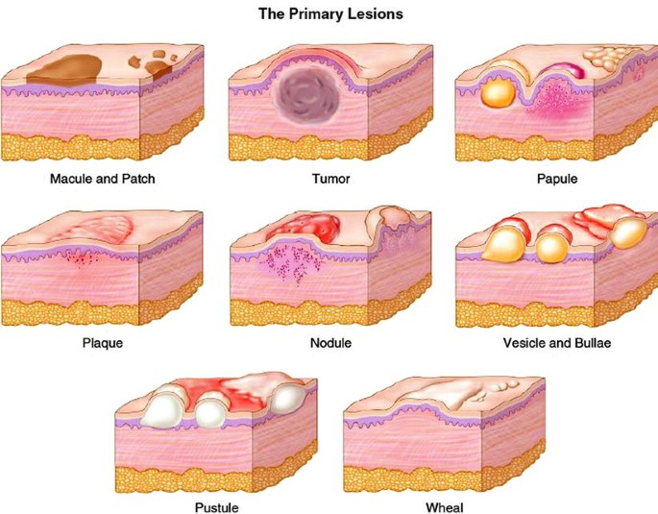

Slide 11
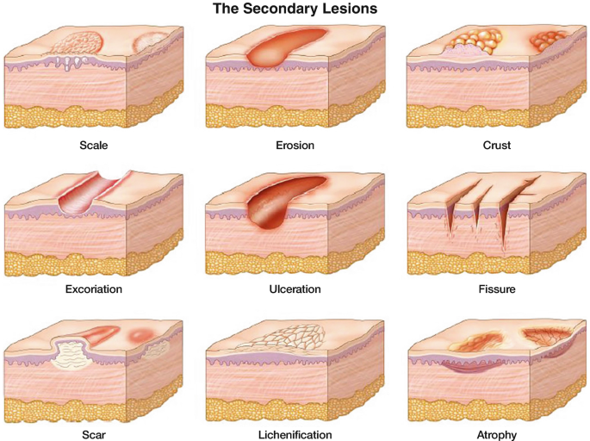

Slide 12
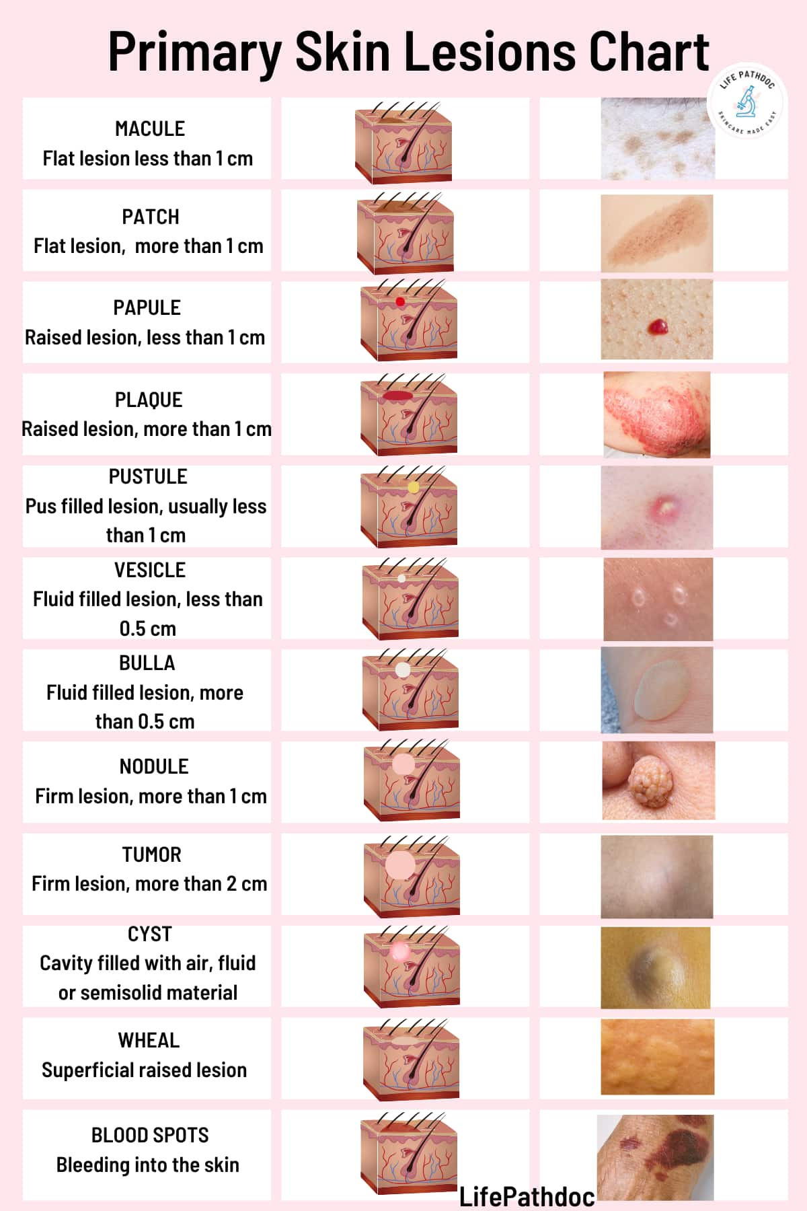

Slide 13
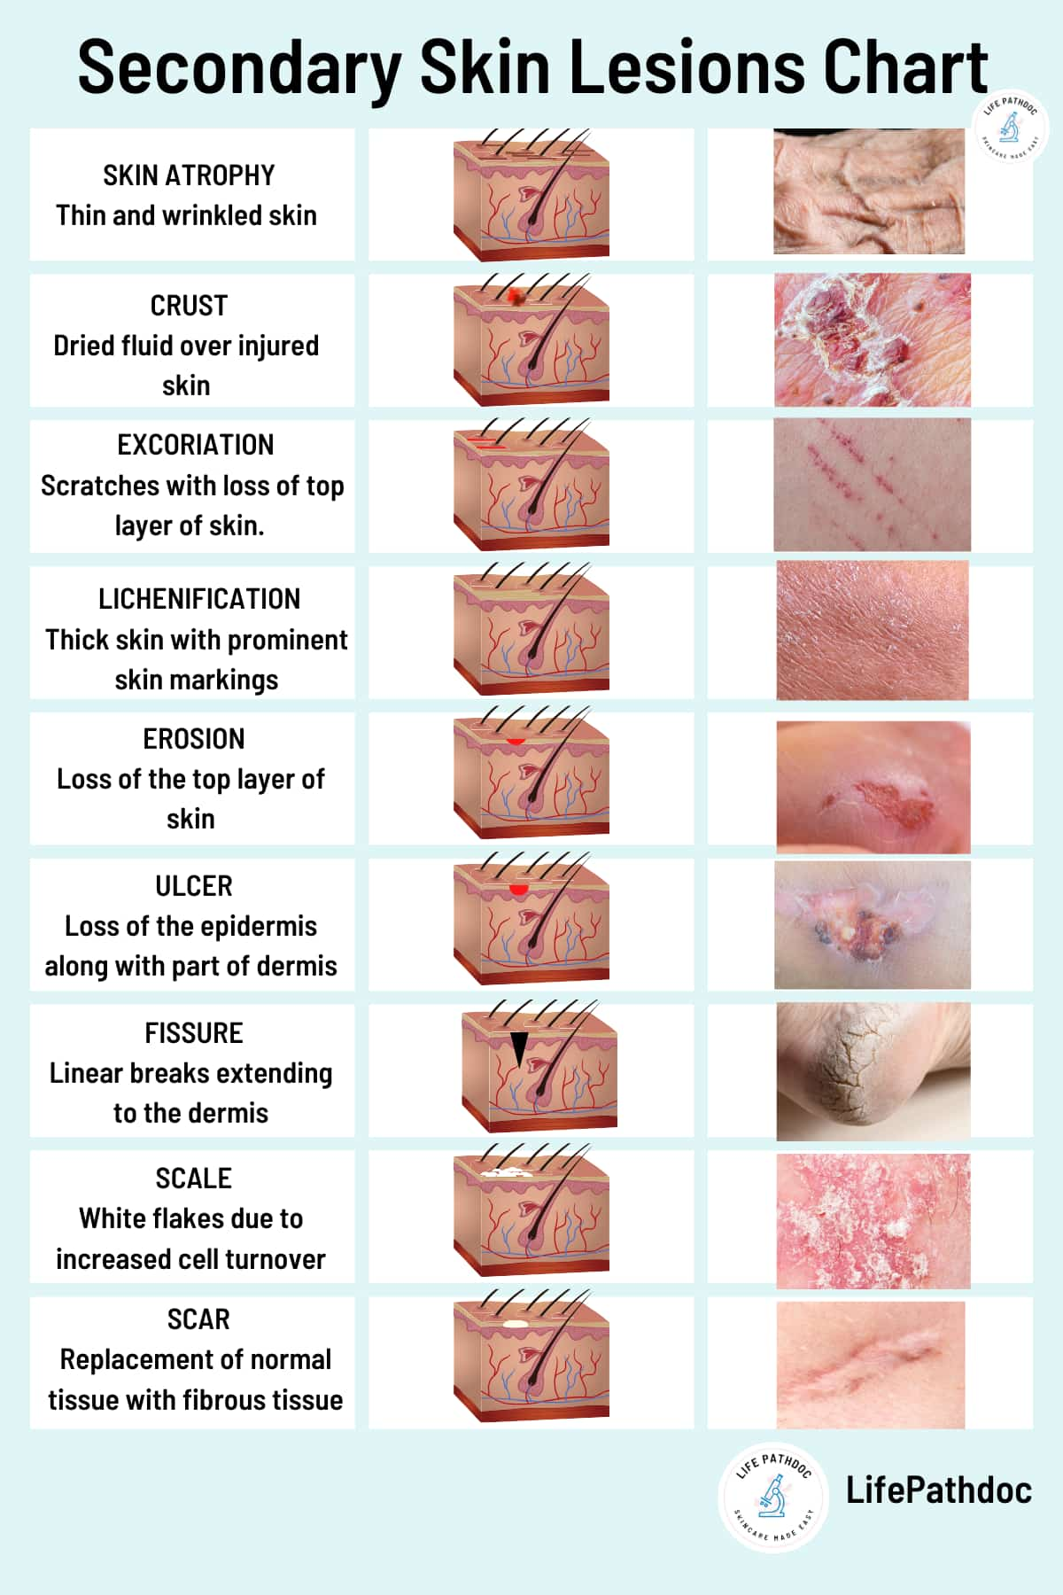

Slide 14
Step 3 (Cont.): Configuration and Distribution
Configuration:
Annular: Ring-shaped (Tinea, Lyme disease)
Linear: In a line (Contact dermatitis, lichen striatus)
Nummular: Coin-shaped (Nummular eczema)
Reticulated: Net-like (Livedo reticularis)
Discrete: Lesions that are separate and distinct from one another.
Grouped: Lesions clustered together in close proximity.

Slide 15
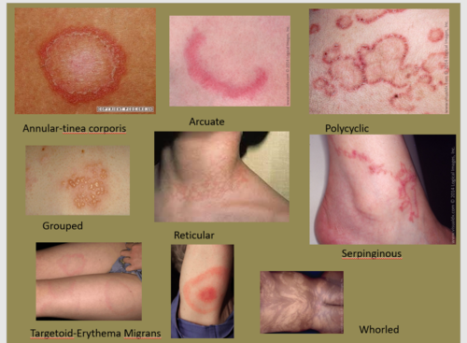

Slide 16
Step 3 (Cont.): Configuration and Distribution
Distribution:
Generalized: Lesions are widespread or randomly distributed over a large area of the body
Localized: Lesions are confined to a specific, limited area.
Symmetric: Lesions appear in similar patterns on both sides of the body (e.g., on extensor surfaces or flexural areas).
Asymmetric: Lesions are not symmetrical.
Unilateral: Lesions affect only one side of the body.
Acral: Lesions affect the distal extremities, such as fingers, toes, ears, and nose.
Seborrheic: Lesions are typically found in areas with a high concentration of sebaceous
Photo-distributed: Sun-exposed areas (SLE, phototoxic reaction)
Extensor surfaces: Elbows, knees (Psoriasis)
Flexural surfaces: Antecubital fossae, popliteal fossae (Atopic dermatitis)
Dermatomal: Following a nerve root (Herpes zoster)
Notes:
"How the lesions are arranged and where they are on the body is often more diagnostic than the lesion itself. Shingles in a dermatomal pattern is a classic example. You would never confuse it with a widespread chickenpox infection."

Slide 17
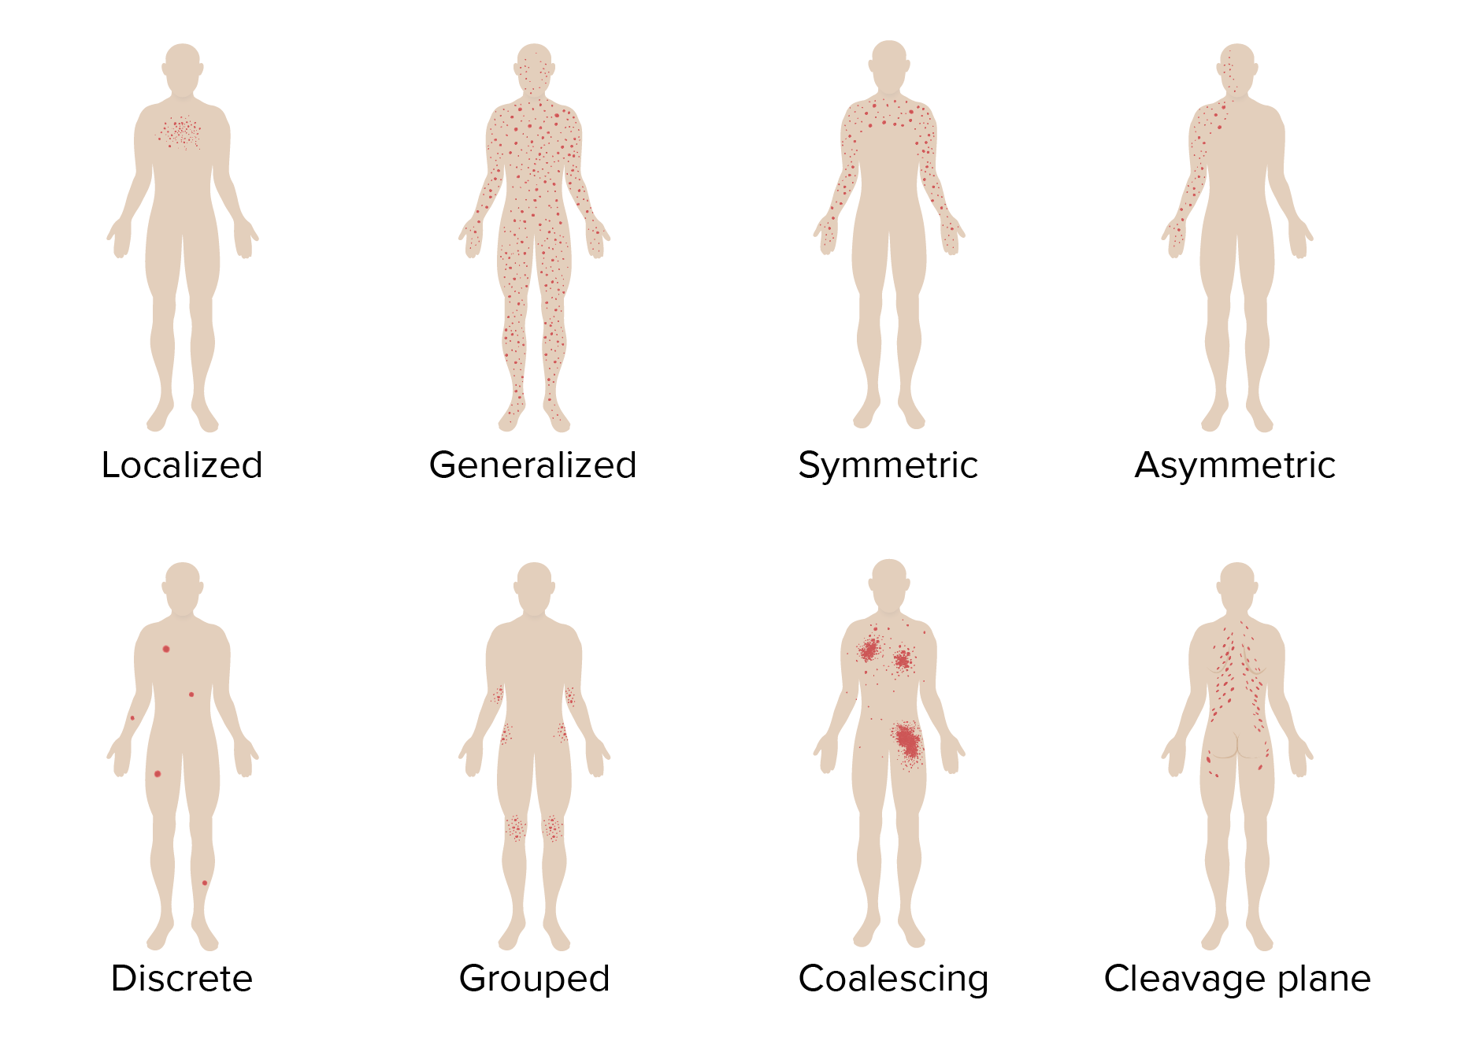

Slide 18
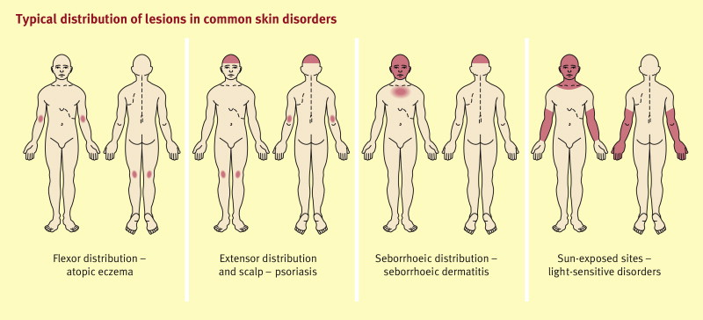

Slide 19
Step 4 & 5: Differential Diagnosis and Testing
Step 4: Formulating a Differential Diagnosis (D/Dx)
Based on morphology + distribution + history, create a list of possible conditions.
Rank them from most to least likely.
Step 5: Selecting Diagnostic Tests
Choose the test that will most efficiently and accurately confirm or rule out your top diagnosis.
Is it a bedside test? Does it require a biopsy?
Notes:
"Your differential might include 3-5 possibilities. For an itchy, scaly, annular plaque, your D/Dx could be: 1. Tinea corporis (most likely), 2. Nummular eczema, 3. Psoriasis. The best test to rule in #1 would be a simple KOH preparation."

Slide 20

Diagnostic Tests & Procedures
Bedside Diagnostic Tests:
Dermatoscopy (Dermoscopy): The Dermatologist's Stethoscope
What it is: A non-invasive tool using polarized light to visualize structures in the epidermis and superficial dermis not visible to the naked eye.
Primary Uses:
Pigmented Lesions: Differentiating benign nevi from melanoma using patterns (pigment network, streaks, blue-white veil).
Non-Pigmented Lesions: Diagnosing basal cell carcinoma (arborizing vessels), sebaceous hyperplasia (yellow globules with crown vessels), and vascular lesions.
Benefit: Significantly increases diagnostic accuracy for skin cancer and reduces unnecessary biopsies.

Slide 21

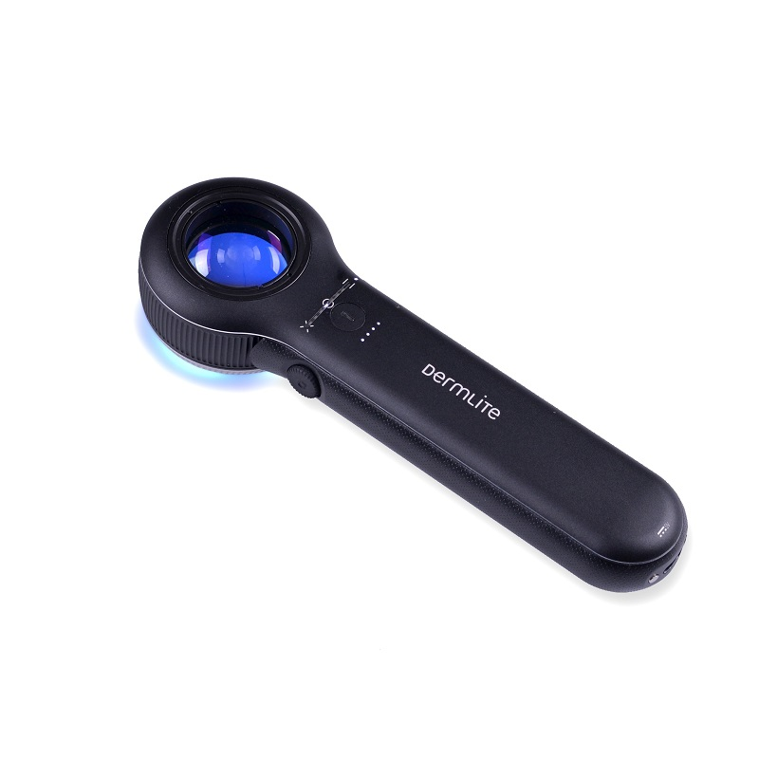

Slide 22
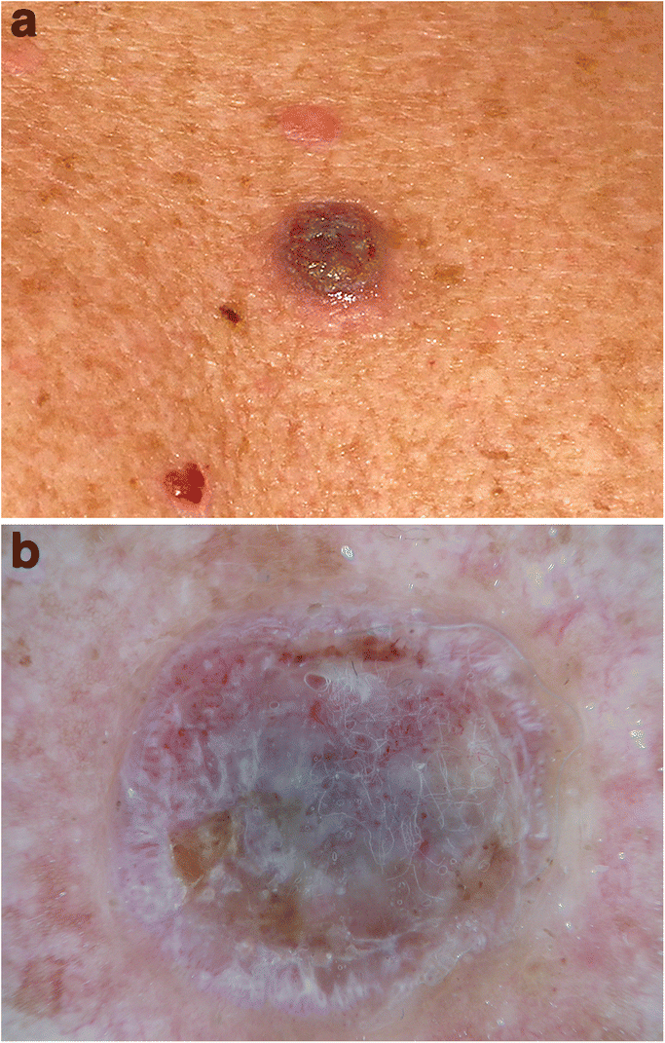
(A) Hypopigmented nodule on the back of a 72-year-old man viewed with the unaided eye.
A Dermatoscopic examination of the lesion (B) shows ulceration with serum crusts and adherent fibers. Central grey colour surrounded by white lines and coiled vessels allows the differential diagnosis of an amelanotic melanoma.

Slide 23
Diagnostic Tests & Procedures
Bedside Diagnostic Tests:
Wood's Lamp (UVA Light, 365 nm)
Principle: Certain organisms and pigments fluoresce.
Findings:
Erythrasma: Coral-red fluorescence (Corynebacterium minutissimum)
Tinea capitis (Microsporum spp.): Blue-green fluorescence
Pseudomonas aeruginosa: Greenish fluorescence
Vitiligo: Bright blue-white (due to complete absence of melanin)
Limitation: Not all fungi fluoresce.
Notes:
"Wood's lamp is quick but its utility is specific. Diascopy is a forgotten but brilliant simple test. If you press on a cherry angioma, it blanches completely and returns. If you press on a purpuric lesion from vasculitis, it does not blanch."

Slide 24
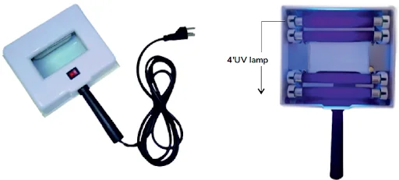
Wood’s Lamp

Slide 25
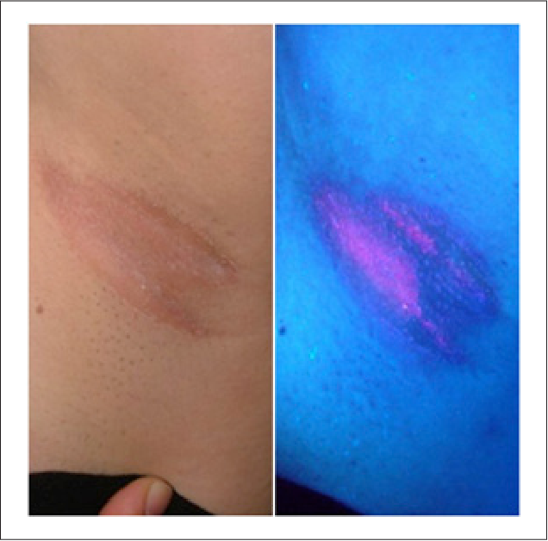
The coral red of Corynebacterium minutissimum in erythrasma under Wood’s lamp examination.

Slide 26
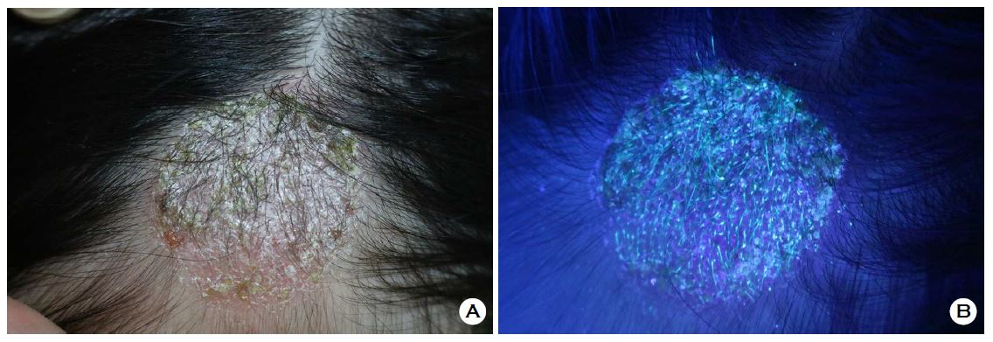
(A) 4 cm sized erythematous plaque with yellowish scale was seen on Left frontal area for 2 weeks. Potassium hydroxide (KOH) test was positive.
(B) Blue-green characteristic fluorescence was seen under wood lamp.

Slide 27
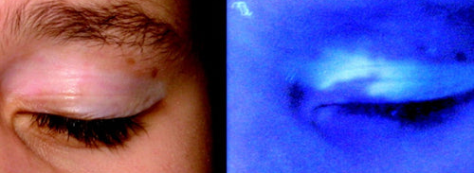
A: Vitiligo of the eyelids in visual light.
B: The same eyelid under Wood's lamp produces a white fluorescent light.

Slide 28
Diagnostic Tests & Procedures
Bedside Diagnostic Tests:
Diascopy:
Principle: Pressing a glass slide on a skin lesion to blanch it (empty blood vessels).
Utility:
To see if a red lesion is due to blood (will not blanch) or inflammation (will blanch).
To see the underlying colour of a granuloma (e.g., apple-jelly colour in cutaneous tuberculosis).

Slide 29
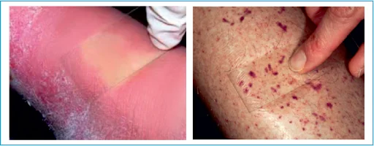
A glass slide is taken and pressed on the skin. It is used:
To differentiate between erythema and purpura: When there is simple erythema due to vasodilation, If you press, the blood spills out to the sides. So, there will be a blanching effect. In purpura, there will be no change because it is either due to vasculitis or extravasation of RBCs.
To differentiate between nevus anemicus and depigmentosis.
To see Apple jelly nodules- seen in Lupus Vulgaris and Sarcoidosis.

Slide 30
Diagnostic Tests & Procedures
Bedside Diagnostic Tests:
Potassium Hydroxide (KOH) Preparation
Indication: Suspected superficial fungal infection (tinea, candidiasis).
Procedure: Scrape scale onto slide -> add 1-2 drops 10% KOH -> gently heat -> examine under microscope.
Positive Finding: Hyphae (long, branching, rod-shaped structures with lines crossing them).
Notes:
"KOH dissolves keratinocytes but leaves the hardy fungal cell walls intact, making them visible.

Slide 31
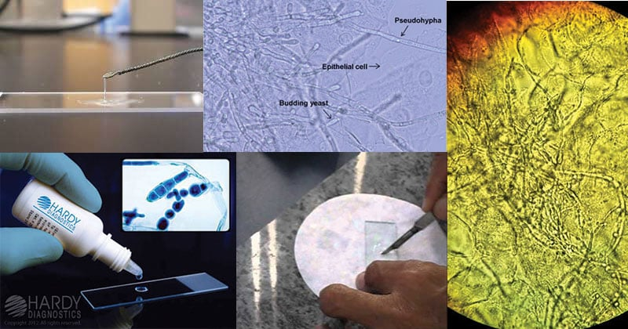

Slide 32
Diagnostic Tests & Procedures
Bedside Diagnostic Tests:
Mineral Oil Preparation for Scabies
Indication: Suspected scabies infestation.
Procedure: Place mineral oil on a burrow -> scrape vigorously -> transfer to slide -> examine.
Positive Finding: Sarcoptes scabiei mite, eggs, or faecal pellets (scybala).
Notes:
For scabies, you must scrape until you see pinpoint bleeding—you need to get the mite from the end of the burrow."

Slide 33
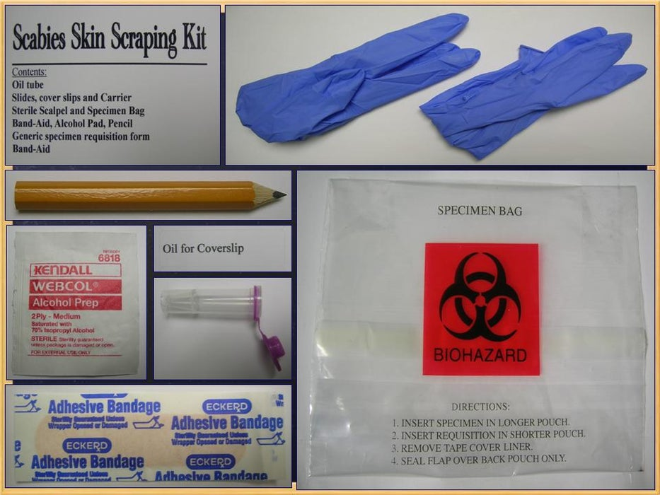

Slide 34
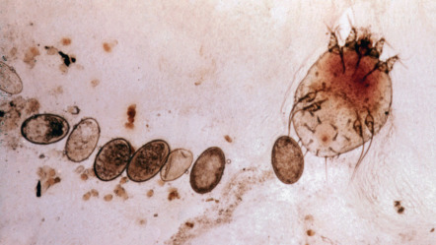

Slide 35

Questions
Thanks

