Slide 1
Knowledge management 2015-2016
Chapter Three
Knowledge Management and Decision Making
Lecturer :BLESA IBRAHIM

Slide 2
Objectives
What is the decision making and what are its types?
What are the steps in the decision-making process?
How to make a better decision using the knowledge in the workplace
Knowledge requirement in different decision making modes
Knowledge management as a support function in decision making

Slide 3
Decision making definition
The word decision is defined as:
“A choice between two or more alternatives”.
Thus decision-making can be defined as:
“the selection of a course of action from among alternatives ”.
As defined by Baker et al in their 2001 study, “efficient decision-making involves a series of steps that require the input of information and knowledge at different stages of the process, as well as a process for feedback”.

Slide 4
Types of decisions
Programmed Decision
A decision that is repetitive and routine and can be made by using a definite, systematic procedure.
Examples:
pricing standard customer orders, determining billing dates

Slide 5
Types of decisions
Nonprogrammed Decision
A decision that is unique and novel.
Examples: Moving into a new market, investing in a new unproven technology, changing strategic direction

Slide 6
What are the steps in the decision-making process?
Steps in the decision-making process:
Identify and define the problem.
Clarify Your Objectives
Identify Alternatives
Analyze the Consequences
Make a Choice

Slide 7
Step 1. Define the Problem
Start by writing down your initial assessment of the problem.
Dissect the problem.
What triggered this problem (as I’ve assessed it)?
Why am I even thinking about solving this problem?
What is the connection between the trigger and the problem?

Slide 8
Step 2. Clarify Your Objectives
Write down all the concerns you hope to address through your decision.
Convert your concerns into specific, concrete objectives.
Separate ends from means to establish your fundamental objectives.
Clarify what you mean by each objective.

Slide 9
Step 3. Identify Alternatives
Generate as many alternatives as you can yourself.
Expand your search, by checking with other people, including experts.
Look at each of your objectives and ask, “how?”
Know when to stop.

Slide 10
Step 4. Analyze the Consequences
Mentally put yourself into the future.
Solving problems by thinking through the process involved from beginning to end, imagining, at each step, what actually would happen.
Eliminate any clearly inferior alternatives.
Organize your remaining alternatives into a table (matrix) that provides a concise, bird's-eye view of the consequences of pursuing each alternative.

Slide 11
Step 5. Make a Choice
Analyses are useless unless the right choice is made.
Under perfect conditions, simply review the consequences of each alternative, and choose the alternative that maximizes benefits.
In practice, making a decision—even a relatively simple one like choosing a computer—usually can’t be done so accurately or rationally

Slide 12
How to make a better decision using the knowledge
Increase Your Knowledge
Ask questions.
Get experience.
Use consultants.
Do your research.
Force yourself to recognize the facts when you see them (maintain your objectivity).
Use Your Intuition
A cognitive process whereby a person instinctively makes a decision based on his or her accumulated knowledge and experience

Slide 13
How to make a better decision
Weigh the Pros and Cons
Quantify realities by sizing up your options, and taking into consideration the relative importance of each of your objectives.
Don’t Overstress the Finality of Your Decision
Remember that few decisions are forever.
Knowing when to quit is sometimes the smartest thing a manager can do.
Make Sure the Timing Is Right

Slide 14
Knowledge requirement in different decision making modes
There are at least six typical of decision making modes that need the knowledge
Emergency action
Routine procedures
Analysis centred decision making
Conflict management
Collaborative learning
Elite corps

Slide 15
Knowledge requirement in different decision making modes
Emergency action
Procedures and judgement are used , and Knowledge in this situation must be gathered quickly such as documentation describing
Routine procedures
Quantifiable information often is more preferred in this kind of decision
Analysis centred decision making
Are based on research and evaluation and the results are stored in a knowledge base
Conflict management (1980)
Typically begins with a meeting of people who represent a various sides of a conflict. Knowledge is presented by variety of people in different structures and forms. These presentations are followed by discussion and negotiation.

Slide 16
Knowledge requirement in different decision making modes
Collaborative learning (nowadays)
Various members of the decision making in the organization work together as equals based on the knowledge that they have.
6. Elite corps
seniors members of the organization meet the staff in order to make better decision, the knowledge comes from the staff participation in many cases.

Slide 17
Knowledge management as a support function in decision making
It is clear that decision making processes can be supported successfully by knowledge management, but there should be the following knowledge management activities
Appointment of knowledge leader- develop a framework
Creation of knowledge teams
Develop knowledge bases- collect best practise
Active process management – knowledge generation
Set up knowledge centre – facilitating knowledge flow
Use collaborative technologies
Creation of knowledge webs- network of experts
Shareware (software)

Slide 18
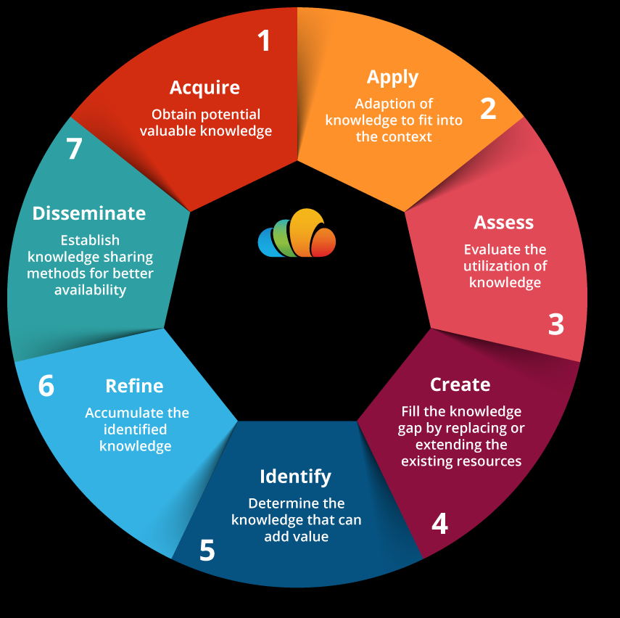
Knowledge management life cycle

Slide 19

The importance of knowledge management in marketing

