Slide 1

Cihan University of Sulaimaniya
Practical Biochemistry
Lecture 4 :
Identification of Carbohydrates (Seliwanoff’s, Bails, mucic Acid)Tests
Prepared by :
Darya Shorsh Hamad
Mcs. in Clinical Biochemistry
E-mail: darya.shorsh@sulicihan.edu.krd
2024 - 2025

Slide 2
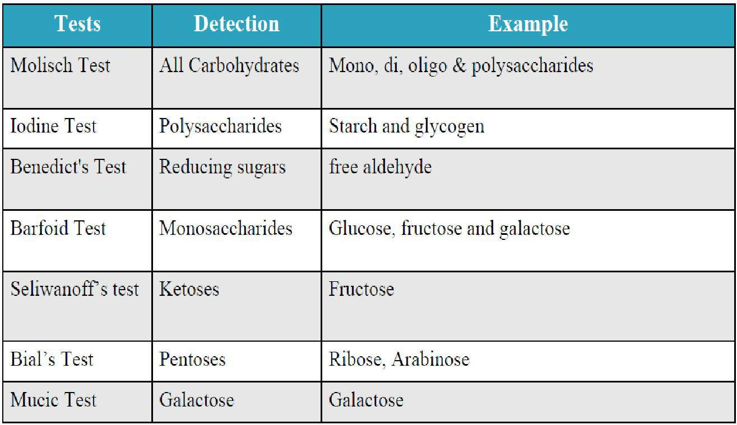
Introduction

Slide 3
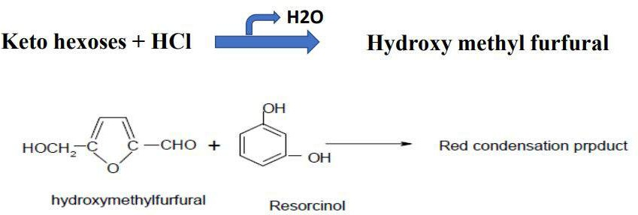
Seliwanoff’s test
Aim of Seliwanoff’s test: is used to differentiate between sugars that have a ketone group (ketose) and sugars that have an aldehyde group (aldoses).
It gives a positive result for ketoses because they tend to dehydrate more quickly compared to aldoses.
Seliwanoff’s Reagent: The reagent of this test consists of resorcinol and concentrated HCl.
Principle: This is a specific test for ketohexoses. Concentrated HCl dehydrates ketohexoses to form furfural derivatives which condense with resorcinol to give cherry red color solution. Aldoses may react slightly to produce a faint pink color.

Slide 4
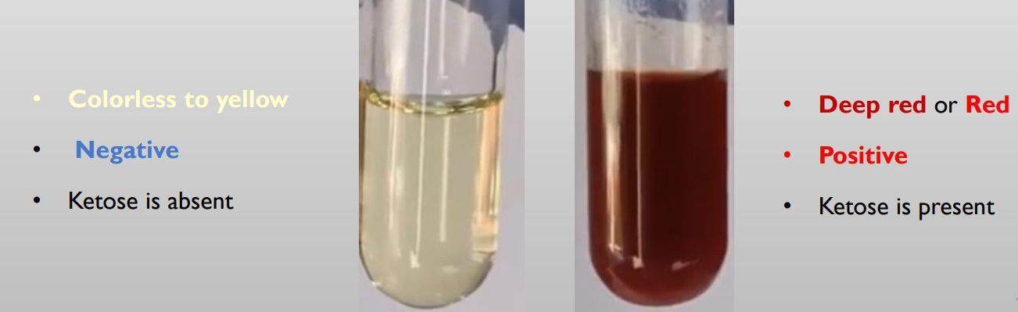
Procedure of Seliwanoff’s Test:
1- Add 3 ml of Seliwanoff’s reagent (a solution of resorcinol and HCl) into each of four separate test tubes.
Add 3 drops of 1% solutions of fructose, glucose, sucrose and starch , one sugar solution per tube . mix the contents of the tubes.
Heat the tubes in a boiling water bath for 1 minute and then cool tubes under tap water.

Slide 5
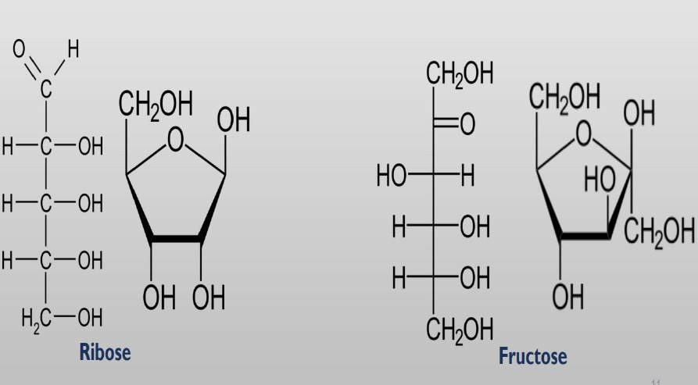
Bial’s Test
Aim: This test is used to distinguish between pentose sugar from hexose
Reagents: Bial's reagent consists of orcinol, concentrated hydrochloric acid (HCl) and ferric chloride.
Principle: In the presence of concentrated HCl, pentose react to give furfural, whereas hexoses give
5-hydroxymethyfurfural, as we have just seen. Furfural reacts with orcinol and ferric ions, which are present in Bial’s reagent, along with conc. HCl, to give a blue-green color.

Slide 6
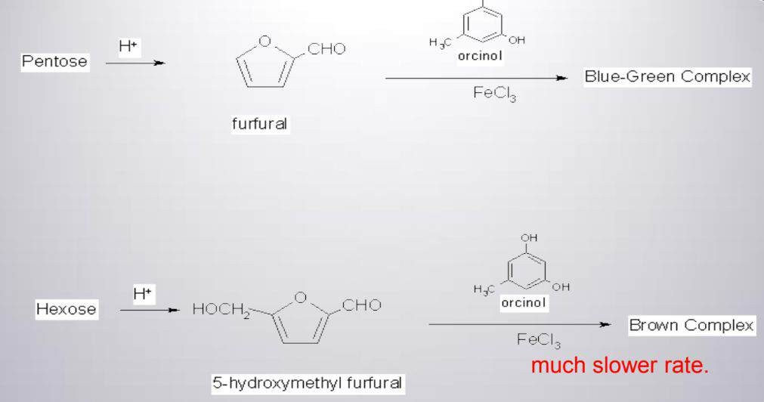
Reaction of Bile Test

Slide 7
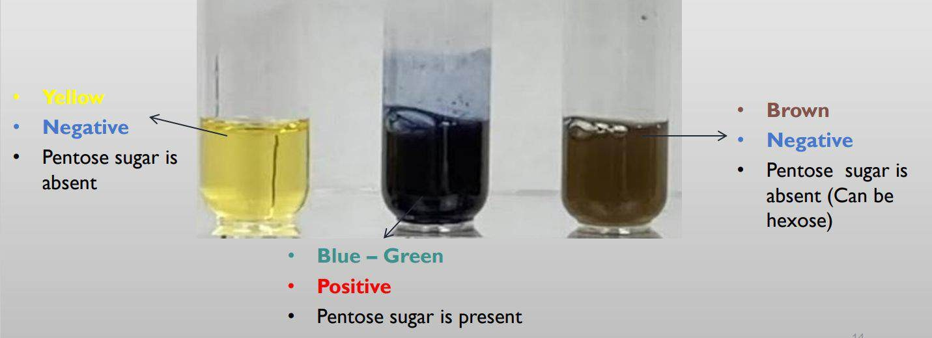
Bial’sTest Procedure
Take 1 ml of Test sugar solutions in test tubes
Add 2.5 ml of Bial’s reagent to each tube and heat in a boiling water bath for 1min
allow the tubes to cool down. Look for the formation of blue-green color.

Slide 8
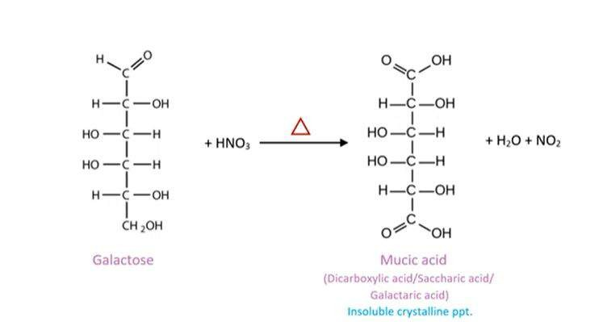
Mucic acid Test
Aim: This test is specifically used to detect galactose. Mucic acid has also another name ( Galataric acid).
Reagent: concentrated nitric acid.
Principle: Monosaccharides like galactose, (galactose containing sugars such as lactose gives positive response to this reaction) in the presence of strong acids like nitric acid, produce saccharic acids. The saccharic acid formed is insoluble and form clear crystals. This acid derivative is known as galactaric or meso-galactaric acid (mucic acid), thus the name for the test.

Slide 9
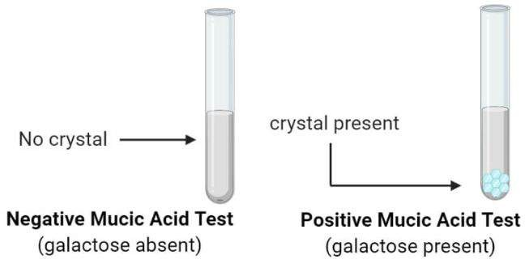
Procedure
1. Mix 3 drops of the carbohydrate solution (galactose
and lactose) and 3 drops of the concentrated Nitric Acid
on a glass slide
2. Pass the mixture over a small flame until it is almost
dry. Cool the mixture at room temperature; examine the
crystals under the microscope.

Slide 10
Lab Questions
Q1: we did the following tests for each of Solution
maltose
and
ribose
give the results and explanation for each solutions.
Mucic | Benedict | Barfoed | Bial | Selliwanoff
Q2: What are carbohydrates give positive result with Seliwanoff ? why?
Q3: What is the result of Bial's test if the sample contain starch?why?

