Slide 1

Cihan University - Sulaimaniya
Clinical Biochemistry
Lab 2
Colorimetry - Lambda max (λmax)
Prepared by :
Darya Shorsh Hamad
Mcs. in Clinical Biochemistry
E-mail: darya.shorsh@sulicihan.edu.krd
AcademicYear 2023-2024

Slide 2
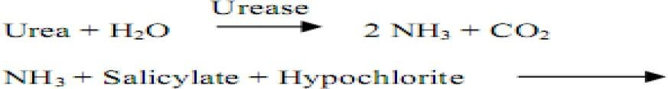
Colorimetric Determination
Principle
Colorimetric analysis is a method to analyze a color. In this case a specific reagent is used to react with a specific component in the serum and a colored complex is formed which is directly proportional to the concentration of the compound in the serum.
Example: The blood urea colorimetric procedure is a modification of the Berthelot reaction. Urea is hydrolyzed in the presence of water and urease to produce ammonia and carbon dioxide. Ammonium ions react with hypochlorite and salicylate to give a green dye. The intensity of the color formed at 578 nm is proportional to the urea concentration in the sample.

Slide 3
Requirements of Colorimetric Analysis
In colorimetric assays three tubes should be prepared as follow:
Reagent blank: which contain the reagents only (without any test or standard substance) and used to set instrument at zero absorbance (Any color given by the reagents used in the analysis can be detected and eliminated)
Standard solution: it is a substance identical to the test solution with a known concentration (it is different from an assay
to another according to the measured parameter)
Test solution: This contains the unknown concentration of the substance together with the reagents used in the test.
Test OD=? C=?
Standard
OD=?
C=100mg/dl
blank

Slide 4
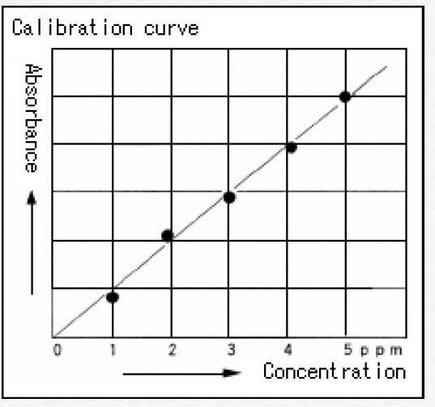
Calculations
Calculation of sample concentration can be done by two methods:
Using standard concentration:
Using calibration curve
Slandered calibration curve are obtained by measuring the absorbance
of a series of standard solutions.
After a series of standard solutions are analyzed a graph of absorbance versus concentration is drawn and it will be a linear relationship.
Solutions of unknown concentration are tested for absorbance; these absorbance results are read from the curve to determine concentration.

Slide 5
LAMBDA (λ ) MAX
The wavelength which a substance shows maximum absorbance is called maximum absorption or λmax.
The value of λ max is important for several reasons:
This wavelength is characteristic of each compound
It provides information on the electronic structure of the analyte
It ensures highest sensitivity and minimize deviations from Beer's Law.

Slide 6
Principle of λmax measurement
The principle behind the determination of Lambda max of any colored substance is that the colored substance absorbs maximum radiation at a particular wavelength in the visible region (400-800 nm).
This colored substances absorb the radiation in different manner depending upon the wavelengths used.
This unique property of maximum absorption at a particular wavelength is known as λ max and is useful for identification of that particular substance.
λ max is not usually affected by concentration used.

Slide 7
Procedure:
Weight accurately 100 mg of KMNO4 and dissolve in 30 ml of distilled water in a volumetric flask.
Make up the volume up to 100ml with distilled water.
Now take 4 ml of above solution and dilute to 20 ml with distilled water in order to get resulting solution (40µg/ml)
Switch on the colorimeter and allow to stabilize for 15 minutes.
Set the absorbance at zero by using distilled water as blank.
Now set 100% transmittance by distilled water.
Take the absorbance of the resulting solution at different wavelengths
Plot the graph between wavelength vs observed absorbance.

Slide 8
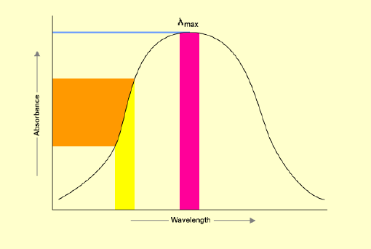
Calculation of LAMBDA (λ ) MAX
We can determine λ max by plotting absorbance vs wavelength in graph.
Wavelength (λ) | Absorbance (OD)
460 | ?
480 | ?
500 | ?
520 | ?
540 | ?
560 | ?
580 | ?
600 | ?
620 | ?

