Slide 1
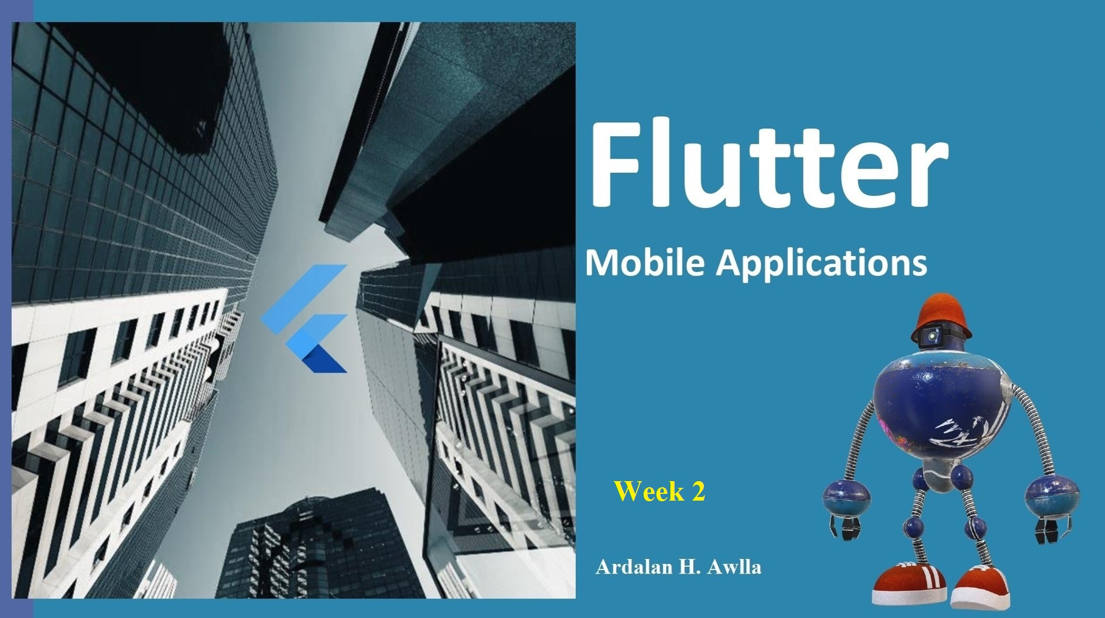

Slide 2
What’s for today?
Flutter App Architecture
Flutter Widgets
Material App Widget
Flutter Framework
Scaffold
Text Widget

Slide 3
Flutter Architecture
The core concept of the Flutter framework is In Flutter, Everything is a widget. Widgets are basically user interface components used to create the user interface of the application.
In Flutter, the application is itself a widget. The application is the top- level widget and its UI is build using one or more children (widgets), which again build using its children widgets. This composability feature helps us to create a user interface of any complexity.
The Flutter architecture mainly comprises of four components.
  Flutter Engine
  Foundation Library
  Widgets
  Design Specific Widgets

Slide 4
Flutter Architecture(2)
Flutter Engine: It is a portable runtime for high-quality mobile apps and primarily based on the C++ language. It implements Flutter core libraries that include animation and graphics, file and network I/O, plugin architecture, accessibility support, and a dart runtime for developing, compiling, and running Flutter applications. It takes Google's open-source graphics library, Skia, to render low-level graphics.
Foundation Library: It contains all the required packages for the basic building blocks of writing a Flutter
application. These libraries are written in Dart language
Widgets: In Flutter, everything is a widget, which is the core concept of this framework. Widget in the Flutter is basically a user interface component that affects and controls the view and interface of the app.
Design Specific Widgets: The Flutter framework has two sets of widgets that conform to specific design
languages. These are Material Design for Android application and Cupertino Style for IOS application.

Slide 5
Gestures
It is a widget that provides interaction (how to listen for and respond to) in Flutter using GestureDetector.
GestureDetector is an invisible widget, which includes tapping, dragging, and scaling interaction of its child widget. We can also use other interactive features into the existing widgets by composing with the GestureDetector widget. Flutter widgets support interaction through a special widget, GestureDetector.
State Management
Flutter widget maintains its state by using a special widget, StatefulWidget. It is always auto re-rendered whenever its internal state is changed. The re-rendering is optimized by calculating the distance between old and new widget UI and render only necessary things that are changes.

Slide 6
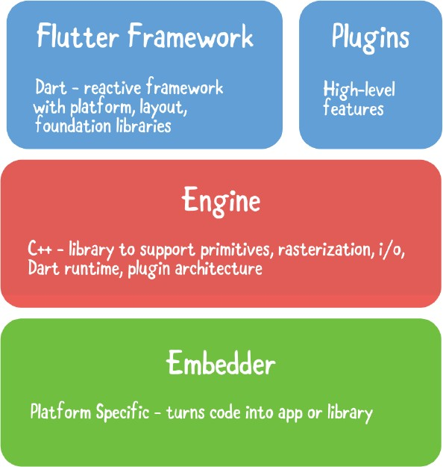
Flutter Layers
Layers are an
important concept of the Flutter
framework, which are grouped into multiple categories in terms of complexity and arranged in the top-down approach. The topmost layer is the UI of the application, which is specific to the Android and iOS platforms. The second topmost layer contains all the Flutter native widgets. The next layer is the rendering layer, which renders everything in the Flutter app. Then, the layers go down to Gestures, foundation library, engine, and finally, core platform- specific code. The following diagram specifies the layers in Flutter app development.

Slide 7
Layers
The Framework layer is written in Dart and contains the high-level libraries that you’ll use directly to build apps. This includes the UI theme, widgets, layout and animations, gestures and foundational building blocks. Alongside the main Flutter framework are plugins: high-level features like JSON serialization, geolocation, camera access, in-app payments and so on. This plugin-based architecture lets you include only the features your app needs.
The Engine layer contains the core C++ libraries that make up the primitives that support Flutter apps. The engine implements the low-level primitives of the Flutter API, such as I/O, graphics, text layout, accessibility, the plugin architecture and the Dart runtime. The engine is also responsible for rasterizing Flutter scenes for fast rendering onscreen.
The Embedder is different for each target platform and handles packaging the code as a stand-alone app or
embedded module.

Slide 8
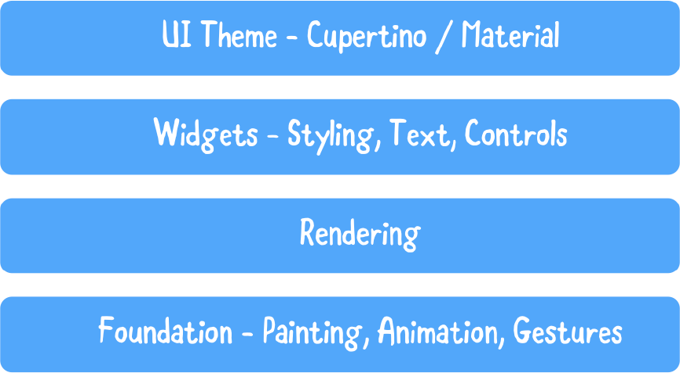
Flutter Framework
Each of the architecture layers is made up of other sublayers and modules, making them almost fractal. Of particular import to general app development is the makeup of the framework layer:
The Flutter framework consists of several sublayers:
At the top is the UI theme, which uses either the Material (Android) or Cupertino (iOS) design language. This affects how the controls appear, allowing you to make your app look just like a native one.
The widget layer is where you’ll spend the bulk of your UI programming time. This is where you compose design and interactive elements to make up the app.
Beneath the widgets layer is the rendering layer, which is the abstraction for building a layout.
The foundation layer provides basic building blocks, like animations and gestures, that build up the higher layers.

Slide 9
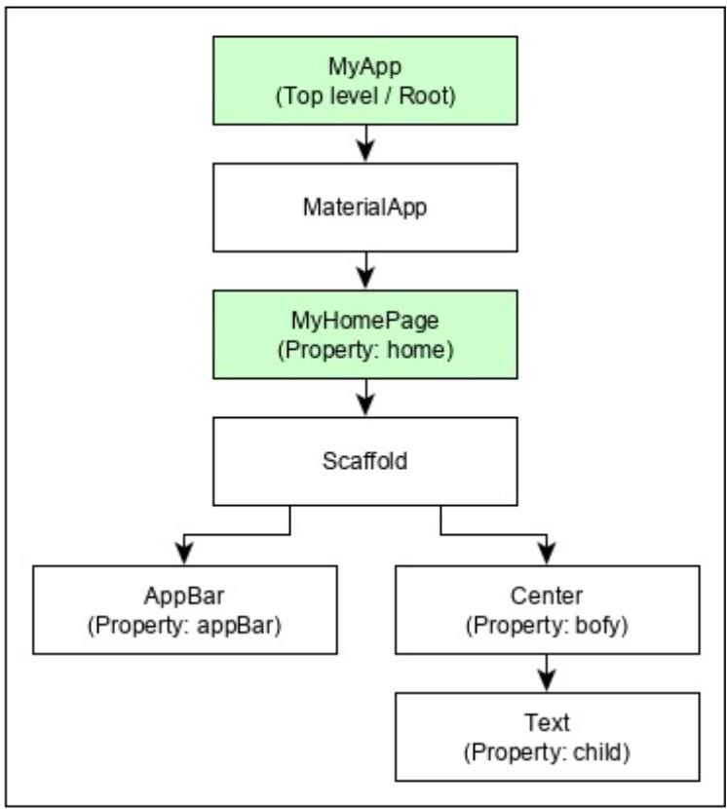
Flutter App Architecture(2)
For example, the widget hierarchy of the hello world application (created in previous practical lecture) is as specified in the following diagram

Slide 10
Flutter Architecture (3)
Here the following points are worth notable −
MyApp is the user created widget and it is build using the Flutter native widget, MaterialApp.
MaterialApp has a home property to specify the user interface of the home page, which is again a user created widget, MyHomePage.
MyHomePage is build using another flutter native widget, Scaffold
Scaffold has two properties – body and appBar
body is used to specify its main user interface and appBar is used to specify its header user interface
Header UI is build using flutter native widget, AppBar and Body UI is build using Center widget.
The Center widget has a property, Child, which refers the actual content and it is build using Text widget

Slide 11
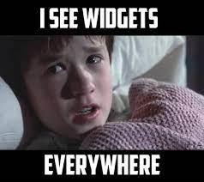
Widgets
Widgets: Each element on a screen of the Flutter app is a widget. The view of the screen completely depends upon the choice and sequence of the widgets used to build the app. And the structure of the code of an app is a tree of widgets.
Widgets are nested with each other to build the app. It means the root of your app is itself a widget, and all the way down is a widget also. For example, a widget can display something, can define design, can handle interaction, etc.
We can split the Flutter widget into two main categories: 1.Visible (Output and Input)
2.Invisible (Layout and Control)

Slide 12
Widgets
When a widget’s state changes, the widget rebuilds its description, which the framework diffs against the previous description in order to determine the minimal changes needed in the underlying render tree to transition from one state to the next.
Widgets are immutable. That is, they cannot be changed. Any properties that they contain are final and can only be set when the widget is initialized. This keeps them lightweight so that it’s inexpensive to recreate them when the widget tree changes.

Slide 13
Widget Categories
Category of Widgets: There are mainly 14 sub categories in which the flutter widgets are divided. They are mainly segregated on the basis of the functionality they provide in a flutter application.
Accessibility: These are the set of widgets that make a flutter app more easily accessible.
Animation and Motion: These widgets add animation to other widgets.
Assets, Images, and Icons: These widgets take charge of assets such as display images and show icons.
Async: These provide async functionality in the flutter application.
Basics: These are the bundle of widgets which are absolutely necessary for the development of any flutter application.
Cupertino: These are the ios designed widgets.
Input: This set of widgets provide input functionality in a flutter application.
Interaction Models: These widgets are here to manage touch events and route users to different views in the application.
Layout: This bundle of widgets helps in placing the other widgets on the screen as needed.
Material Components: This is a set of widgets that mainly follow material design by Google.
Painting and effects: This is the set of widgets which apply visual changes to their child widgets without changing their layout
or shape.
Scrolling: This provides sacrollability of to a set of other widgets that are not scrollable by default.
Styling: This deals with the theme, responsiveness, and sizing of the app.
Text: This display text.

Slide 14
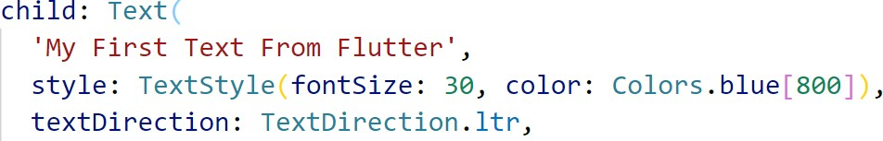
Visible Widgets
The visible widgets are related to the user input and output data. Some of the important types of this widget are:
Text widget:
A Text widget holds some text to display on the screen. We can align the text widget by using textAlign property, and style property allow the customization of Text that includes font, font weight, font style, letter spacing, color, and many more. We can use it as like below code snippets.

Slide 15
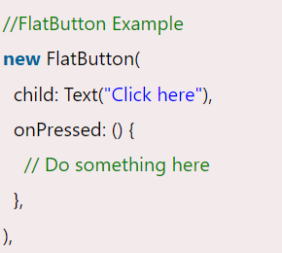
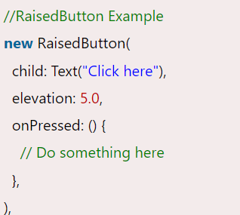


Buttons
This widget allows you to perform some action on click. Flutter does not allow you to use the Button widget directly; instead, it uses a type of buttons like
a FlatButton and a RaisedButton. We can use it as like below code snippets.
In the above example, the onPressed property allows us to perform an action when you click the button, and elevation property is used to change how much it stands out.
15

Slide 16
Image
This widget holds the image which can fetch it from multiple sources like from the asset folder or directly from the URL. It provides many constructors for loading image, which are given below:
  Image: It is a generic image loader, which is used by ImageProvider.
  asset: It load image from your project asset folder.
  file: It loads images from the system folder.
  memory: It load image from memory.
  network: It loads images from the network.
To add an image in the project, you need first to create an assets folder where you keep
your images and then add the below line in pubspec.yaml file.

Slide 17
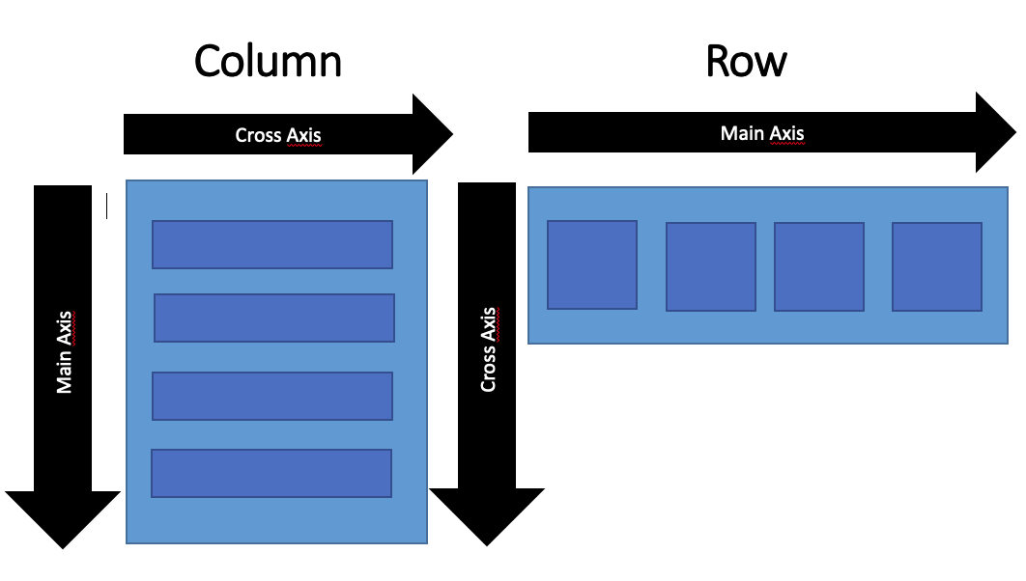
Invisible Widgets (Layout Widgets)
Column
A column widget is a type of widget that arranges all its children's widgets in a vertical alignment. It provides spacing between the widgets by using the mainAxisAlignment and crossAxisAlignment properties. In these properties, the main axis is the vertical axis, and the cross axis is the horizontal axis.
Row:
The row widget is similar to the column widget
, but it constructs a widget horizontally rather
than vertically. Here, the main axis is the horizontal axis, and the cross axis is the vertical axis.

Slide 18
Invisible Widgets (Layout Widgets)
Center
This widget is used to center the child widget, which comes inside it. All the previous examples contain inside the center widget.
Padding
This widget wraps other widgets to give them padding in specified directions. You can also provide padding in all directions. We can understand it from the below example that gives the text widget padding of 6.0 in all directions.
Scaffold
This widget provides a framework that allows you to add common material design elements like AppBar, Floating Action Buttons, Drawers, etc.
Stack
It is an essential widget, which is mainly used for overlapping a widget, such as a button on a
background gradient.

Slide 19
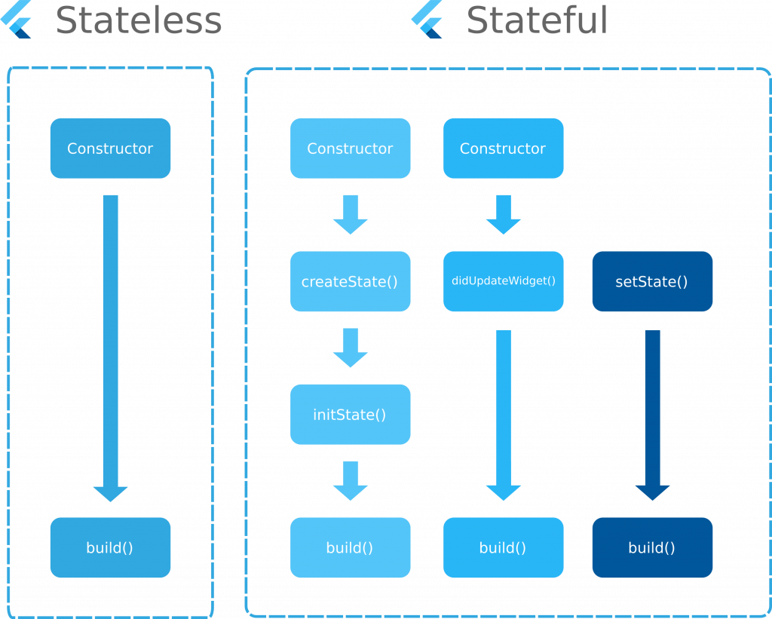
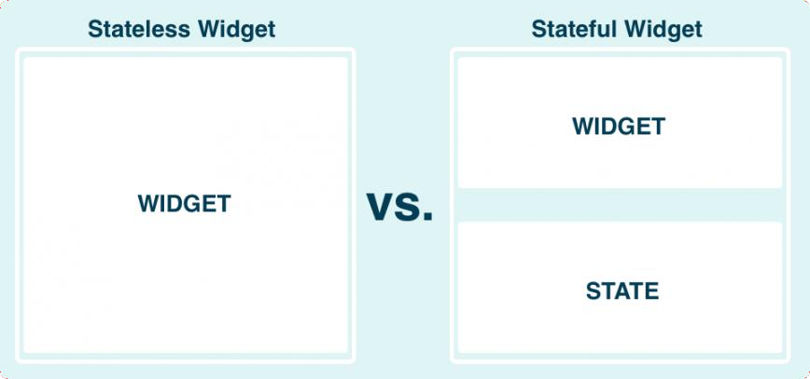
State Management Widgets
In Flutter, there are mainly two types of widget:
  StatelessWidget 2.StatefulWidget

Slide 20
Stateless Widgets
Stateless widgets are widgets that don’t store any state. That is, they don’t store values that might change. For example, an Icon is stateless; you set the icon image when you create it and then it doesn’t change any more.
A Text widget is also stateless. You might say, “But wait, you can change the text value.” True, but if you want to change the text value, you just create a whole new widget with new text. The Text widget doesn’t store a text property that can be changed.
The Stateless Widget does not have any state information. It remains static throughout its lifecycle. The examples of the Stateless Widget are: Text, Row, Column, Container, etc.

Slide 21
Stateful Widgets
Stateful widget: means it can keep track of changes and update the UI based on those changes.
Now you might say, “But we said that widgets are immutable! How can they keep track of
changes?” Yes, the stateful widget itself is immutable, but it creates a State object that keeps
track of the changes. When the values in the State object change, it creates a whole new widget with the updated values. So the lightweight widget (blueprint) gets recreated but the state persists across changes.
A stateful widget is useful for something like a checkbox. When a user clicks it, the check state is updated. Another example is an Image widget. The image asset may not be available when the widget is created (like if it is being downloaded), so a stateless widget isn’t an option. Once the image is available, it can be set by updating the state.

Slide 22
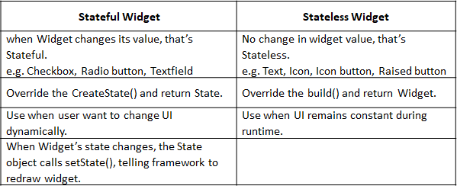
Stateful Vs Stateless

Slide 23
State creation shortcodes
You can create stateless or stateful widgets using short-codes inside main.dart
To create a stateless widget simply write :
stless
To create a stateful widget write :
then hit enter.
stful
You should give a name to your widget

Slide 24

Thank You Questions?

