Slide 1
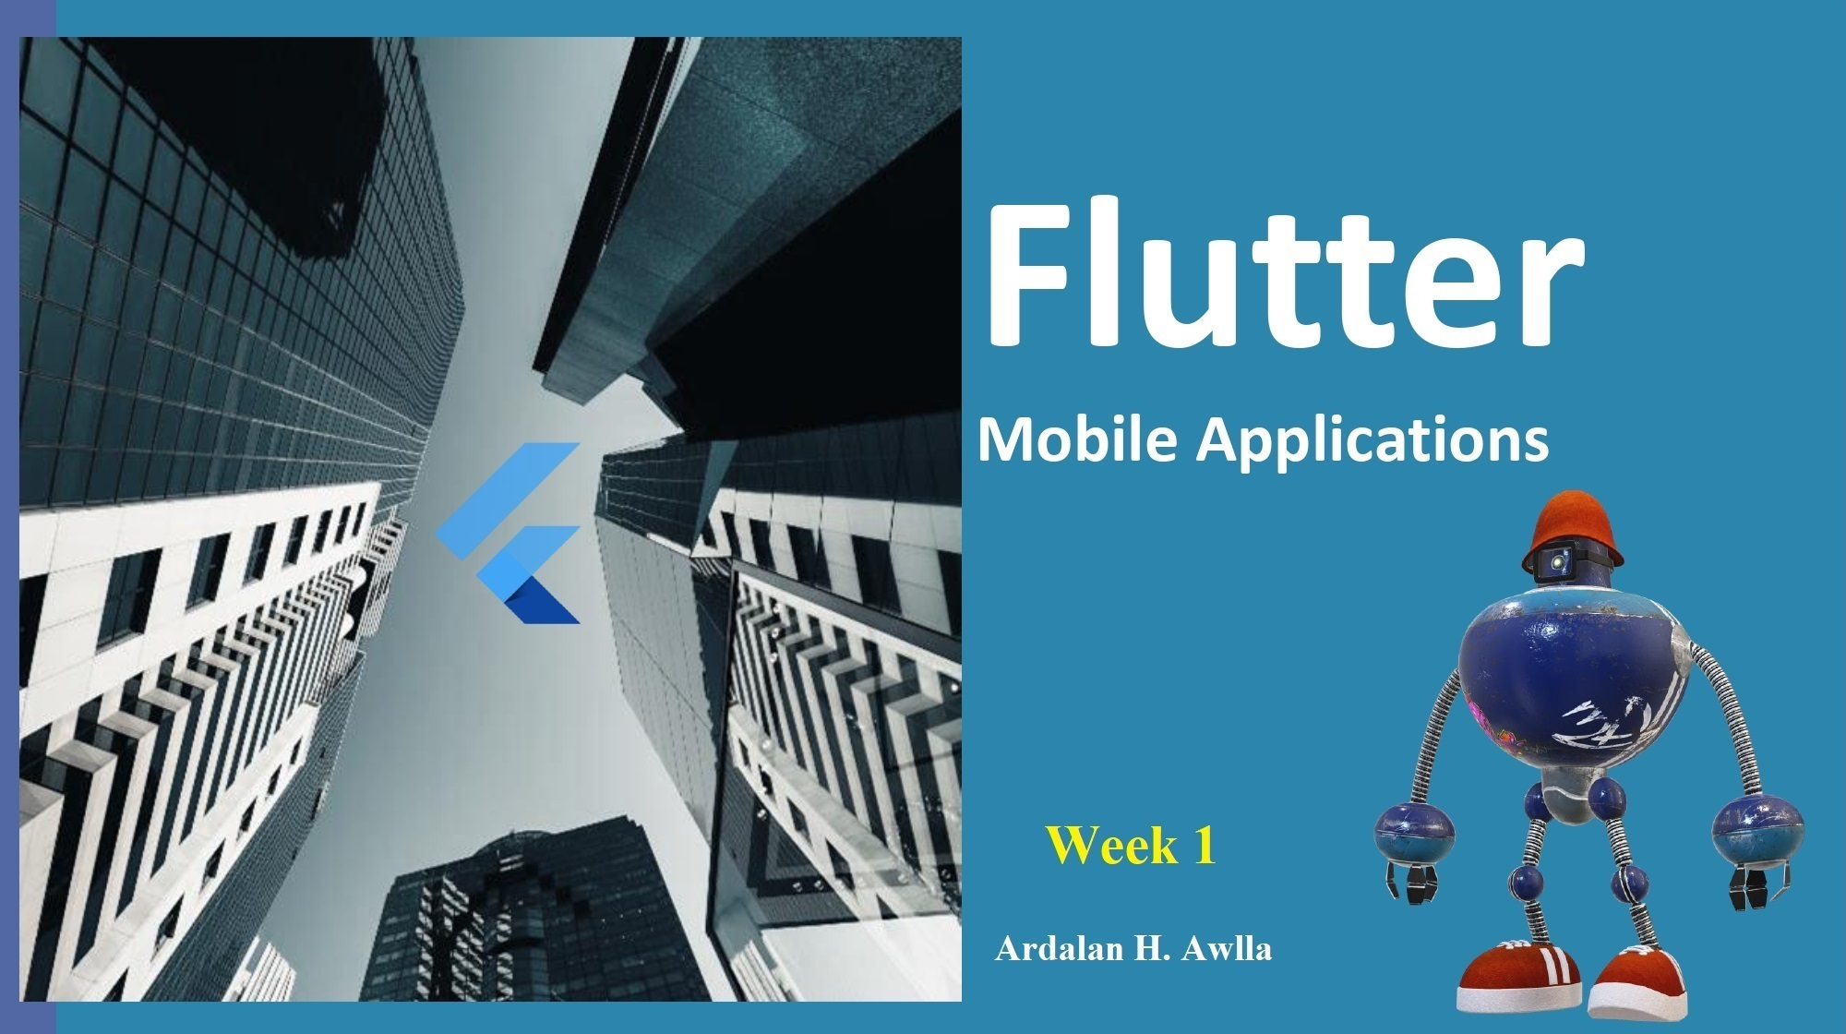


Slide 2
What’s for today?
Flutter Introduction
Dart Language
Importance of Flutter
Why Flutter
DartPad
Coding in Visual Studio

Slide 3
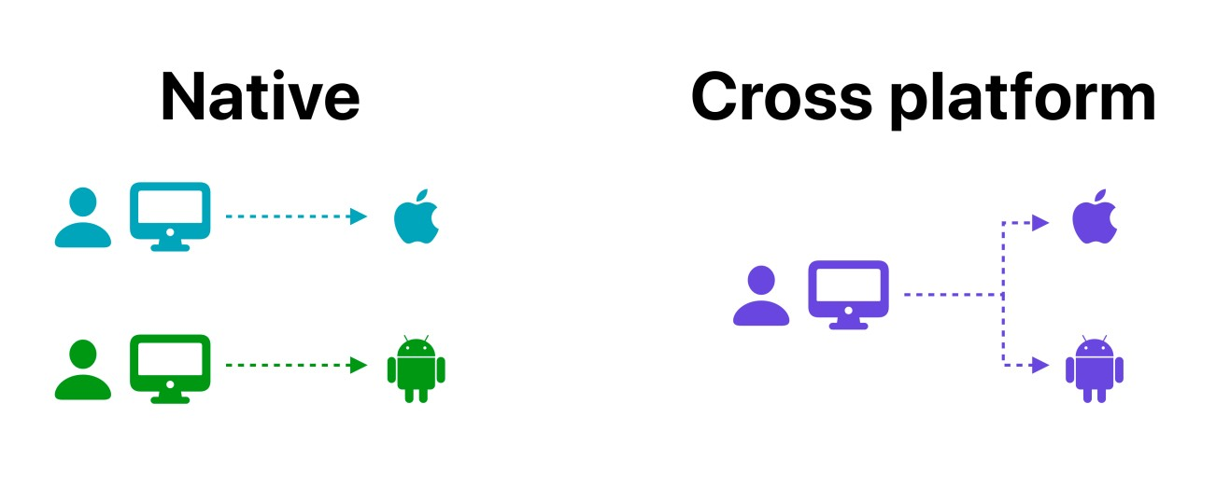
Mobile app Development
In general, developing a mobile application is a complex and challenging task. Android provides a native framework based on Java language and iOS provides a native framework based on Objective-C / Swift language.
to develop an application supporting both the OSs, we need to code in two different languages using two different frameworks. To help overcome this complexity, there exists mobile frameworks supporting both OS. These frameworks range from simple HTML based hybrid mobile application framework. these frameworks always have many disadvantages, one of the main drawback being their slow performance.

Slide 4
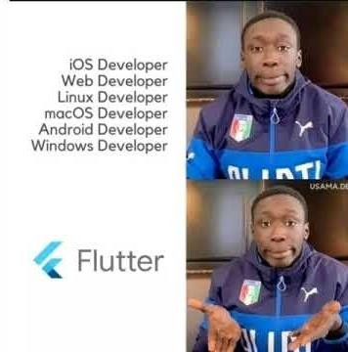
What is Flutter?
Flutter is an open source framework to create high quality, high performance mobile applications across mobile operating systems - Android and iOS. It provides a simple, powerful, efficient and easy to understand SDK to write mobile application in Google’s own language, Dart.
Flutter also offers many ready to use
widgets (UI) to create a modern application. These widgets are optimized for mobile environment and designing the application using widgets is as simple as designing HTML.

Slide 5
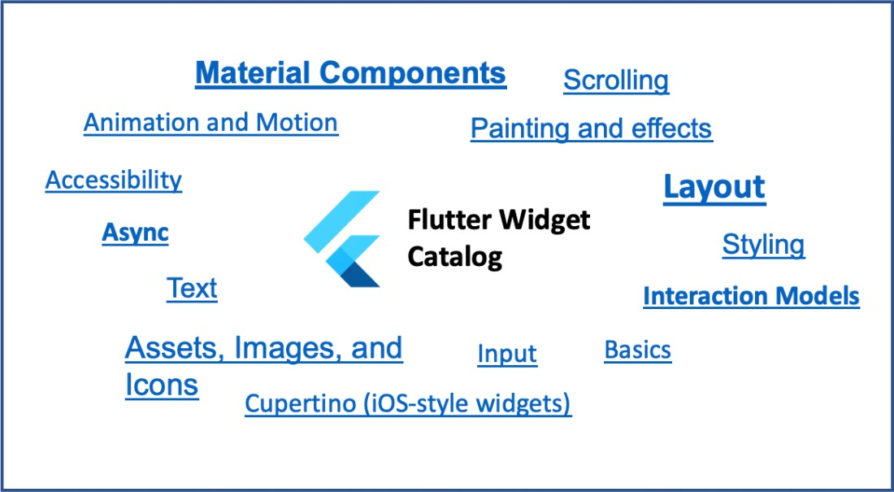
What is Flutter? (2)
Flutter application is itself a widget. Flutter widgets also supports animations and gestures.
The application logic is based on reactive programming.
Widget may optionally have a state. By changing the state of the widget, Flutter will automatically (reactive programming) compare the widget’s state (old and new) and render the widget with only the necessary changes instead of re-rendering the whole widget.

Slide 6

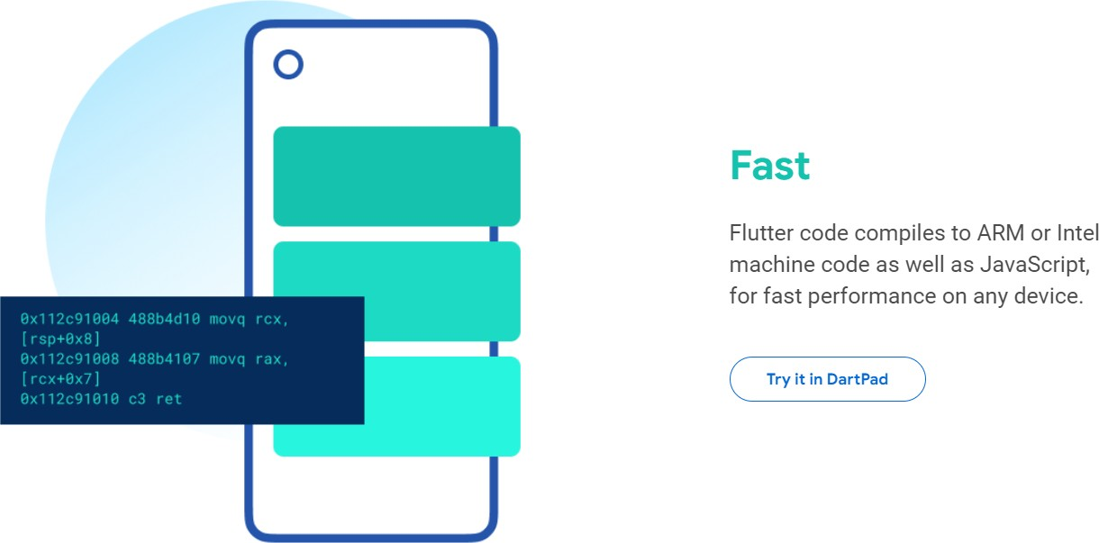

Flutter is Fast
ARM (Advanced RISC Machine): a type of processor architecture commonly used in mobile devices.

Slide 7
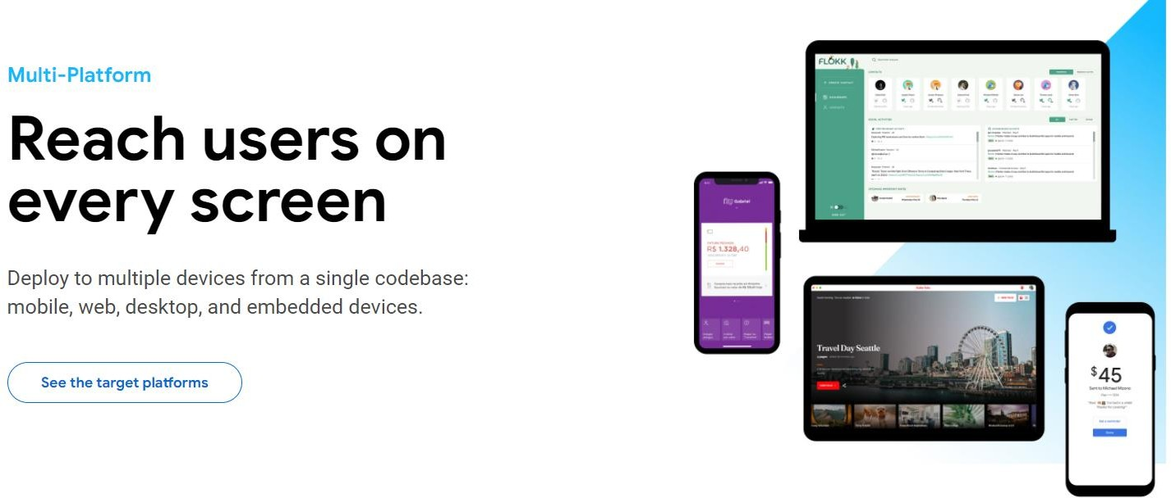

Flutter is reachable by users

Slide 8
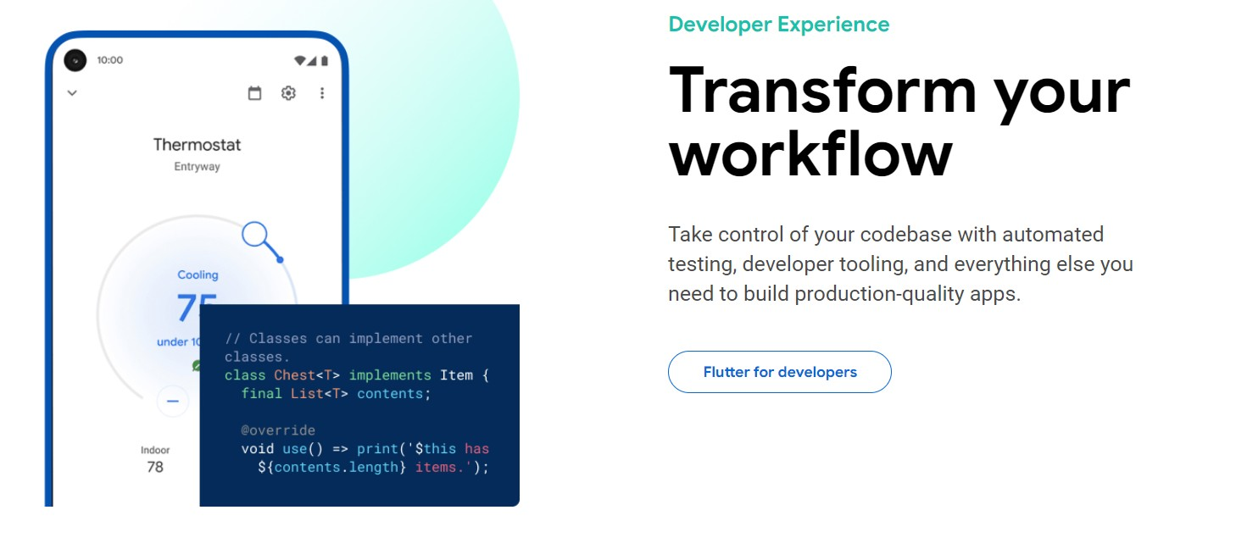

Flutter has many tools

Slide 9
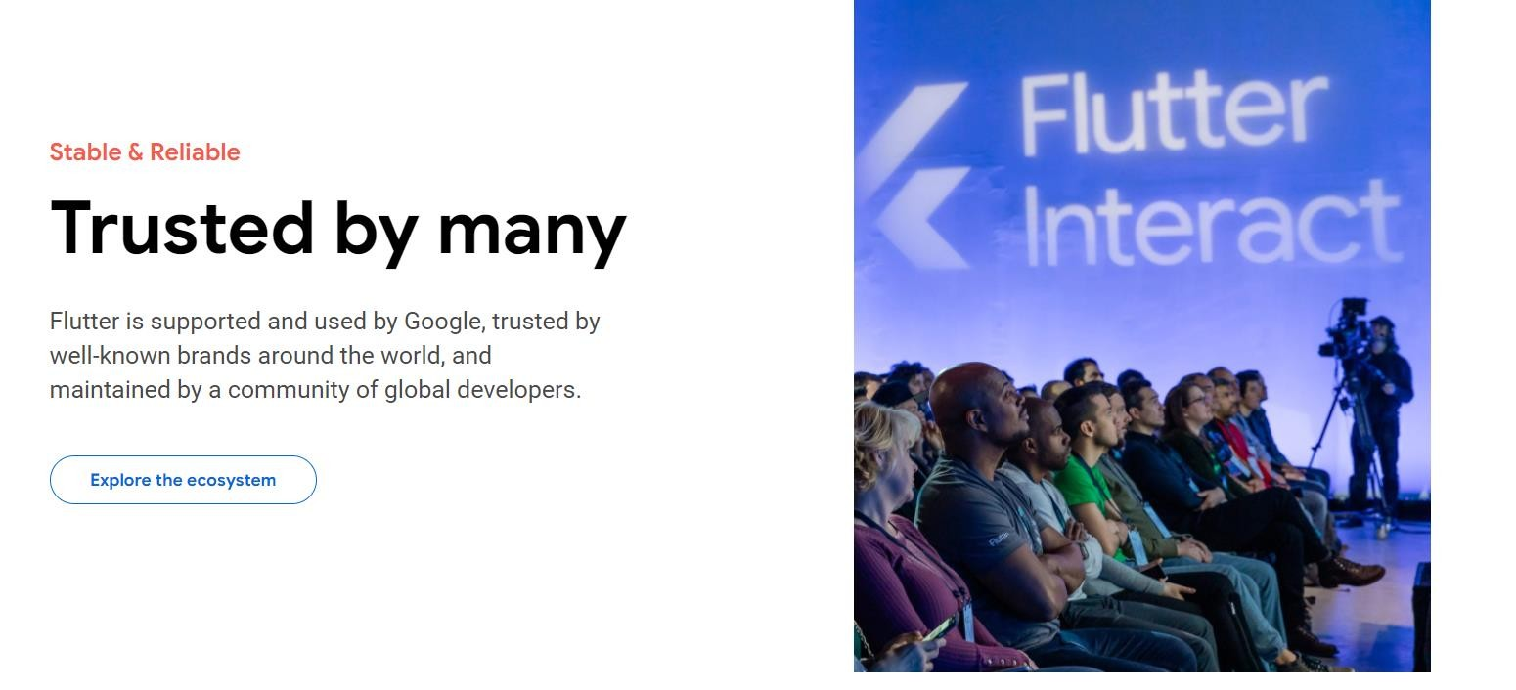

Has Full Support

Slide 10
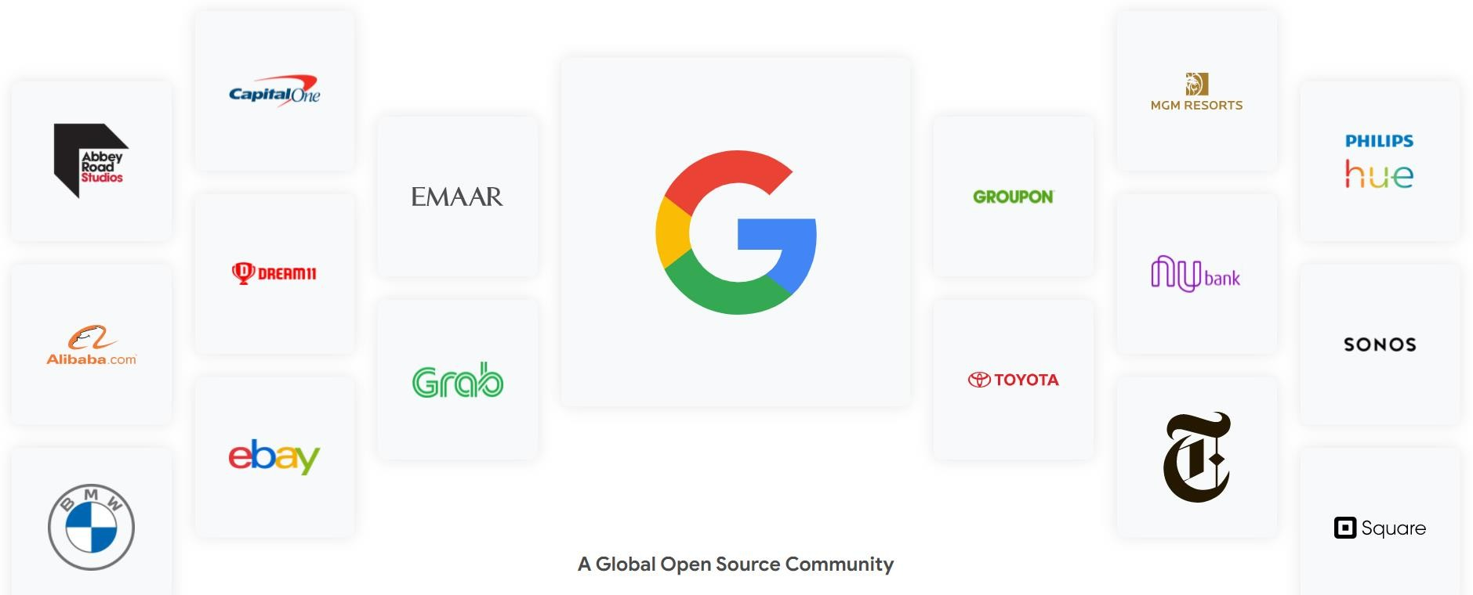
Trusted by many large companies

Slide 11
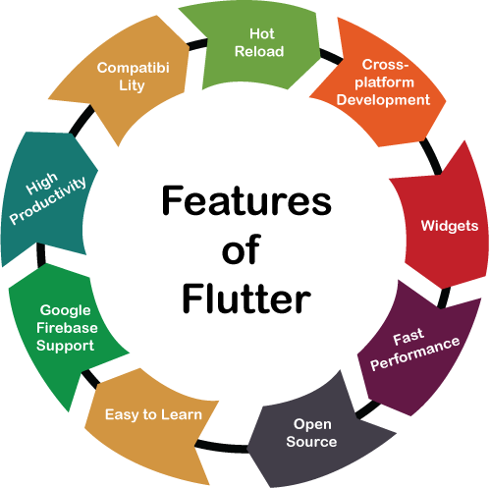
Features of Flutter
Modern and reactive framework.
Uses Dart programming language and it is very easy to learn.
Fast development.
Beautiful and fluid user interfaces.
Huge widget catalog.
Runs same UI for multiple platforms.
High performance application.

Slide 12
Advantages of Flutter
Dart has a large repository of software packages which lets you to extend the capabilities of your application.
Developers need to write just a single code base for both applications (both Android and iOS platforms). Flutter may to be extended to other platform as well in the future.
Flutter needs less testing. Because of its single code base, it is sufficient if we write automated tests once for both the platforms.
Flutter’s simplicity makes it a good candidate for fast development. Its customization capability and extendibility makes it even more powerful.
With Flutter, developers has full control over the widgets and its layout.
Flutter offers great developer tools, with amazing hot reload.

Slide 13
Disadvantages of Flutter
Despite its many advantages, flutter has the following drawbacks in it:
Since it is coded in Dart language, a developer needs to learn new language (though it is easy
to learn).
Modern framework tries to separate logic and UI as much as possible but, in Flutter, user interface and logic is intermixed. We can overcome this using smart coding and using high level module to separate user interface and logic.
Flutter is yet another framework to create mobile application. Developers are having a hard time in choosing the right development tools in hugely populated segment.

Slide 14
Introduction to DART language

Slide 15

Dart!
Dart is an open-source general-purpose programming language. It is originally developed by Google. Dart is an object-oriented language with C-style syntax. It supports programming concepts like interfaces, classes, unlike other programming languages Dart doesn’t support arrays. Dart collections can be used to replicate data structures such as arrays, generics, and optional typing.
The following code shows a simple dart program:

Slide 16

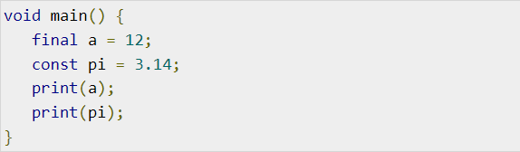
Variables and Data types
Variable is named storage location and Data types simply refers to the type and size of data associated with variables and functions.
Dart uses var keyword to declare the variable. The syntax of var is defined below,
The final and const keyword are used to declare constants. They are defined as below:

Slide 17
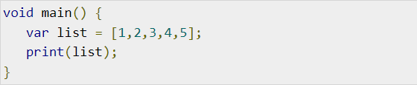
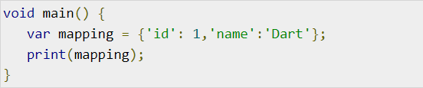
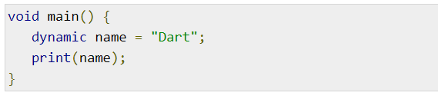
Dart Data types
Dart language supports the following data types −
Numbers − It is used to represent numeric literals – Integer and Double.
Strings − It represents a sequence of characters. String values are specified in either single or
double quotes.
Booleans − Dart uses the bool keyword to represent Boolean values – true and false.
Lists and Maps − It is used to represent a collection of objects. A simple List can be defined as:
Dynamic − If the variable type is not defined, then its default type is dynamic. The following example illustrates the dynamic type variable −

Slide 18
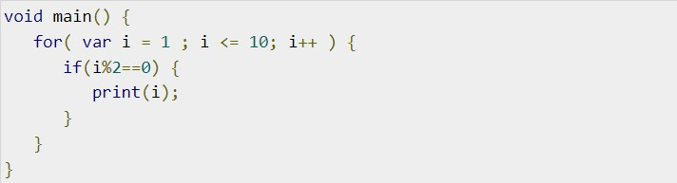
Decision making and Loops
A decision making block evaluates a condition before the instructions are executed. Dart supports If, If..else and switch statements.
Loops are used to repeat a block of code until a specific condition is met. Dart supports for, for..in , while and do..while loops.

Slide 19
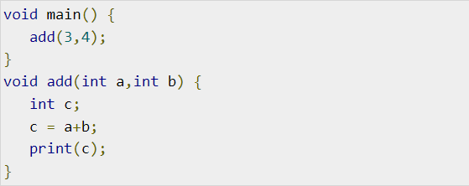
Dart Functions
A function is a group of statements that together performs a specific task. Let us look into a simple function in Dart as shown here −
•

Slide 20
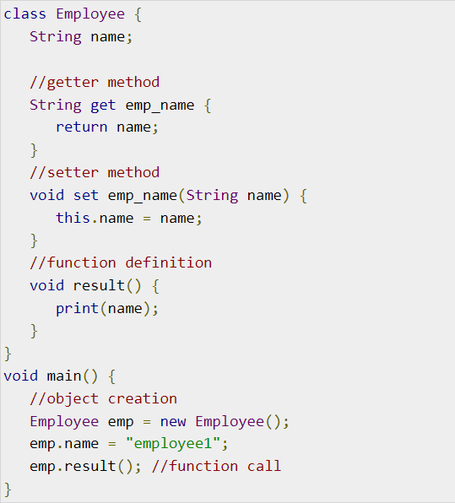
Object Oriented Programming
Dart is an object-oriented language. It supports object-oriented programming features like classes, interfaces, etc.
A class is a blueprint for creating objects. A
class definition includes the following −
Fields
Getters and setters
Constructors
Functions

Slide 21
Flutter Installation
LAB 3

Slide 22


Installation in Windows
Step 1 − Go to URL, https://flutter.dev/docs/get-started/install/windows and download the latest Flutter SDK
Step 2 − Unzip the zip archive in a folder, say C:\flutter\
Step 3 − Update the system path to include flutter bin directory.
Step 4 − Flutter provides a tool, flutter doctor to check that all the requirement of flutter development is met.
Step 5 − You need an Emulator to run the app (android is available on windows)
Step 6 – Install Visual Code on your system.

Slide 23
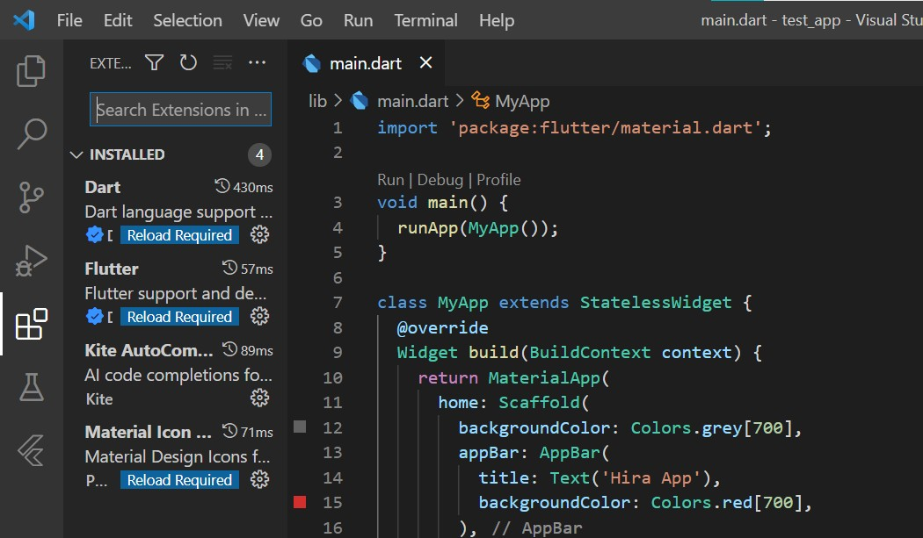
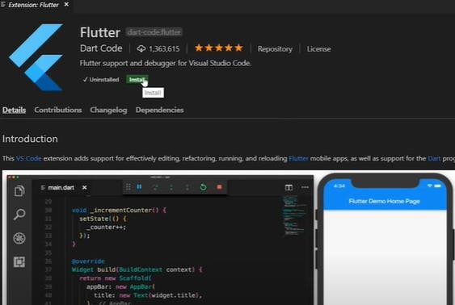
Flutter Extensions
Click on Extensions
Search for Flutter
Install flutter
Search For DART
Install dart
Other Extensions:
Material icon theme
Bracket pair colorizer
Color highlight
pubspec assist

Slide 24
Creating a Flutter project
Step 1 : Create a folder and open it inside visual studio code
Step 2: open a new terminal and type:
flutter create project_name
Step 3: To RUN an app you need to open an emulator
Step 4: Click on run > run without debugging Or Ctrl +f5
It takes some time first, but then you have hot Reloading.

Slide 25
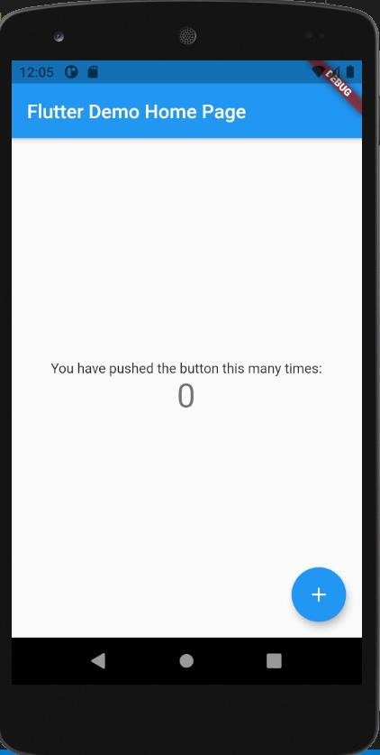
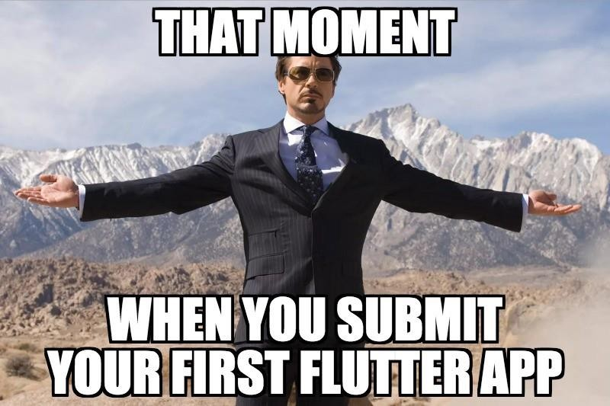
Congrats! Your first flutter app is running

Slide 26


Thank You Questions?

