Slide 1

Cihan University – Sulaimaniya College of Science and Technology
Computer Science Department
Object-Oriented Programming
OOP Concepts (Classes & Object)
1
Asst. Lecturer:
Ardalan H. Awlla
2024 - 2025
1

Slide 2
OUTLINES
What is OOP?
Procedural programming v/s object-oriented programming
Class in C#
Types of class in C#
Object in C#
C# Methods
Parameters and Arguments

Slide 3
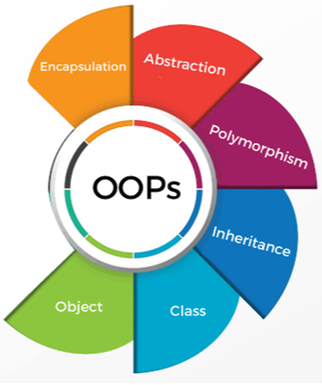
Object-Oriented Programming System (OOPs)
Object-Oriented Programming is a programming paradigm (model) or a style of programming that is centered around objects rather than functions.
It simplifies the software development and maintenance by providing some concepts:
Class
Object
Inheritance
Polymorphism
Abstraction
Encapsulation

Slide 4
Procedural Programming v/s Object-Oriented Programming
Procedural Programming | Object-Oriented Programming
Is a programming model which is based upon the concept of calling procedure. | Is a programming model which is based upon the concept of objects.
program is divided into small parts called functions. | program is divided into small parts called objects
There is no code reusability present because it doesn’t have the concept of inheritance. | It offers code reusability by using the feature of inheritance.
does not have any proper way for hiding data so it is less secure. | provides data hiding so it is more secure.
There is no access modifiers. | It has access modifiers like private, public, protected.
Examples: C, Fortran, Basic etc. | Examples: Java, Python, C# etc.

Slide 5
Class in C#
A class is a template or blueprint from which objects are created.
A class in C# can contain:
Variables
Methods
Constructors
Blocks
class and interface

Slide 6

Class in C# (cont.)
Class and Object in C#
Green
Toyota
Avalon
Red
Ford
Fusion
Blue
Mercedes
McLaren

Slide 7
Class declaration
Declaration of class must start with the keyword class followed by the class name and class members are declared within braces.
Syntax of declaring class:
class Class_Name
{
// variables;
// methods()
}
Note: Class modifiers can be public or default access.

Slide 8
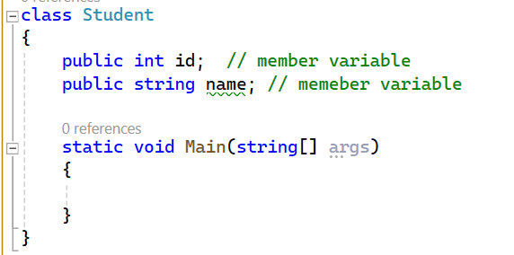
Complete Example of Class in C#
//C# Program to illustrate how to define a class and class or member variables.
0
null
Output:

Slide 9
Types of Classes in C#
Different types of classes in C# are:
public class
private class
nested class
sealed class
abstract class
static class
partial class
predefined classes (like Console.WriteLine()), and etc.

Slide 10
Public Class in C#
When a class is declared with a public, it is called a public class.
A public class is visible and accessible from anywhere.
The instance of the public class can be created from any other class.
public class Test{
static void Main(String [] args){
Console.WriteLine("public class");
}}

Slide 11
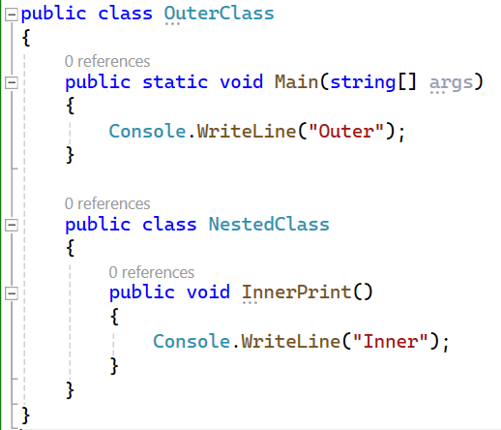
Nested Class in C#
A class declared within another class is called an Nested class.

Slide 12
Private Class in C#
An outer class cannot be declared with a private access modifier but a nested class can be declared as private.
A nested class is a member of the outer class.
By mistake, if you try to use private modifiers with an outer class, you will get a compile-time error: “Modifier private not allowed here“.
private class OuterClass {
class NestedClass {
}
}

Slide 13
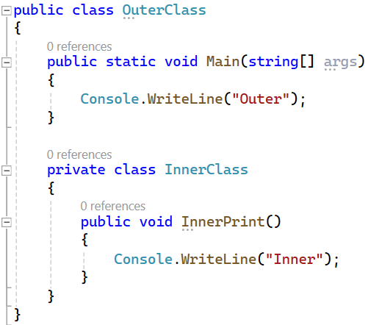
Private Class in C# (cont.)
Example of Private Class

Slide 14
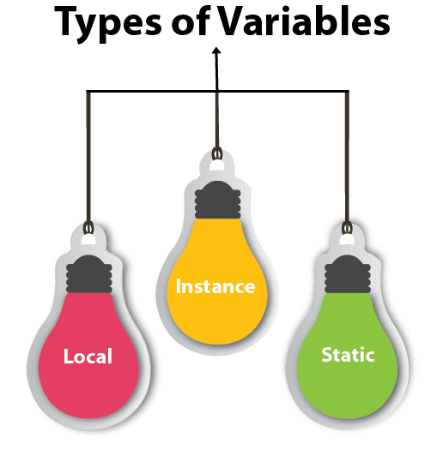
C# Variables
A Variable is a data container that stores the data values during C# program execution.
There are three types of variables in C#: Local, Instance, and Static.
Local Variable: A variable declared inside the body of the method is called local variable.
Instance Variable: A variable declared outside the body of the method is called instance variable.
Static Variable: A variable declared outside the body of the method with the static keyword is called static variable.

Slide 15
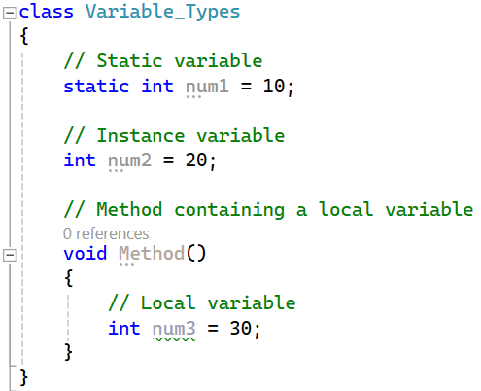
Example to Understand the types of Variables in C#

Slide 16

Object in C#
Object is an Instance of a Class. Each object has an identity, a behavior and a state.
Characteristics of Object:
State: represents the data of an object that is stored in fields (variables).
Behavior: represents the behavior/action of an object such as call, withdraw, etc.
Class
States
Student
Name
Age
Color
Behaviors
Eating()
Walking()
Studying()

Slide 17
Object Creation in C#
In C#, an object of a class is created using the new keyword in three steps. They are as follows.
Declaration of a reference variable. Example: ClassName object_name;
Creation of an object. Example: new ClassName();
Linking the object and the reference variable.
Example: ClassName object_name = new ClassName();

Slide 18
Object Creation in C# (cont.)
Create object from class Student.
Student obj_name = new Student ();
Student →Name of the class
obj_name → Object reference variable which stores the address of the object in the memory
new → keyword that stores the object in the memory.
Student() → Constructor of the class.

Slide 19
Object Creation in C# (cont.)
Creating multiple objects.
Student s1 = new Student ();
Student s2 = new Student ();
Creating the object with passing different parameters to the constructor
Student s = new Student ();
Department d = new Department ("Computer");

Slide 20
Accessing Class Members
Instance variables and methods are accessed via objects.
Syntax for accessing class members:
ObjectName.VariableName // calling variable
ObjectName.MethodName(parameter-list) // calling method
Test ob = new Test();
ob.username = "computer";
ob.set_UserName();

Slide 21
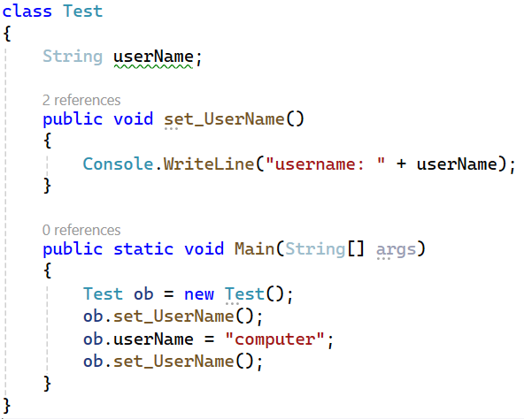
Accessing Class Members (cont.)
username: null
username: computer
Output:

Slide 22
C# Methods
A method is a collection of statements that performs a specific task or operation which only runs when it is called.
Each method can be called any number of times during program execution.
It is widely used because it provides reusability of code means that write once and use it many times. It also provides easy modification.
The most important method in C# is the main() method.
The main() method is the starting point for C# to start the execution of a program.
Without the main() method, C# will not execute the program.
C# Methods
Pre-defined method
User-defined method
Static
method
instance
method

Slide 23
Declaration of Methods
A method must be declared within a class. It is defined with the name of the method, followed by parentheses ().
Syntax of method declaration:
Access_modifier data_type method_name (parameter1, parameter2, …) {
// Body of the method
}
Example: public int sum(int num1, int num2){
// Body of the method ……
}
To execute a method you can invoke or call it from other methods.

Slide 24
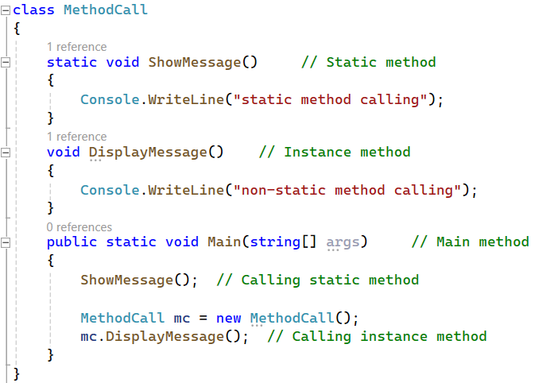
Calling User-Defined Method in C#
Output:
static method calling
non-static method calling

Slide 25
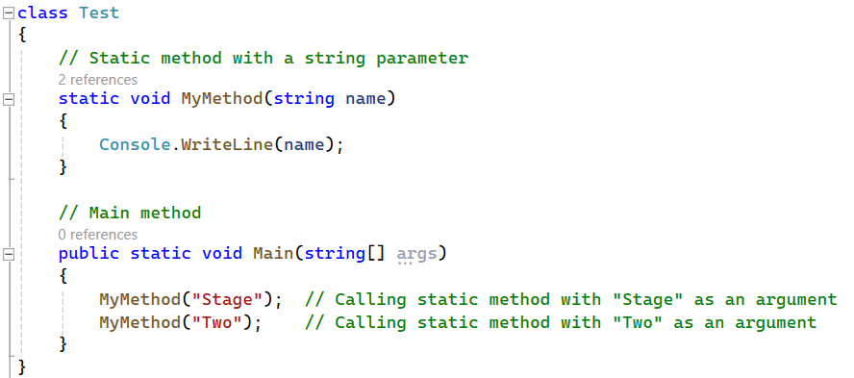
Parameters and Arguments
Parameters act as variables inside a method.
Parameters are specified after a method name, inside the parentheses.
When a value is passed to a method, it is called an argument.
parameter
Output:
Stage
Two
argument

Slide 26
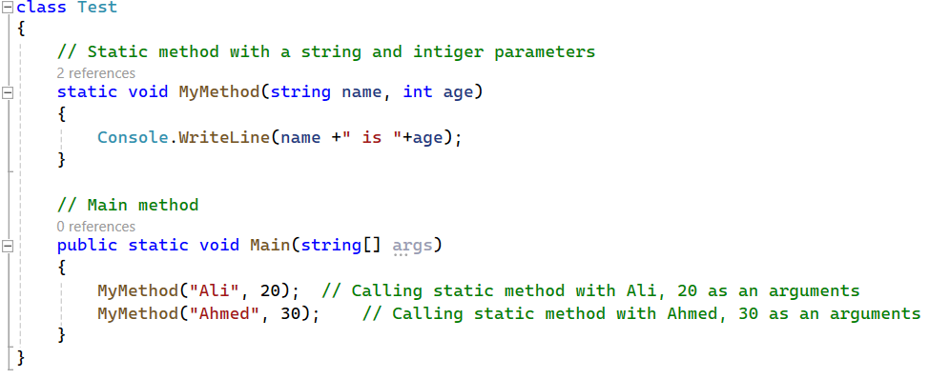
Parameters and Arguments (cont.)
You can add as many parameters as you want, just separate them with a comma.
Output:
Ali is 20
Ahmed is 30
Note: when you are working with multiple parameters, the method call must have the same number of arguments as there are parameters, and the arguments must be passed in the same order.

Slide 27
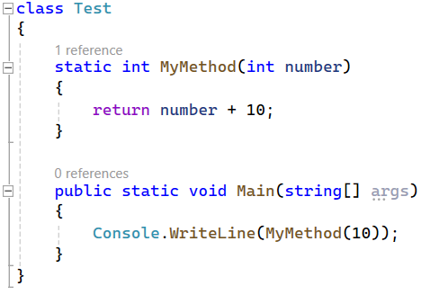
Return Values
When the void keyword is used to declare a method, it means that the method cannot return a value.
If you want the method to return a value, you can use a primitive data type (such as int, char, etc.) instead of void, and use the return keyword inside the method.
Output:
20

Slide 28
Your Turn
Individual Task:
Write down about (OOP, object, class, variable, method).
Give a simple C# Program to illustrate how to define a class, fields (variables), methods, objects, and accessing class members via object.
Note: In your C# code specify each of the required task with comment.

