Slide 1

Cihan University – Sulaimaniya College of Science and Technology
Computer Science Department
Object-Oriented Programming
Overview of C#
Programming Language
0
Asst. Lecturer:
Ardalan H. Awlla
2024 - 2025
1

Slide 2
OUTLINES
What is a Computer Program?
What is C#?
Features of C#
C# Platform
C# Programming Model
C# Application
Variables in C#
C# Data Types
C# Operators
Control Statements in C#
2

Slide 3

What is a Computer Program?
A computer program is a collection of instructions that can be executed by a computer to perform a specific task.
OR
A computer program is a list of instructions that tell a computer what to do.
Some examples of computer programs are Operating System, a web browser, an office suite, etc.
3

Slide 4
What is C#?
C# is a widely used object-oriented programming language that is used for developing applications that can run on multiple platforms, including computers, mobile devices, and servers, when used with the appropriate frameworks like .NET Core or .NET 6+.
Similar to C++, but with advanced and simplified features.
The rules and syntax of C# are based on the C, C++ and Java languages.
Developed by Microsoft(Anders Hejlsberg) in 2000.
4

Slide 5
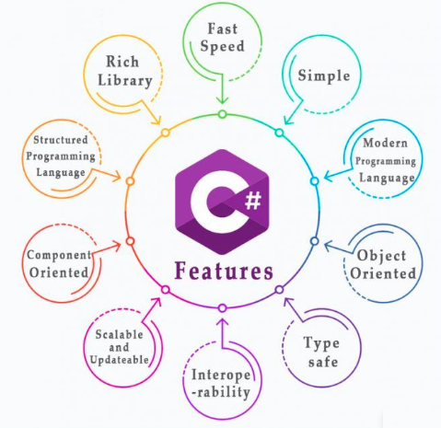
Features of C#
We know that C# is an object-oriented and platform-independent language In addition to these two popular features, there are many other features that we need to know.
5

Slide 6
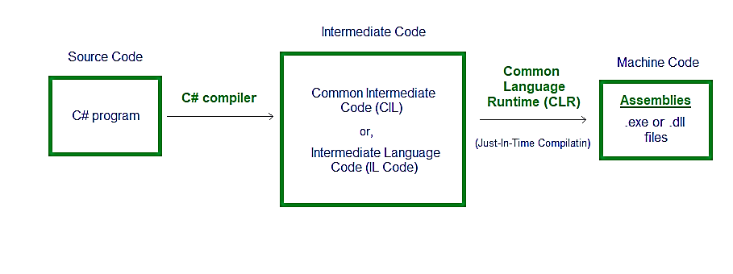
C# Programming Model
When we write a C# program, the source code (in the form of a .cs file) is compiled by the C# compiler and converted into Intermediate Language (IL) code, which is included in an assembly file (usually a .dll or .exe). At runtime, the .NET runtime (CLR) takes the IL code and compiles it into native machine code that can be directly executed by the computer system.
7

Slide 7
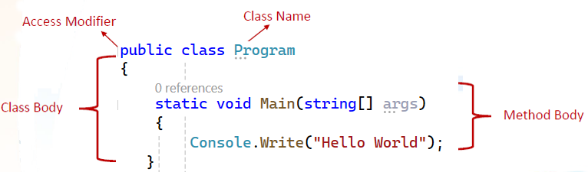
C# Application
To write and run a C# code for an application, we should have a class that normally contain one or more methods.
8

Slide 8
Variables in C#
Variables are containers for storing data values.
Syntax of Declaring (Creating) Variables in C#:
Example:
type variable = value;
int number = 15;
Data type
value
Variable name
9

Slide 9
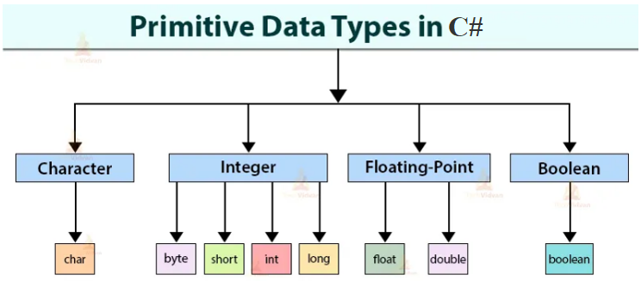
C# Data Types
Data types are divided into two groups:
Primitive data types
Non-primitive data types
10

Slide 10
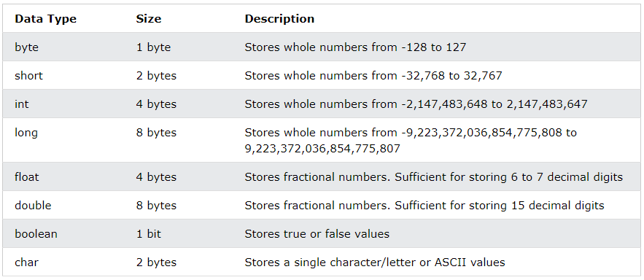
Primitive Data Types
A primitive data type specifies the size and type of variable values.
There are eight primitive data types in C#:
11

Slide 11
Declaring Variables in C#
Example:
byte bnum= 5;
short snum= 1000;
int inum= 100000;
long longNum= 900000L;
float floatNum = 5.99f;
double dnum= 99.9;
char letterA = 'A';
boolean myBool = true;
String myText = "Hello";
We can give values to a variable while creating:
int number= 15;
Console.Write(number);
We can declare a variable without assigning a value, and assign the value later:
int number;
number = 15;
Console.Write(number);
12

Slide 12
Prompting the User for Input
Another way to assign a value to a variable is to prompt the user for input.
In C#, the Console class is used to get user input.
To read user input, you use methods from the Console class. For example:
string input = Console.ReadLine();
13

Slide 13
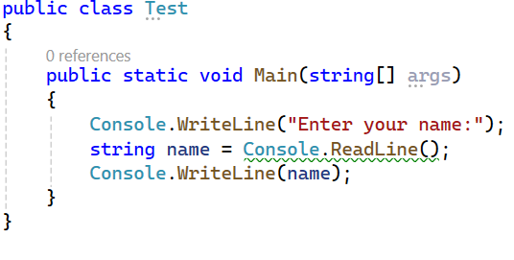
Prompting the User for Input (cont).
14

Slide 14
C# Operators
Operators are special symbols that perform specific operations.
Example of + operator: int sum = 10 + 20;
C# divides the operators into the following groups:
Arithmetic operators
Assignment operators
Comparison operators
Logical operators
15

Slide 15
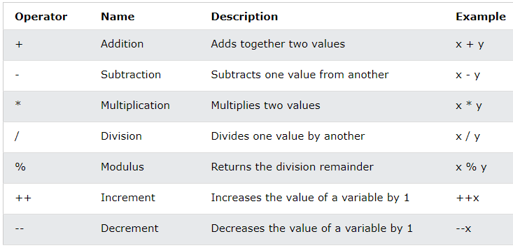
Arithmetic Operators
Arithmetic operators are used to perform common mathematical operations.
16

Slide 16
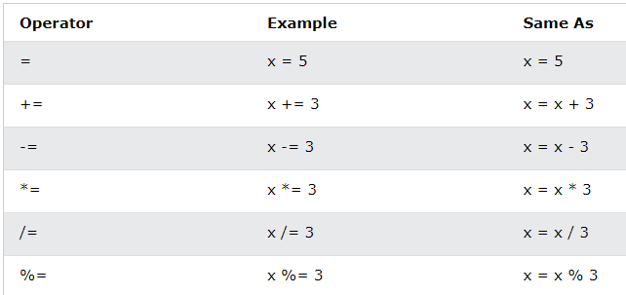
Assignment Operators
A list of assignment operators:
17

Slide 17
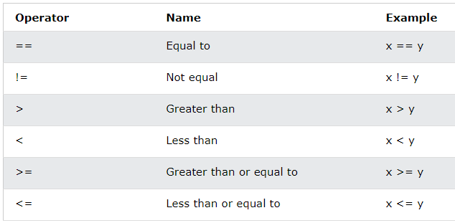
Comparison Operators
Comparison operators are used to compare two values:
18

Slide 18
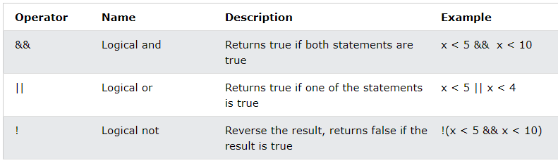
Logical Operators
Logical operators are used to determine the logic between variables or values:
19

Slide 19
Control Statements in Java
Control statements in C# are those statements that provide better control to the programmer on the flow of execution in the program.
CONTROL STATEMENTS
Conditional Statements
Iteration Statements
Jump Statements
if
If-else
nested if
If-else-if
switch
while
do-while
for
For-each
break
continue
return
20

Slide 20
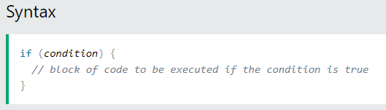
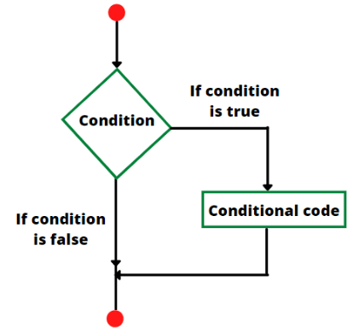
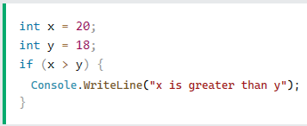
if Statements
Use the if statement to specify a block of C# code to be executed if a condition is true.
Example:
21

Slide 21
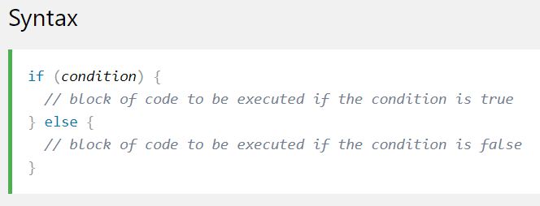
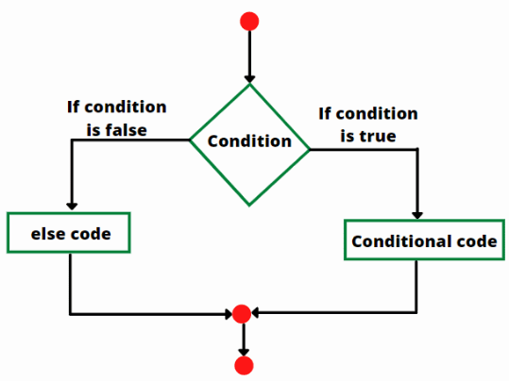
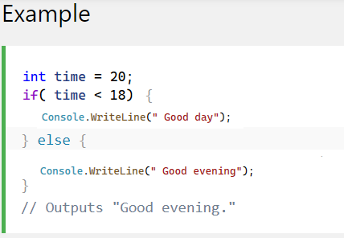
If-else Statements
Use the else statement to specify a block of code to be executed if the condition is false.
22

Slide 22
nested if Statements
If an “if statement” is declared inside another if, or if-else statement, it is called nested if statement.
Syntax
If (condition1){
statement1;
If(condition2){
statement2;
}}
The following example is nested if statement:
If (a>b){
If(b>c){
Console.write("a is greater than b and c"); // statement
}
}
23

Slide 23
If-else-if Statements
if-else-if in is a multi-way decision structure that is used to decide among three or more actions.
Syntax
if(condition)
statement1;
else if(condition)
statement2;
else if(condition)
statement3;
...
else statement;
Example:
if (total_mark>=90)
Console.Write("Grade A");
else if (total_mark>=80)
Console.Write("Grade B");
else if (total_mark>=70)
Console.Write("Grade C");
else
Console.Write("Grade E");
24

Slide 24
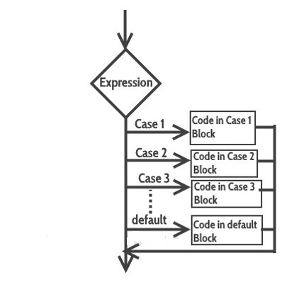
switch case Statements
switch case statement is used when we have number of options (or choices) and we may need to perform a different task for each choice.
Syntax
switch (expression)
{
case value1: statement1;
break;
case value2: statement2;
break;
.
.
case valueN: statementN;
break;
default: statementDefault;
}
int i =1;
switch (i)
{
case 1: Console.Write("case one ");
break;
case 2: Console.Write("case two");
break;
case 3: Console.Write("case three");
break;
default: Console.Write("number");
}
25

Slide 25
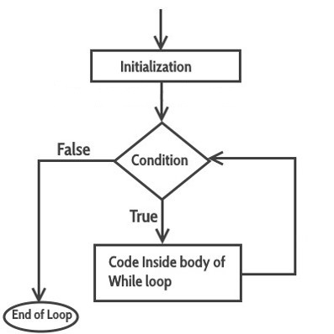
while loop
In while loop, if the specified condition is true, then the body of loop is executed repeatedly until the specified condition becomes false.
Syntax
while (condition)
{
// loop body
statement;
increment/decrement;
}
public class Test {
public static void main(String[] args) {
int sum = 0, i = 1;
while (i <= 3) {
sum = sum + i;
i++;
}
Console.Write("sum is " + sum);
// sum is 6
}}
26

Slide 26
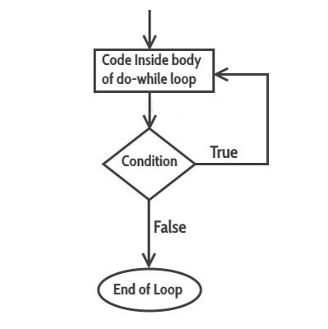
do while loop
A do-while loop is the same as a while loop except that it executes the body of the loop first and then evaluates the loop continuation condition.
Syntax
do {
// loop body
statement;
increment/decrement;
} while (condition)
public class Test {
public static void main(String[] args) {
int sum = 0, i = 1;
do {
sum = sum + i;
i++;
} while (i <= 3);
Console.Write("sum is " + sum);
// sum is 6
}}
27

Slide 27
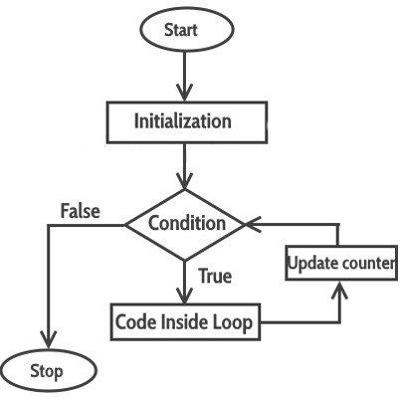
for loop
A for loop executes a block of statements as long as the condition is true.
Syntax
for (initialization; condition ; increment/decrement)
{
statement;
}
Example:
int i;
for (i = 1; i <= 10; i++ ) {
Console.Write(" Hello Java ");
}
28

Slide 28
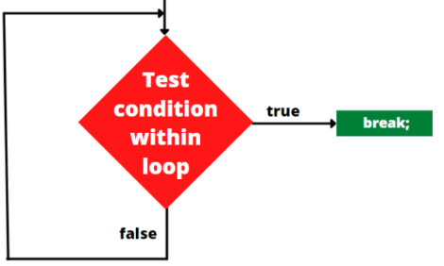
break Statements
A break statement in Java is used to break a loop or switch statement. When a break statement is executed inside a loop or switch statement, the loop is immediately terminated at a specified condition and the program control continues the next statement immediately following the loop.
Syntax
// Jump statement
break;
29

Slide 29
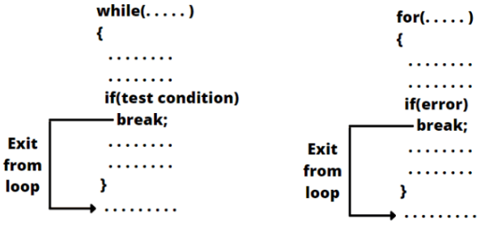
break Statements (cont.)
A break can be used inside the loop to come out of it.
30

Slide 30
break Statements (cont.)
Example program based on break statement.
public class BreakExample1 { Output:
public static void main(String[] args) { num: 1
for(int i = 1; i <= 10; i++) { num: 2
if(i == 5) break; // Breaking a loop. num: 3
Console.Write("num: " +i); num: 4
}
}}
31

Slide 31
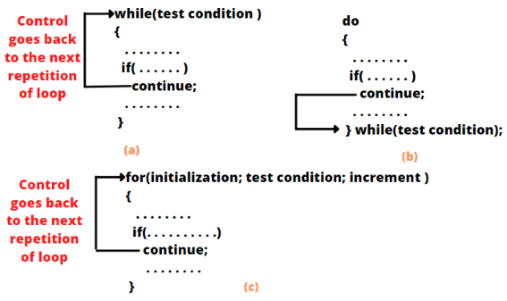
continue Statements
When the continue statement is encountered the control of execution continues with the next repetition of the loop.
Syntax
continue;
32

Slide 32
continue Statements (cont.)
Example program based on continue statement.
public class ContinueUse {
public static void main(String[] args) {
for(int i = 10; i >= 1; i--) {
if(i > 5)
continue; // It will skip the rest statement and go back in the for loop.
System.out.print(i + " ");
}
}}
Output: 5 4 3 2 1
33

Slide 33

34

