Slide 1

Cihan University of Sulaimaniya
Practical Biochemistry
Lecture 3 Identification of Carbohydrates
Benedict’s and Barfoef
Prepared by :
Darya Shorsh Hamad
Mcs. in Clinical Biochemistry
E-mail: darya.shorsh@sulicihan.edu.krd
2024-2025

Slide 2
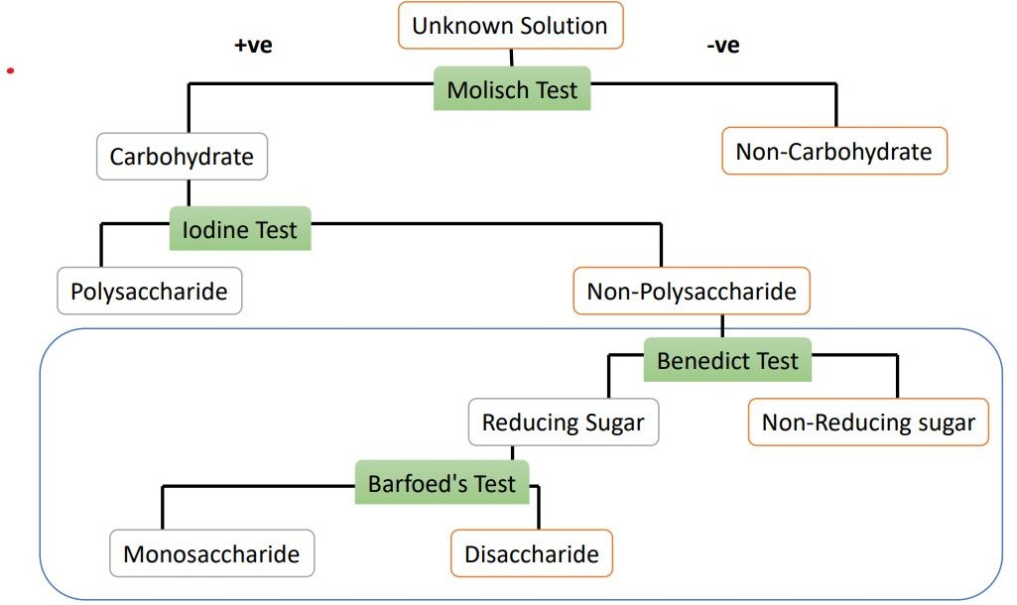
Introduction:

Slide 3
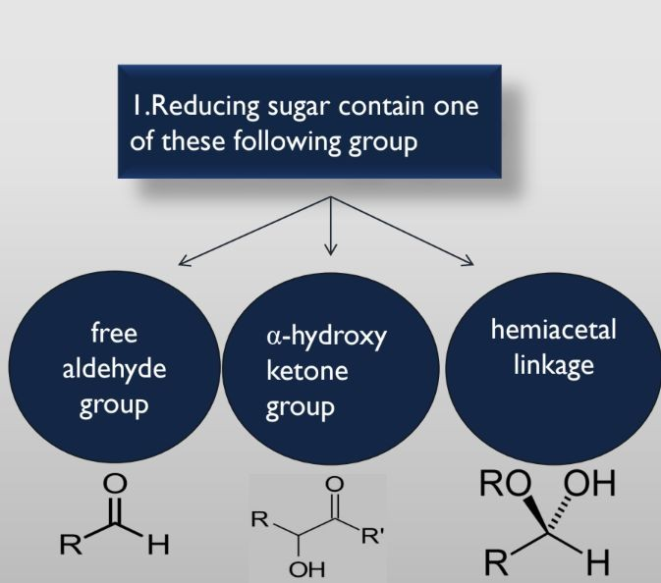
Reducing Suger And Non-Reducing Suger
Reducing sugars have a free aldehyde group or a free ketone group. This means that they can donate electrons to other compounds.
All monosaccharides (e.g., glucose, fructose, galactose)
Some disaccharides (e.g., lactose, maltose)
Some polysaccharides (e.g., starch, glycogen)

Slide 4
Non-reducing sugars do not have a free aldehyde or ketone group. This means that they cannot donate electrons to other compounds, and therefore they do not give a positive result with chemical tests for reducing sugars
Examples of non-reducing sugars: Some disaccharides (e.g., sucrose) Some oligosaccharides (e.g., trehalose) Some polysaccharides (e.g., cellulose)

Slide 5
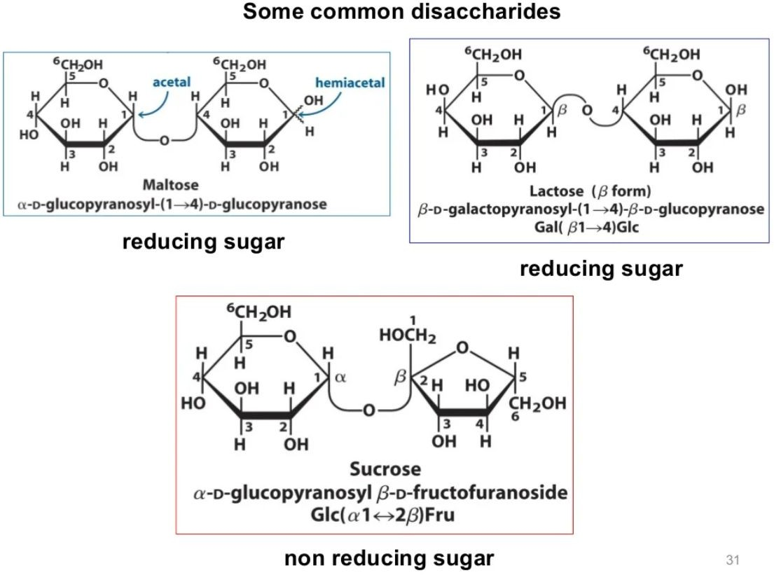

Slide 6
3- Benedict’s Test:
All reducing sugars give positive Benedict's Test
Principle of Benedict’s Test
Benedict’s reagent contains blue copper(II) sulfate (CuSO4).5H2O which is reduced to red copper(I)oxide by reducing sugar.
Reducing sugars have free aldehyde or ketone group ,it under go converting in to enediol forms under hot alkaline condition, The enediol are strong reducing agents converting cupric ions (Cu+2) of the Benedict’s solution into Cuprose ion which altemately oxide as a red precipitate red copper(I) oxide by aldehydes.
The copper oxide is insoluble in water and so precipitates.
The color of the final solution ranges from green to brick red depending on how many of the copper(II) ions are present.

Slide 7
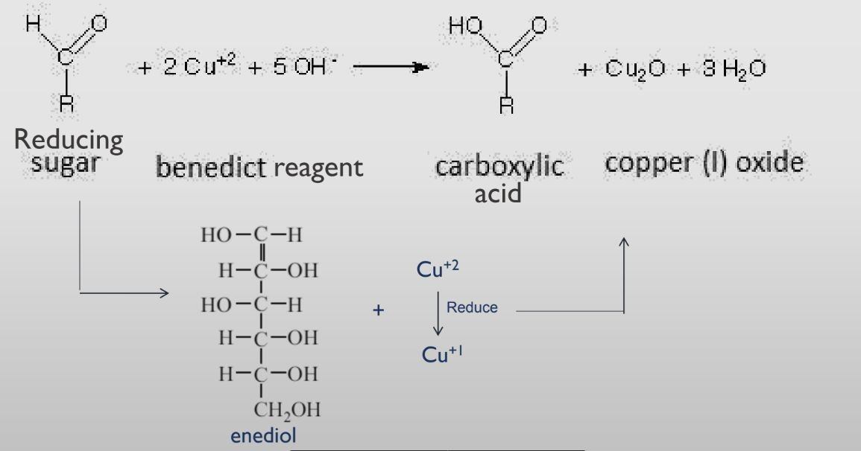
Reaction of Benedict Test

Slide 8
Benedict’s Test
Benedict's qualitative reagent contains:
Copper sulfate: Furnishes cupric ions (Cu2+) in solution.
Sodium carbonate: Provides an alkaline medium.
Sodium citrate: Prevents the precipitation of cupric ions as cupric hydroxide by forming a loosely bound cupric-sodium citrate complex which on dissociation gives a continuous supply of cupric ions.
Benedict's test is a semiquantitative test. This means that it can be used to estimate the amount of reducing sugar in a sample, but it is not as accurate as a quantitative test.
Benedict's test is employed as a routine test for examination of urine for sugar. This is because reducing sugars are not normally present in urine. If reducing sugars are detected in urine, it may be a sign of a medical condition such as diabetes mellitus,

Slide 9
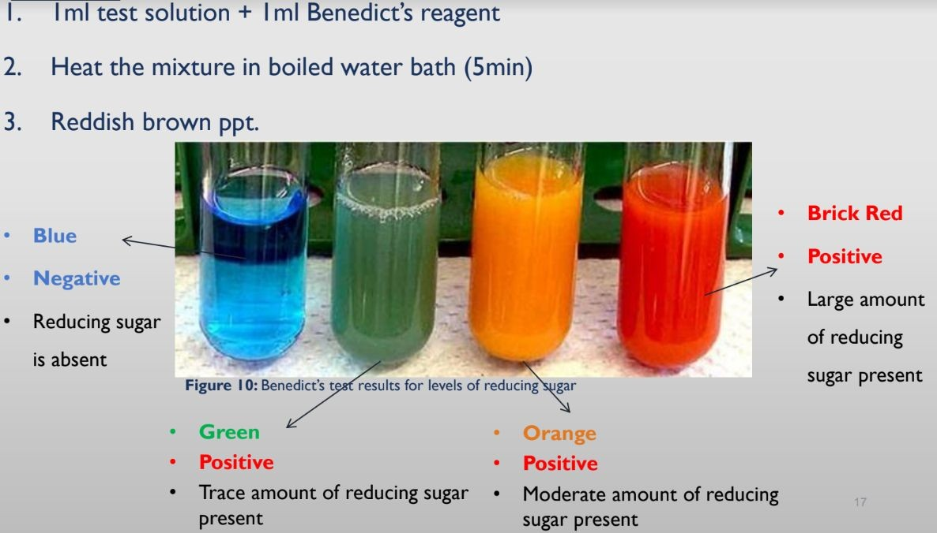
Procedure

Slide 10
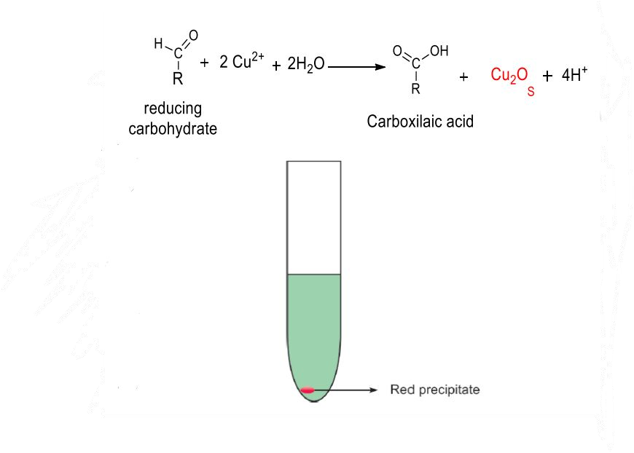
Barfoed’sTest
Barfoed’s test is a chemical test used for detecting the presence of monosaccharides.
Barfoid’s reagent is copper acetate in dilute acetic acid(PH 4.6).
Reducing monosaccharides are oxidized by the copper ions in a weak acidic
medium to form a carboxylic acid and a reddish ppt of Cu2O(cuprous oxide)

Slide 11
Barfoed’sTest
Reducing monosaccharaides are oxidized by the copper ions in a weak acidic medium to form a carboxylic acid and a reddish ppt of Cu2O (cuprous oxide).
•
Reducing disaccharides (such as lactose) undergo the same reaction but at slower rate. Therefore, boiling time is critical and positive test within (2min.) indicate the monosaccharaides.
in case of disaccharides they are first converted into monosaccharide and then colored precipitate are formed. So the prolonged boiling
may hydrolyses disaccharides to give a false positive test.

Slide 12
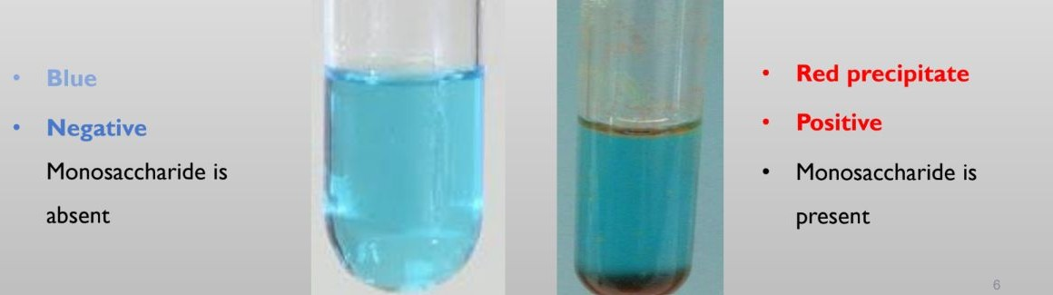
Procedure
Add 3 ml of Barfoed’s reagent into two test tubes separately (name the tubes as tube 1 and Tube 2).
add 2 ml of glucose solution to the tube 1 and sucrose solution to the tube 2.
Boil both tubes for one minute only.
Test tubes are allowed to cool under tap water.
There is reduction and formation of red scum at the bottom and the sides of test tube in monosaccharides.

Slide 13
Difference between Barfoed’s test and Benedict's test
the main difference between Benedict's test and Barfoed's test is the pH of the medium. Benedict's test is performed in an alkaline medium, while Barfoed's test is performed in an acidic medium.
In an alkaline medium, all reducing sugars, including monosaccharides and disaccharides, react with Benedict's reagent to form a colored precipitate. However, in an acidic medium, only monosaccharides react with Barfoed's reagent. This is because monosaccharides can enolize in an acidic medium, but disaccharides cannot.
Enolization is a chemical reaction in which a keto group is converted to an enol group. Enols are more reactive than ketones, so they are more likely to reduce cupric ions.
Therefore, the Barfoed's test can be used to distinguish between monosaccharides and disaccharides. A positive Barfoed's test indicates the presence of a monosaccharide. A negative Barfoed's test indicates the presence of a disaccharide or a non-reducing sugar.

Slide 14
Thank You
Any Questions?

