Slide 1

Cihan University - Sulaimaniya
Clinical Biochemistry
Lab 3
Introduction to Spectrophotometry
Prepared by :
Darya Shorsh Hamad
Mcs. in Clinical Biochemistry
E-mail: darya.shorsh@sulicihan.edu.krd
Academic Year 2024-2025

Slide 2
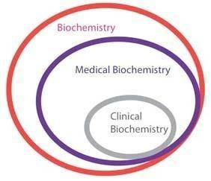
Biochemistry
Medical Biochemistry:
Deals with chemical basis of human body.
Clinical Biochemistry:
Deals with clinical diseases/pathological conditions of human body.

Slide 3
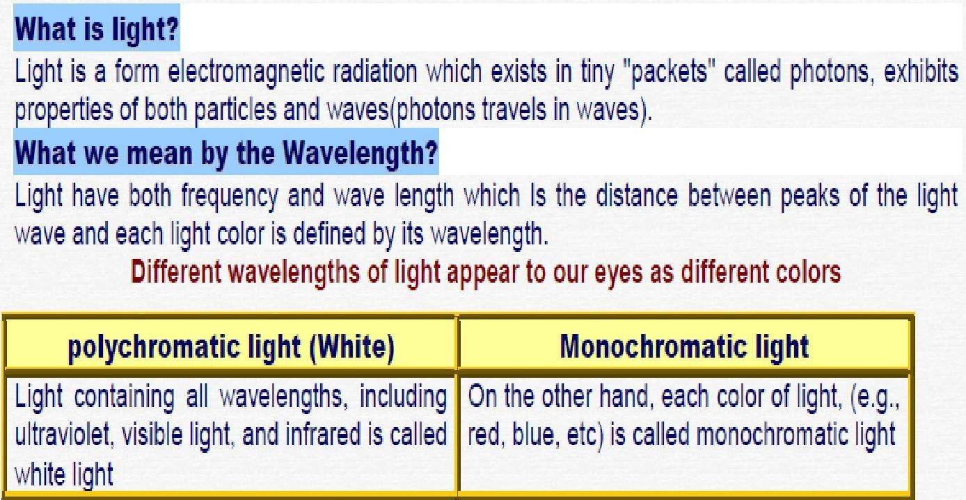
Spectrophotometry

Slide 4
Fundamentals of Spectrophotometry
Photometric measurement
It means the use of light for measurement of the concentration of a
substances in solution
Colorimetry
Also known as Photometry. It is defined as the use of only the visible
portion of light spectrum for measurement of concentration
Spectrophotometry
It is defined as the use of the visible and UV portions of light spectrum
for measurement of concentration
Colorimetry
Instrumental Methods (spectrophotometry)
Non-Instrumental Methods

Slide 5
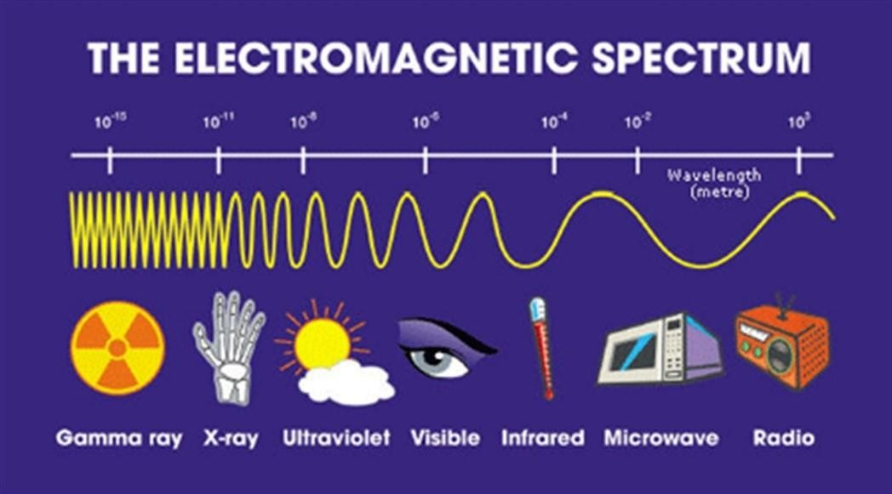
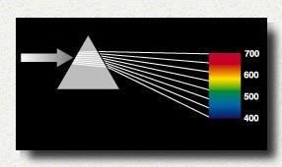
Colorimetry
□Visual Observations :
Because colorimetry is based on inspection of materials
with the human eye, it is necessary to review aspects
of visible light.
□Visible light:
is the narrow range of electromagnetic waves with the
wavelength of 400-700 nm.

Slide 6
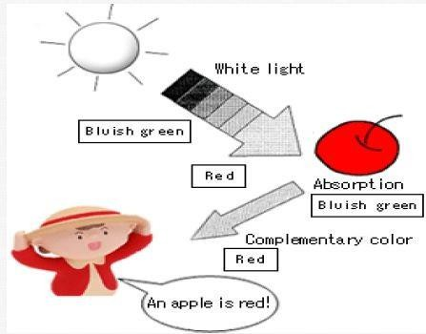
Why an apple looks red to our eye?
When a certain material is exposed to light containing various colors (white light), it takes in and keeps only its favorite colors from this light (a phenomenon called ―absorption of light). Its disliked color (called a ―complementary color) is then reflected, and becomes visible to our eyes as the color of the material.
In other words, an apple prefers blue and green (490-500 nm) and dislikes red (610-750 nm). When it is exposed to white light, it will absorb blue and green, and look like red, which is the complementary color.

Slide 7
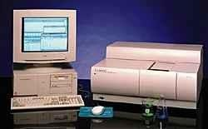
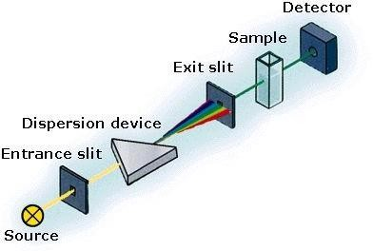
Fundamentals of Spectrophotometry
Spectrophotometer
Basic Design
□An instrument used to make absorbance or transmittance
measurements is known as a spectrophotometer

Slide 8
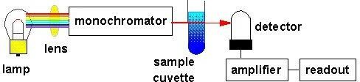
Simple Spectrophotometer Schematic
□The lamp: emits all colors of light (i.e., white light).
□The monochromator: selects one wavelength and that wavelength is sent through the sample.
□The detector: detects the wavelength of light that has passed through the sample.
□The amplifier: increases the signal so that it is easier to read against the background noise.

Slide 9
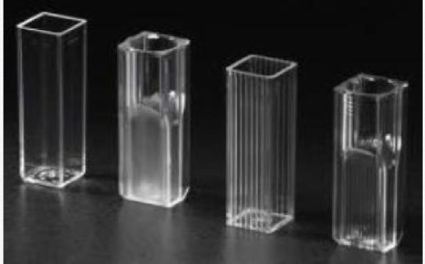
Fundamentals of Spectrophotometry
Absorption cell (cuvets)
A cuvette is a kind of laboratory glassware, usually a small tube of circular or
square cross section, sealed at one end, made of plastic, glass, or optical grade quartz and designed to hold samples for spectroscopic experiments.
Types of Cells
There are three different types of cuvettes commonly used, with different usable
wavelengths:
Glass, with a wavelength from 380 to 780 nm (visible spectrum)
Plastic, with a wavelength from 380 to 780 nm (visible spectrum)
Quartz, with a wavelength below 380 nm (ultraviolet spectrum)

Slide 10
Fundamentals of Spectrophotometry
Precautions
✔ Always clean the cells thoroughly and rinse at least once with a portion
of the sample, before filling the sample for measurement.
✔ Always wipe the exposed surface of the cells dry and free from finger prints, using tissue paper.
✔ Clean cells thoroughly immediately after use.
✔ Do not leave solutions, particularly strong alkali, in the cells for periods
more than an hour.
✔ Never use a brush or any tool for cleaning which may scratch the
optical surfaces.

Slide 11

Absorbance
Absorbance is the measure of the quantity of light that a sample absorb (neither transmits nor reflects) and is proportional to the concentration of a substance in a solution.
The absorbance of a solution depends on:
✔
✔
✔
✔
Nature of substance Concentration of substance Wavelength of light
Path of light
Optical density (OD)
The O.D. is used the same as absorbance and directly proportional to the concentration of the
colored compound.

Slide 12
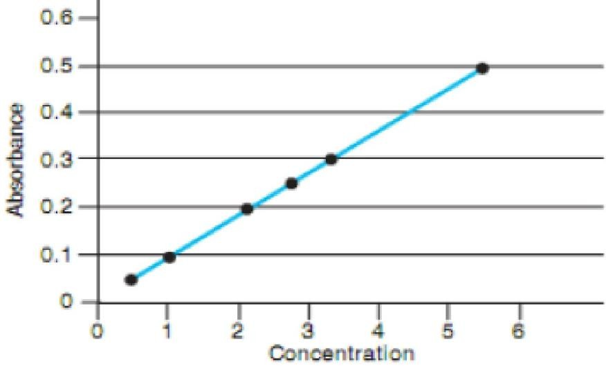
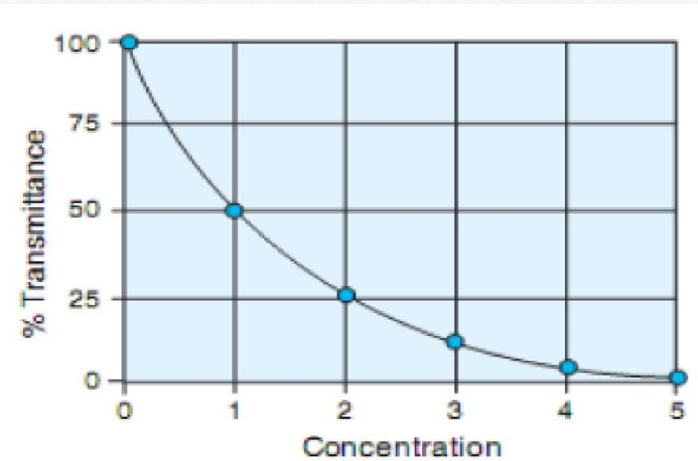
Fundamentals of Spectrophotometry
Transmittance
The transmittance of a sample is the ratio of the intensity of
the light that has passed through the sample to the intensity of the light when it entered the sample and displayed as a percentage (%T).
As Concentration (C) increases, light Transmission (%T)
decreases.

Slide 13
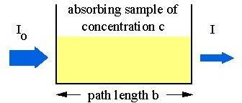

Law of Absorbance
The Lambert Law
It states that the intensity of light transmitted by a colored solution decrease as
the path of light increase
The absorbance of a solute is directly proportional to the path of light

Slide 14

Law of Absorbance
The Beer law
It states that the intensity of light transmitted by a colored solution decrease as
the concentration increase.
The absorbance of a solute is directly proportional to the concentration of a solution.

Slide 15
The Beer-Lambert Law
Also known as Beer's law where the two laws are usually combined together and used in all absorption analysis
A: is the absorbance
C: is the concentration of the compound in solution, expressed in mol/L
b: the path length of the cuvette in which the sample is contained expressed in cm
: :is the molar absorptivity with units of L mol-1 cm-1
✔ The Main use of Beer’s Law is to determine the concentration of various solutions.

Slide 16
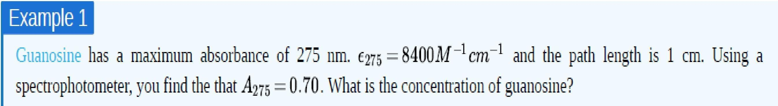
Fundamentals of Spectrophotometry

