Slide 1
International Business Management
second semester
lecture: Blesa Ibrahim Mohammed
2022– 2023
Good luck ☺

Slide 2
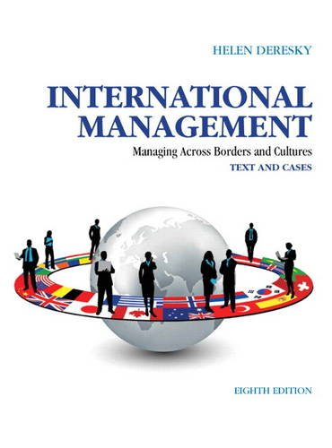
International management
International management involves understanding international economics, leading change in international corporations and creating global business strategies.

Slide 3
What is the role of international management?
Planning, organizing, staffing, directing and controlling are basic functions of management.

Slide 4
What do you mean by international strategy?
International strategy is a business plan or strategy created by a company to do its business in international markets. An international strategy requires analyzing the international market, studying resources, defining goals, understanding market dynamics & develop offerings

Slide 5
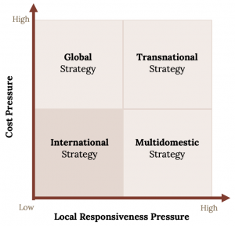
What are the types of international management?
(1)International
(2) multi domestic
(3) global
(3) transnational

Slide 6
Multi-domestic strategy Tark
A multi-domestic strategy is a strategy by which companies try to achieve maximum local responsiveness by customizing both their product offering and marketing strategy to match different national conditions.

Slide 7
Global strategic management Tark
Global strategic management activities enable businesses to capitalize on competitive opportunities worldwide. ... Appreciation of the complexities of national institutions, multiple stakeholders and fluctuating demands, helps managers allocate resources efficiently to sustain and grow their businesses.

Slide 8
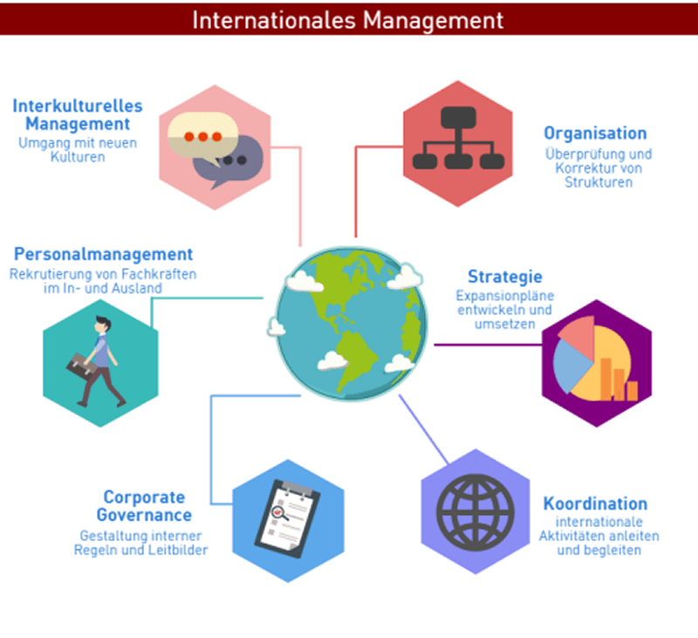
International management tark

Slide 9
transactional strategy tark
A pure transactional strategy and corresponding marketing efforts focus first on converting potential buyers into paying customers and second on maximizing each sale. ... The main objective is increasing sales through product `availability and value-based perceptions.

Slide 10
What is international business management ?
International business refers to the trade of goods, services, technology, capital and/or knowledge across national borders and at a global or transnational scale.
It involves cross-border transactions of goods and services between two or more countries. ... International business is also known as globalization.

Slide 11
What are the benefits of studying International Business Administration ?
Gain an international perspective. ...
Develop key management skills. ...
Boost your employability. ...
Solve commercial challenges. ...
Build your business knowledge.

Slide 12
What are the 3 types of management?
Autocratic
Democratic
Laissez-Faire,

Slide 13
Why is international management important in business? Tark
International management is a critical area for any serious student of management because of globalization, the worldwide phenomenon where by the countries of the world are becoming more interconnected and where trade barriers among nations are disappearing

Slide 14

What is International business ?
international business refers to the trade of goods, services, technology, capital and/or knowledge across national borders and at a global or transnational scale. It involves cross-border transactions of goods and services between two or more countries.

Slide 15
What is the difference between international management and international business?
International business theory is heavily dependent on( economics) whilst international management draws on (business policy) and (strategic management), which themselves derive strength from core concepts in organization behavior, marketing, economics and psychology.

Slide 16
What is Globalization? Tark
Globalization refers to any activity that brings the people, cultures and economies of different countries closer together. In business, "globalization" refers to practices by which organizations become better connected to their customers around the world. This includes any aspect of operating in different national markets, from product design to marketing.
For example: Online marketplaces like eBay, Many large restaurant chains, like McDonald's, Netflix operates in more than 190 countries
The impact of global inter-connectivity has been a boon for the world economy in recent decades and has increased global GDP from $89.6 trillion in 2010 to a projected $149 trillion in 2021

Slide 17
What is Internationalization? Tark
Internationalization is a corporate strategy that involves making products and services as adaptable as possible, so they can easily enter different national markets.
For example: Products intended for use by speakers of multiple languages typically undergo an internationalization process. For example, IKEA internationalizes the assembly instructions for its furniture by using only diagrams and illustrations, without including any text that would need to be translated.

Slide 18
What is Localization?
localization is the process of adapting a product to a specific target market. This usually happens after internationalization has taken place. Where internationalization develops a product that’s easy to adapt for many audiences in many different countries, localization takes that product and makes it highly relevant for one specific market.
For example: Many of the McDonald's restaurants in Israel serve kosher food and drink and close during the Sabbath and Jewish holidays. McDonald's has also opened a meat-free restaurant in India, a country in which much of the population does not eat beef or pork. In both cases, McDonald's has maintained its global brand identity but tailored its products and services for local markets. These cases exemplify localization.

Slide 19
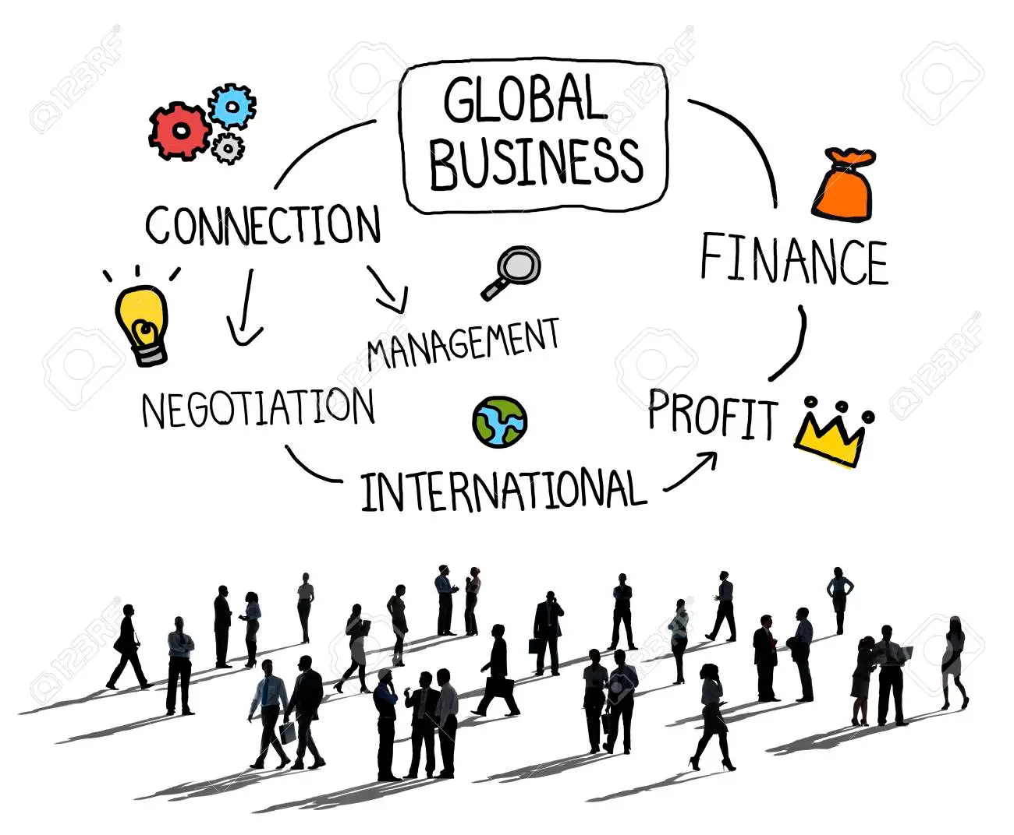
Global business international management

Slide 20
What is international strategic management ?
A management planning process, which determines the strategies and goals, but in an international setting: how to expand abroad or compete internationally. Globalization, and therefore strategic theory evolves from different types of factors: Political. Technological.

Slide 21
What are the factors that affecting international management
Languge ,culture , policies ,economy ,government , labor relations ,marketing research ,financing , control.

Slide 22
What are the four stages of internationalization?
10Direct exportation, indirect exportation (use of agents), foreign presence, and home manufacture and foreign assembly

Slide 23
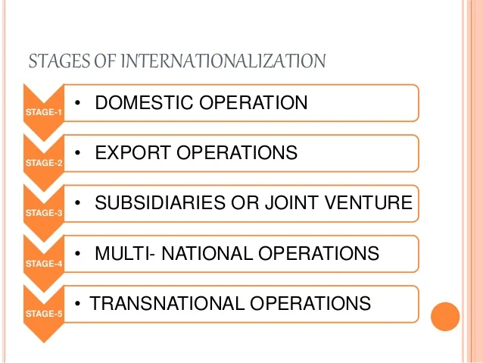
What are the stages of internationalization?

Slide 24
What is global business environment?
The global business environment can be defined. as the environment in different sovereign countries, with factors exogenous to the home environment of. the organization, influencing decision making on. resource use and capabilities.

Slide 25
What is a global business definition?
Global business, also called international business, is the production and sale of goods and services between countries. The term can also encompass the nuances, politics, and dynamics of doing business in a global economy. ... Produce goods in a different country and sell domestically and internationally.

Slide 26

Why is global business environment important?
International business environment has many positive aspects in spite of various issues, such as it contributes new technology, infrastructure development, managerial skills, creating jobs, providing better services, and bringing in investment capital from other countries by exporting products.

Slide 27
How does the global environment affect business?
Raw material availability, supply chain reliability, labor supply, wages, worker expectations, government regulations and consumer demand are all influenced by global factors at work.

Slide 28
What are the different facts of global business environment?
Political risks
Cultural differences
Exchange risks
legal & taxation issues.
Technological environments.

Slide 29
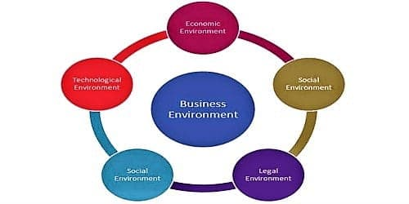
Dimensions of business environment

Slide 30
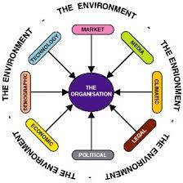
Global Business Environment .

Slide 31
What are the aims of international management ?
Global Expansion: Many organizations engage in international management to expand their operations and reach new markets. This can involve entering new countries or regions to tap into new customer bases and increase market share.
Profit Maximization: International management aims to optimize financial performance by identifying and capitalizing on global business opportunities. This may involve cost optimization, revenue generation, and overall profit maximization.
Risk Management: Operating in multiple countries introduces various risks such as political instability, economic fluctuations, and cultural differences. International management aims to identify, assess, and manage these risks effectively to ensure the sustainability and success of global operations.
Cultural Adaptation: Understanding and adapting to diverse cultures is crucial for successful international management. This involves developing strategies that respect and incorporate cultural nuances, ensuring that products and services align with local preferences and values.
Legal and Regulatory Compliance: Different countries have distinct legal and regulatory frameworks. International management aims to ensure compliance with various laws and regulations in each operating country to avoid legal issues and maintain a positive corporate image.

Slide 32
6. Supply Chain Optimization: International businesses often have complex supply chains that span multiple countries. The goal of international management is to optimize the supply chain for efficiency, cost-effectiveness, and responsiveness to changing market conditions.
6. Talent Management: Managing a global workforce requires addressing challenges related to diverse talents, skills, and work cultures. International management aims to attract, develop, and retain a skilled and culturally diverse workforce to meet organizational goals.
7. Corporate Social Responsibility (CSR): International businesses are increasingly expected to engage in socially responsible practices. International management aims to incorporate CSR principles into global operations, addressing environmental and social concerns and enhancing the organization's reputation.
8. Technology Integration: Leveraging technology is essential for global business success. International management aims to integrate and adapt technological solutions that facilitate communication, collaboration, and operational efficiency across borders.

