Slide 1
Total Quality Management

Slide 2
Total Quality Management (TQM)
Book Name: Total Quality Management (2nd Edition)
Author: Joel E. Ross
Chapter Chapter Heading
1 Introduction to Total Quality Management
2 Leadership for TQM
3 Information Analysis and Information Technology
4 Strategic Quality Planning
5 Human Resource Development and Management
6 Management of Processing Quality
7 Customer Focus and Satisfaction
8 Benchmarking
9 Organization for TQM; Structure and Teams
10 Productivity, Quality, and Reengineering
11 The Cost of Quality
12 ISO 9000: Universal Standards of Quality

Slide 3
Distribution of Internal Sessional Evaluation
Area of marks | Maximum Marks
Assignments/Projects (Minimum 2 Assignments) | 5
Quizzes (Minimum 2 quizzes) | 3
Attendance | 1
Class Participation (Punctuality and Case Studies) | 1

Slide 4
Total Quality Management (TQM)
CHAPTER 1
Introduction to Total Quality Management

Slide 5
Why Quality?
Reasons for quality becoming a cardinal priority for most organizations:
Competition – Today’s market demand high quality products at low cost. Having `high quality’ reputation is not enough! Internal cost of maintaining the reputation should be less.
Changing customer – The new customer is not only commanding priority based on volume but is more demanding about the “quality system.”
Changing product mix – The shift from low volume, high price to high volume, low price have resulted in a need to reduce the internal cost of poor quality.

Slide 6
Why Quality?
Product complexity – As systems have become more complex, the reliability requirements for suppliers of components have become more stringent.
Higher levels of customer satisfaction – Higher customers expectations are getting spawned by increasing competition.
Relatively simpler approaches to quality viz. product inspection for quality control and incorporation of internal cost of poor quality into the selling price, might not work for today’s complex market environment.

Slide 7
What is a customer?
Anyone who is impacted by the product or process delivered by an organization.
External customer: The end user as well as intermediate processors. Other external customers may not be purchasers but may have some connection with the product.
Internal customer: Other divisions of the company that receive the processed product.
What is a product?
The output of the process carried out by the organization. It may be goods (e.g. automobiles, missile), software (e.g. a computer code, a report) or service (e.g. banking, insurance)

Slide 8
How is customer satisfaction achieved?
Two dimensions: Product features and Freedom from deficiencies.
Product features – Refers to quality of design.
Examples in manufacturing industry: Performance, Reliability, Durability, Ease of use, Esthetics etc.
Examples in service industry: Accuracy, Timeliness, Friendliness and courtesy, Knowledge of server etc.
Freedom from deficiencies – Refers to quality of conformance.
Higher conformance means fewer complaints and increased customer satisfaction.

Slide 9
introduction to Total Quality Management"
Total Quality Management
TQM
Total – Made up of the whole(or) Complete.
Quality – Degree of Excellence a product or service provides to the customer in present and future.
Management – Act , art, or manner of handling , controlling, directing, etc.
TQM is the art of managing the whole to achieve excellence.
Total Quality Management

Slide 10
Therefore , TQM is the art of Managing the whole to achieve excellence .

Slide 11
What Does TQM mean ?
Total Quality Management
Means that the organizations culture is defined by and supports the constant attainment of customer satisfaction through an integrated system of tools ,and training.
This involves the continuous improvement of organizational processes , resulting in high Quality products and services .

Slide 12
quality What is quality?
Dictionary has many definitions: “Essential characteristic,” “Superior,” etc.
“ Quality is the totality of features and characteristics of a product or service that bears on its ability to satisfy given needs.”

Slide 13
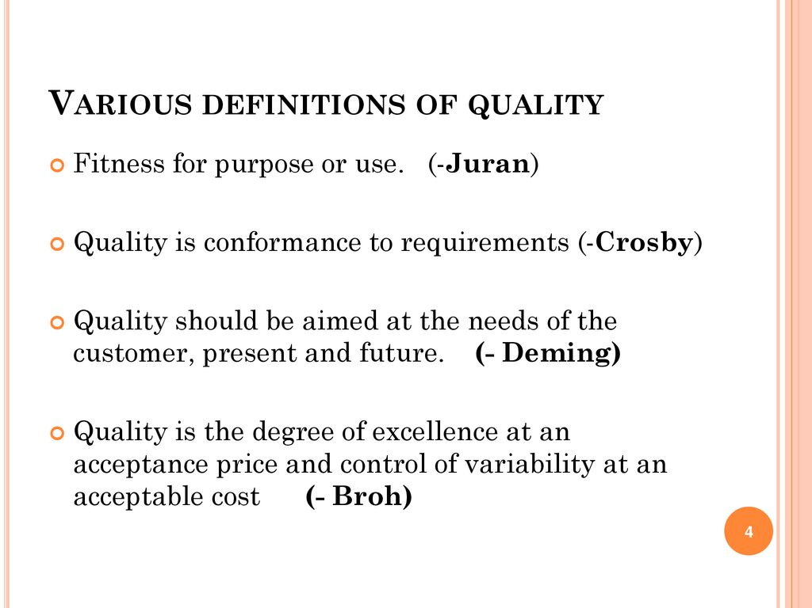

Slide 14
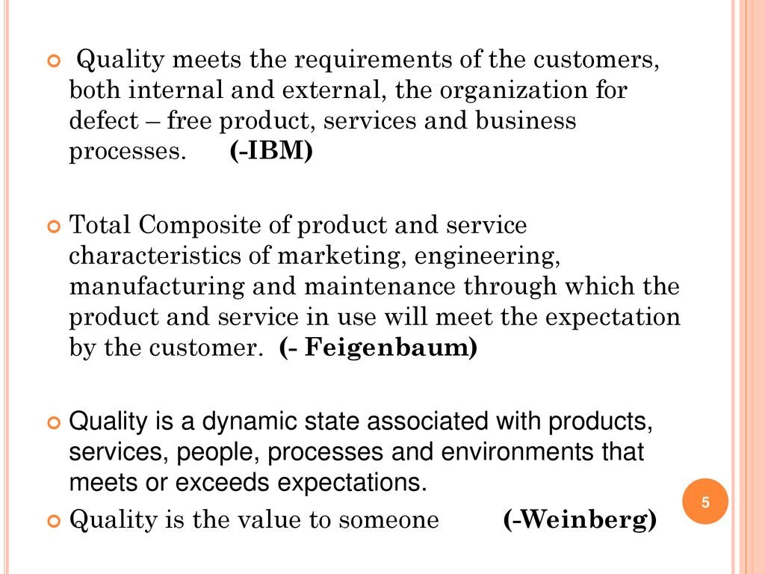

Slide 16
The 9 Dimensions of Quality
Performance
Features
Conformance
Reliability
Durability
Service
Response- of Dealer/ to Customer
Aesthetics – of product
Reputation- of /Dealer

Slide 17
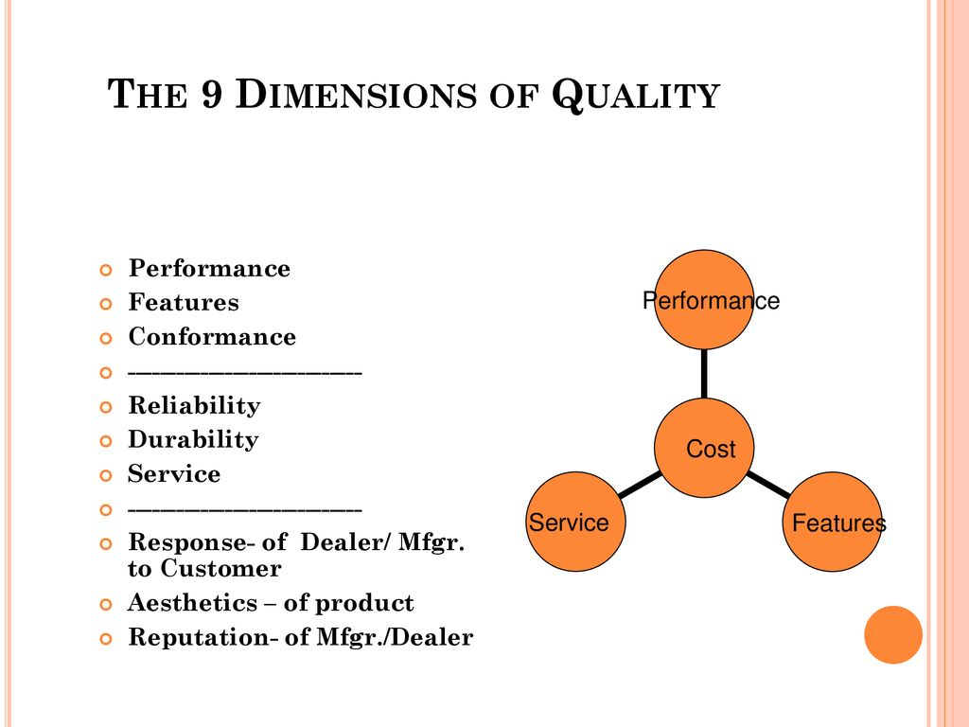

Slide 18
Dimensions of Quality
Performance - main characteristics of the product/service
Aesthetics - appearance, feel, smell, taste
Special features - extra characteristics
Conformance - how well product/service conforms to customer’s expectations
Safety - Risk of injury
Reliability - consistency of performance

Slide 19
Dimensions of Quality (Cont’d)
Durability - useful life of the product/service
Perceived Quality - indirect evaluation of quality (e.g. reputation)
Service after sale - handling of customer complaints or checking on customer satisfaction

Slide 20
Examples of Quality Dimensions

Slide 21
Examples of Quality Dimensions (Cont’d)

Slide 22
Quality perspectives
Everyone defines Quality based on their own perspective of it. Typical responses about the definition of quality would include:
Perfection
Consistency
Eliminating waste
Speed of delivery
Compliance with policies and procedures
Doing it right the first time
Delighting or pleasing customers
Total customer satisfaction and service

Slide 23
Quality perspectives
Judgmental perspective
“goodness of a product.”
Shewhart’s transcendental definition of quality – “absolute and universally recognizable, a mark of uncompromising standards and high achievement.”
Examples of products attributing to this image: Rolex watches, Lexus cars.
Product-based perspective
“function of a specific, measurable variable and that differences in quality reflect differences in quantity of some product attributes.”
Example: Quality and price perceived relationship.

Slide 24
Quality perspectives
User-based perspective
“fitness for intended use.”
Individuals have different needs and wants, and hence different quality standards.
Example – Nissan offering ‘dud’ models in US markets under the brand name Datson which the US customer didn’t prefer.
Value-based perspective
“quality product is the one that is as useful as competing products and is sold at a lesser price.”
US auto market – Incentives offered by the Big Three are perceived to be compensation for lower quality.

Slide 25
Quality perspectives
Manufacturing-based perspective
“the desirable outcome of a engineering and manufacturing practice, or conformance to specification.”
Engineering specifications are the key!
Example: Coca-cola – “quality is about manufacturing a product that people can depend on every time they reach for it.”

Slide 26
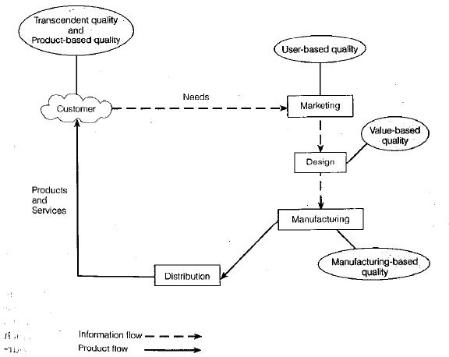
Quality perspectives

Slide 27
Quality levels
At organizational level, we need to ask following questions:
Which products and services meet your expectations?
Which products and services you need that you are not currently receiving?
At process level, we need to ask:
What products and services are most important to the external customer?
What processes produce those products and services?
What are the key inputs to those processes?
Which processes have most significant effects on the organization’s performance standards?

Slide 28
Quality levels
At the individual job level, we should ask:
What is required by the customer?
How can the requirements be measured?
What is the specific standard for each measure?

Slide 29
Service Quality
Tangibles
Convenience
Reliability
Responsiveness
Time
Assurance
Courtesy

Slide 30
Examples of Service Quality
Dimension | Examples
1. Tangibles | Were the facilities clean, personnel neat?
2. Convenience | Was the service center conveniently located?
3. Reliability | Was the problem fixed?
4. Responsiveness | Were customer service personnel willing and able to answer questions?
5. Time | How long did the customer wait?
6. Assurance | Did the customer service personnel seem knowledgeable about the repair?
7. Courtesy | Were customer service personnel and the cashier friendly and courteous?

Slide 31
Determinants of Quality
Ease of
use
Design
Conforms to design
Service

Slide 32
Determinants of Quality
1. Design, planned quality
Intension of designers to include or exclude features in a product or service
EX: Designed size, actual durability
Customer input is accounted for
2. Conformance to design (standards), executed quality
The degree to which goods or services conform to the intent of the designers
EX: Actual size, actual durability
Design for quality: Design with quality in mind
3. Ease of use
EX: Directions, instructions, training
4. Service after delivery

Slide 33

The Consequences of Poor Quality
Loss of business
Liability
Productivity
Costs

Slide 34
The Consequences of Poor Quality
Loss of business: Customer quietly stops buying. Customer complaints rarely reach to the upper management.
Liability: Due to damages or injuries resulting from poor quality (design, conformance, ease of use, service)
Low productivity: Rework or scrap. More input but does not increase the output.
High costs

Slide 35
TQM What is TQM?
A comprehensive, organization-wide effort to improve the quality of products and services, applicable to all organizations.
Total Quality Management (TQM) is a system of principles, methods, and best practices that
provide a framework for organizations to strive for excellence in everything they do.

Slide 36
What's the goal of TQM ?
(Do the right things right the first time ,every time )
TQM is all Managers leading and facilitating all
Contributors in everyone's two main objectives :
1- Total client satisfaction – through quality products and services , and
2- Continuous improvements – to processes , systems , people, suppliers , partners , products , and services .

Slide 37
Basic Beliefs of TQM ?
1- The Customer makes the ultimate determination of quality .
2- Top Management must provide Leadership and support for all quality initiatives .
3- Preventing Variability is the key to producing high quality .
4- Quality goals are moving target , thereby requiring a commitment toward continuous improvement .
5- Improving quality requires the establishment of effective metrics . We must speak with data and facts not just opinions .

Slide 38
The Three aspects of TQM ?
Counting : Tools ,Techniques , and training in their use for analysing , understanding , and solving quality problems .
Customers :Quality for the customers as a driving force and central concern .
Culture : shares Values and beliefs , expressed by leaders , that define and support quality .

Slide 39
CH:2
Modern History of Quality Management ?

Slide 40
Modern History of Quality Management ?
Fredrick .W. Taylor wrote principles of Scientific Management in 1911 .
Walter A . Shewhart used Statistics in quality control and inspection , and showed that productivity improves when variation is reduced (1924), wrote Economic control of Manufactured product in 1931 .
W.Edwards Deming and joseph M. Juran Students of Shewhat , went to Japan in 1950 , began transformation from (shoddy) to (world class) goods .

Slide 41
In 1960 Dr. K. Ishikawa formalized ( quality circles) the use of small groups to eliminate Variation and improve processes .
In the late 70s and early 80s
Deming returned from japan to write out of the crisis and began his famous 4 day Seminars in the united states .
Phil Crosby wrote Quality is Free .

Slide 42
NBC ran ( if japan can do it , why cant we ?
Motorala began 6 Sigma .

Slide 43
Deming's 14 Points ?
1- Create constancy of purpose for improvement
2- Adopt anew Philosophy .
3-Crease dependence on mass inspection .
4- Do not award business on price alone .
5- Work Continually on the system of production and services .
6- Institute modern methods of training .
7-Institute modern methods of supervision of workers .

Slide 44
8- Drive out fear.
9-Break down barriers between departments .
10- Eliminate slogans , exhortations, and targets for the workforce .
11- Eliminate Numerical quotas .
12- Remove barriers preventing pride of work manpower .
13- Institute a vigorous program for education and retaining .
14- Take action to accomplish the transformation .

Slide 45
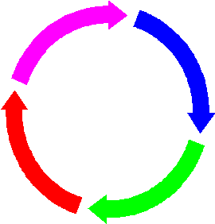
The Deming Cycle or PDCA Cycle Plan ACT DO CHECK

Slide 46
The PDSA Cycle
Plan
Document process
Collect and analyze data
Develop a plan
Shewhart cycle
Deming wheel
Act
Standardize successful method, revise unsuccessful plan
Do
Implement plan
Collect data for evaluation
Using data to check: results match the goal?
Study

Slide 47
PLAN: Plan a change to the process.
Predict the effect this change will have and plan how the effects will be measured .
DO : Implement the change on a small scale and measure the effects .
CHECK : Study the results to learn what effect the change had , if any .
ACT : Adept the change as a permanent modification to the process, or abandon it .

Slide 48
Elements for Success
Management Support
Mission Statement
Proper Planning
Customer and Bottom Line Focus
Measurement
Empowerment
Team Work / Effective Meeting
Continuous Process Improvement
Dedicated Resources

Slide 49
Total Quality Management and Continuous Improvement
TQM is the Management Process used to make Continuous improvement to all functions .
TQM represents an on going, continuous commitment to improvement .
The foundation of total quality is a management philosophy that supports meeting customer requirements through continuous improvement .

Slide 50
Continuous Improvement Versus Traditional Approach
Traditional Approach Continuous Improvement
Market – share focus Customer Focus
Individuals Cross- Functional Team
Focus on (who) and (why) Focus on (what ) and (how)
Short- term Focus Long – Term Focus
Status quo Focus Continuous Improvement
Product Focus Process Improvement Focus
Innovation Incremental Improvement
Fire Fighting Problem Solving

Slide 51
Value- based Approach
Manufacturing Dimensions Service Dimensions
Performance Reliability
Features Responsiveness
Reliability Assurance
Conformance Empathy
Durability Tangibles
Serviceability
Aesthetics
Perceived Quality

Slide 52
TQM six basic Concepts
1-Management commitment to TQM principles and methods & long term Quality plans for the Organization
2-Focus on customers – internal & external
3-Quality at all levels of the work force.
4-Continuous improvement of the production/business process.
5-Treating suppliers as partners
6-Establish performance measures for the processes.

Slide 53
Effects of poor Quality
Low customer satisfaction
Low productivity, sales & profit
Low morale of workforce
More re-work, material & labour costs
High inspection costs
Delay in shipping
High repair costs
Higher inventory costs
Greater waste of material

Slide 54
Benefits of Quality Higher customer satisfaction
Reliable products/services
Better efficiency of operations
More productivity & profit
Better morale of work force
Less wastage costs
Less Inspection costs
Improved process
More market share
Spread of happiness & prosperity
Better quality of life for all.

Slide 55
Evolution of TQM philosophies
The Deming Philosophy
Definition of quality, “A product or a service possesses quality if it helps somebody and enjoys a good and sustainable market.”
Improve quality
Decrease cost because of less rework, fewer mistakes.
Productivity improves
Long-term competitive strength
Stay in business
Capture the market with better quality and reduced cost.

Slide 56
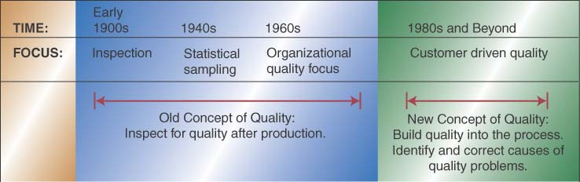

Slide 57
CH:3
Process improvement tools

Slide 58
Process improvement tools
Seven QC Tools
Flow charts
Check sheets
Histograms
Pareto diagrams
Cause-and-effect diagrams
Scatter diagrams
Control charts

Slide 59
Flow charts
Process map identifies the sequence of activities or the flow in a process.
Objectively provides a picture of the steps needed to accomplish a task.
Helps all employees understand how they fit into the process and who are their suppliers and customers.
Can also pinpoint places where quality-related measurements should be taken.
Also called process mapping and analysis.
Very successfully implemented in various organizations. e.g. Motorola reduced manufacturing time for pagers using flow charts.

Slide 60
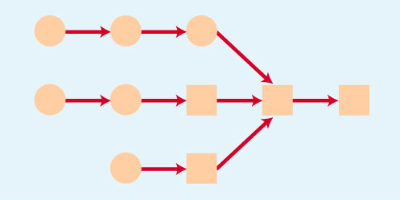

Slide 61
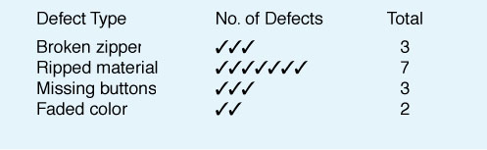
Check sheets
Special types of data collection forms in which the results may be interpreted on the form directly without additional processing.
Data sheets use simple columnar or tabular forms to record data. However, to generate useful information from raw data, further processing generally is necessary.
Additionally, including information such as specification limits makes the number of nonconforming items easily observable and provides an immediate indication of the quality of the process.

Slide 62
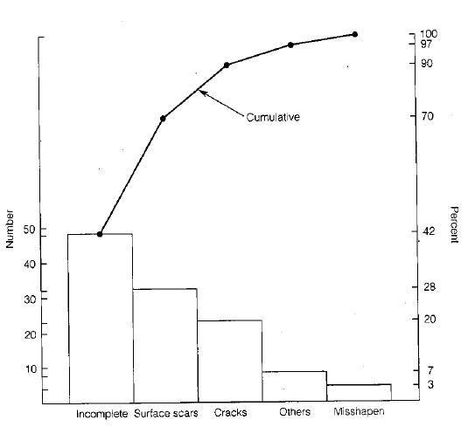
Pareto diagrams
Based on the 85-15 Pareto distribution.
Helpful in identifying the quality focus areas.
Popularized by Juran.
It is a histogram of the data from the largest frequency to the smallest.

Slide 63
Develop a list of problems to be compared.
Develop a standard measure for comparing the items. For example, how often it occurs: frequency (e.g., utilization, complications, errors); how long it takes (time); how many resources it uses (cost).
Choose a timeframe for collecting the data.
For each item, tally how often it occurred (or cost or total time). Then, add these amounts to determine the grand total for all items.
Find the percent of each item in the grand total by taking the sum of the item, dividing it by the grand total, and multiplying by 100.

Slide 64
List the items being compared in decreasing order of the measure of comparison: e.g., the most frequent to the least frequent. The cumulative percent for an item is the sum of that item’s percent of the total and that of all the other items that come before it in the ordering by rank.
List the items on the horizontal axis of a graph from highest to lowest. Label the left vertical axis with the numbers (frequency, time, or cost).
Label the right vertical axis with the cumulative percentages (the cumulative total should equal 100%).

Slide 65
Draw in the bars for each item.
Draw a line graph of the cumulative percentages. The first point on the line graph should line up with the top of the first bar.

Slide 66
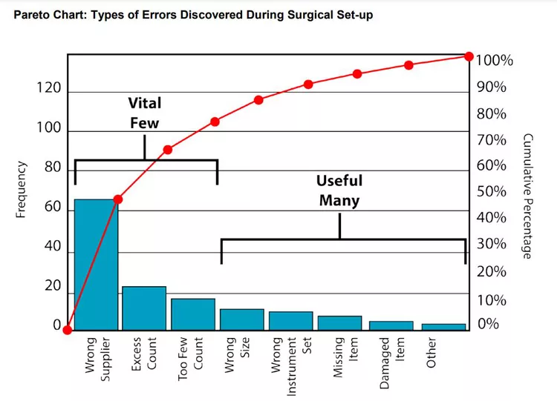

Slide 67
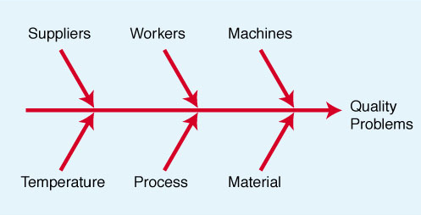
Cause-effect diagrams
Also called fishbone diagrams (because of their shape) or Ishikawa diagrams.
Helps in identifying root causes of the quality failure. (Helps in the diagnostic journey.)
Notes:
svbsvjv

Slide 68
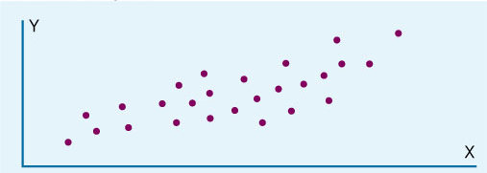
Scatter diagrams
Graphical components of the regression analysis.
Often used to point out relationship between variables. Statistical correlation analysis used to interpret scatter diagrams.

Slide 69
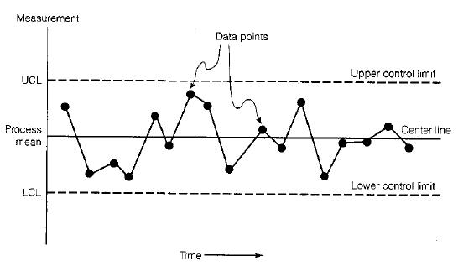
Run charts and Control charts
Run chart: Measurement against progression of time.
Control chart: Add Upper Control Limit and Lower Control Limit to the run chart.

Slide 70
Quality circles
Teams of workers and supervisors that meet regularly to address work-related problems involving quality and productivity.
Developed by Kaoru Ishikawa at University of Tokyo.
Became immediately popular in Japan as well as USA.
Lockheed Missiles and Space Division was the leader in implementing Quality circles in USA in 1973 (after their visit to Japan to study the same).
Typically small day-to-day problems are given to quality circles. Since workers are most familiar with the routine tasks, they are asked to identify, analyze and solve quality problems in the routine processes.

Slide 71
Additional process improvement tools
Kaizen blitz
An intense and rapid improvement process in which a team or a department throws all its resources into an improvement project over a short period of time.
Short time “burst” rather than long range simmer- hence the name.
Blitz teams usually comprise of employees from all areas involved in the process who understand it and can implement the changes on the spot.

Slide 72
Additional process improvement tools
Poka-Yoke (Mistake proofing)
Approach for mistake-proofing processes using automatic devises or methods to avoid simple human error.
Developed and refined in the 1960s by the late Shigeo Shingo, a Japanese manufacturing engineer who developed the Toyota production system.
Focused on two aspects:
Prediction – Recognizing that a defect is about to occur and provide a warning.
Detection – Recognizing that a defect has occurred and stop the process.

Slide 73
Quality Management Awards and Framework
ISO 9000: 2000
Malcolm Baldrige National Quality Award
Deming Prize
Six Sigma

Slide 74
ISO 9000: 2000
Created by International Organization for Standardization (IOS) which was created in 1946 to standardize quality requirement within the European market.
IOS initially composed of representatives from 91 countries: probably most wide base for quality standards.
Adopted a series of written quality standards in 1987 (first revised in 1994, and more recently (and significantly) in 2000).
Prefix “ISO” in the name refers to the scientific term “iso” for equal. Thus, certified organizations are assured to have quality equal to their peers.

Slide 75
ISO 9000: 2000
Defines quality systems standards based on the premise that certain generic characteristics of management principles can be standardized.
And that a well-designed, well-implemented and well managed quality system provides confidence that outputs will meet customer expectations and requirements.
Standards are recognized by 100 countries including Japan and USA.
Intended to apply to all types of businesses. (Recently, B2B firm bestroute.com became the first e-commerce company to get ISO certification.)

Slide 76
ISO 9000: 2000
Created to meet five objectives:
Achieve, maintain, and seek to continuously improve product quality in relation to the requirements.
Improve the quality of operations to continually meet customers’ and stakeholders’ needs.
Provide confidence to internal management that quality requirements are being met.
Provide confidence to the customers that quality requirements are being met.
Provide confidence that quality system requirements are fulfilled.

Slide 77
ISO 9000: 2000 structure
Consists of three documents
ISO 9000 – Fundamentals and vocabulary.
ISO 9001 – Requirements.
Organized in four sections: Management Responsibility; Resource Management; Product Realization; and Measurement, Analysis and Improvement.
ISO 9004 – Guidelines for performance improvements.

Slide 78
ISO 9000: 2000 Quality Management Principles
Principle 1: Customer Focus
Principle 2: Leadership
Principle 3: Involvement of people
Principle 4: Process approach
Principle 5: Systems approach for management
Principle 6: Continual improvement
Principle 7: Factual approach to decision making
Principle 8: Mutually beneficial supplier relationships.

Slide 79
ISO 9000: 2000 registration
Originally intended to be a two-party process where the supplier is audited by its customers, the ISO 9000 process became a third-party accreditation process.
Independent laboratory or a certification agency conducts the audit.
Recertification is required every three years.
Individual sites – not entire company – must achieve registration individually.
All costs are to be borne by the applicant.
A registration audit may cost anywhere from $10,000 to $40,000.
(more information at http://www.iso.ch)

Slide 80
Six Sigma
Business improvement approach that seeks to find and eliminate causes of defects and errors in processes by focusing on outputs that are critical to customers.
The term Six Sigma is based on a statistical measure that equates 3.4 or fewer errors or defects per million opportunities.
Motorola pioneered the concept of Six Sigma.
The late Bill Smith, a reliability engineer is credited with conceiving the idea of Six Sigma.
GE (specifically CEO Jack Welch) extensively promoted it.

Slide 81
Six Sigma
Core philosophy based on key concepts:
Think in terms of key business processes and customer requirements with focus on strategic objectives.
Focus on corporate sponsors responsible for championing projects.
Emphasize quantifiable measures such as defects per million opportunities (dpmo).
Ensure appropriate metrics is identified to maintain accountability.
Provide extensive training.
Create highly qualified process improvement experts -“belts”.
Set stretch objectives for improvement.

Slide 82
Six Sigma
Contrasts between traditional TQM and Six Sigma (SS) -
TQM is based largely on worker empowerment and teams; SS is owned by business leader champions.
TQM is process based; SS projects are truly cross-functional.
TQM training is generally limited to simple improvements tools and concepts; SS is more rigorous with advanced statistical methods.
TQM has little emphasis on financial accountability; SS requires verifiable return on investment and focus on bottom line.

Slide 83
TQM for Top Management
Strategic Quality Management (SQM)
Competitive Advantage

Slide 84
SQM: Hoshin planning
Hoshin kanri: Japanese for management cycle build around Plan, Do, Check, Act. Elements of this cycle include –
Quality policies
Quality goals
Deployment of goals
Plans to meet goals
Organizational structure
Resources
Measurement feedback
Review of progress
Training

Slide 85
SQM: Vision/Mission statement
Developed by taking everyone in confidence. Guide for the Quality journey. Ties quality to overall business goals.
Vision Statement: Collection of quality policies. A vision statement outlines what a company wants to be. It focuses on tomorrow; it is inspirational; it provides clear decision-making criteria; and it is timeless. A vision needs to address three areas: people, culture (or values) and product or service.
Mission statement: A mission statement outlines what the company is now. It focuses on today; it identifies the customers; it identifies the critical processes; and it states the level of performance.

Slide 86
SQM: Vision/Mission statement
It has been said that a vision is something to be pursued, while a mission is something to be accomplished.
Mission is what you do best every day, and vision is what the future looks like because you do that mission so exceedingly well.
For vision – Think leading with inspiration and courage, obsessed with future possibility.
For mission – Think managing with greatness and untamed strength, improving everything daily.
Famous vision statement – “By the end of the decade, we will put a man on the moon.” JFK.
Famous mission statement – “CRUSH REEBOK.” Nike

Slide 87
SQM: Quality policies
Prepared to provide guidelines for planning the overall quality program; and defining the action to be taken in situation for which personnel had requested guidelines.
Policies state: a) a principle to be followed; b) what is to be done.
Examples of quality policy – For a computer manufacturer: “In selecting suppliers, decision makers are responsible for choosing the best source even if this means internal sources are not selected.”

Slide 88
SQM: Quality goals
A goal (or objective) is a statement of the desired result to be achieved within a specified period – an aimed-at target.
These goals then become basis for detailed planning of activities.
Tactical goals are short range (up to 1 year), whereas strategic goals are long range (say, 5 years).
Examples of corporate quality goals – For a health product company, the quality goals over the next year could be: “The average leakage rate for …. product shall be reduced to …”
Note that quality goal statements include quantified data.
Typically Pareto analysis is used to develop the quality goals.

Slide 89
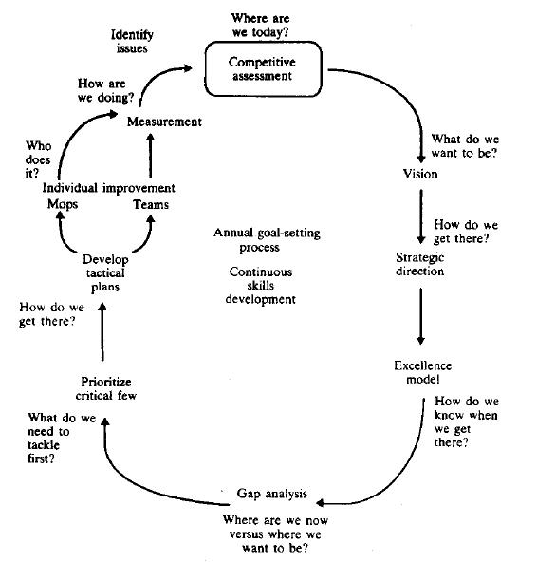

Slide 90
SQM: Deploying quality goals
Broad goals don’t lead to results. First they have to be deployed as follows:
Division and subdivision of the goal until specific deeds to be done are identified.
Allocation of responsibility of doing these deeds.
Provision for the needed resource.

Slide 91
SQM: Caveats
Reasons of failure of SQM could be
Lack of leadership by upper management.
Lack of infrastructure for quality.
Failure to understand the skepticism about the “new quality program.”
Management assumption that the exhortation approach will work.
Failure to start small and learn from pilot programs.
Reliance on specific techniques as the primary means.
Underestimating the time and resource required.

