Slide 1
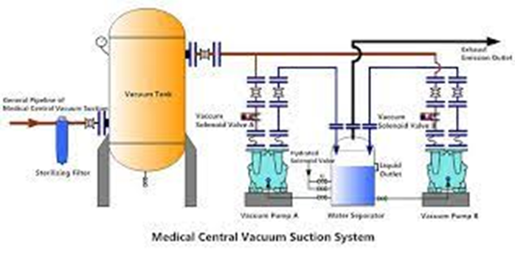
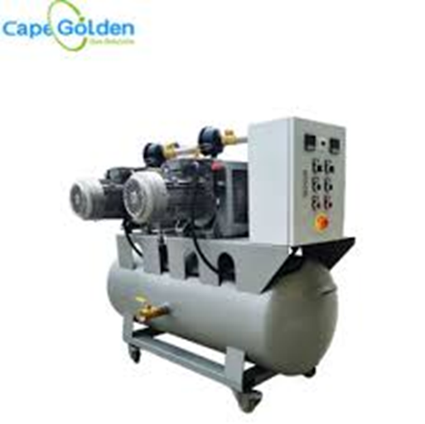
Centralized vacuum or suction system
By: Dr. Azad J. Ali

Slide 2
Suction Systems
It plays a crucial role in many parts as :
Operating theatre.
Anesthesia room (induction room).
Recovery room.
Intensive Care Unit (ICU).
Patient’s room( ward).

Slide 3
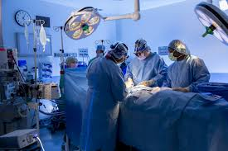
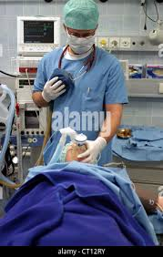
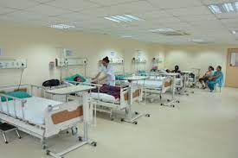
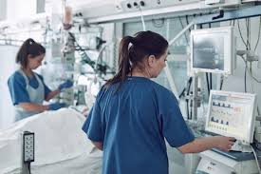
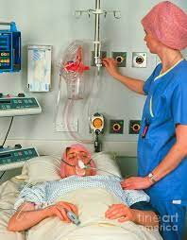

Slide 4
Components
1-A pump or a power source (-500 mmHg)
2-A suction controller with a filter.
3-A receiver or a collection vessel.
4-A suction tubing and suction nozzle
(e.g. Yankauer nozzle) or catheter.

Slide 5
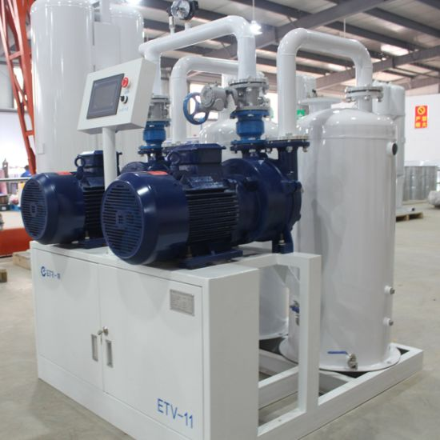
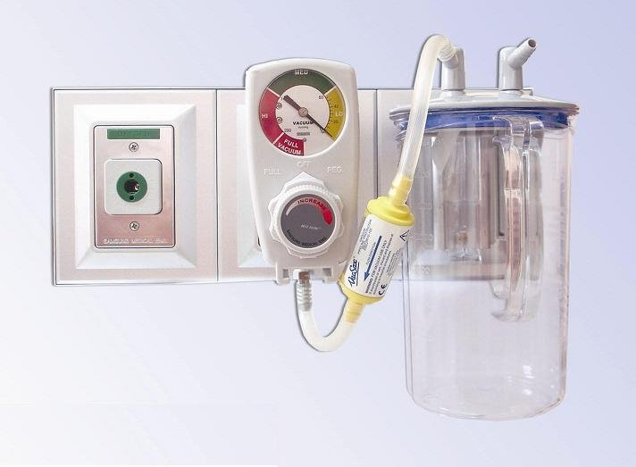
Central suction system
Pump or Vacuum generator
Vacuum controller, filter & receiver(collection vessel)

Slide 6
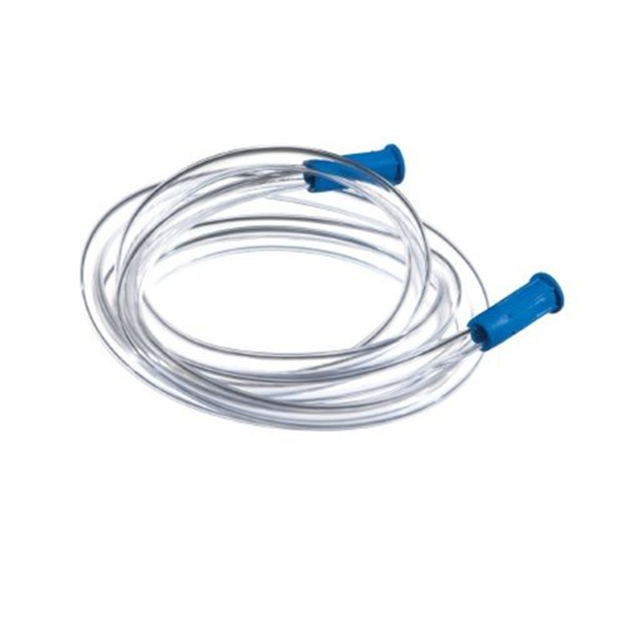
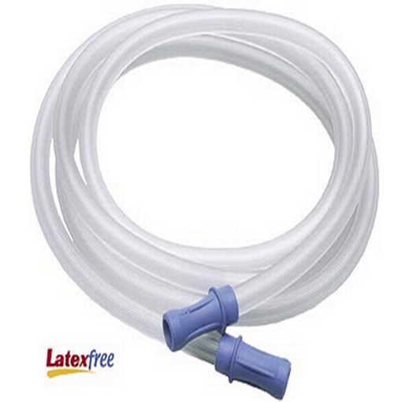
Suction tubing transparent , flexible , firm & of sufficient diameter

Slide 7
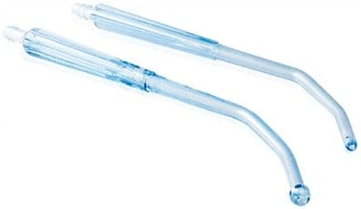
Yankauer Nozzle

Slide 8
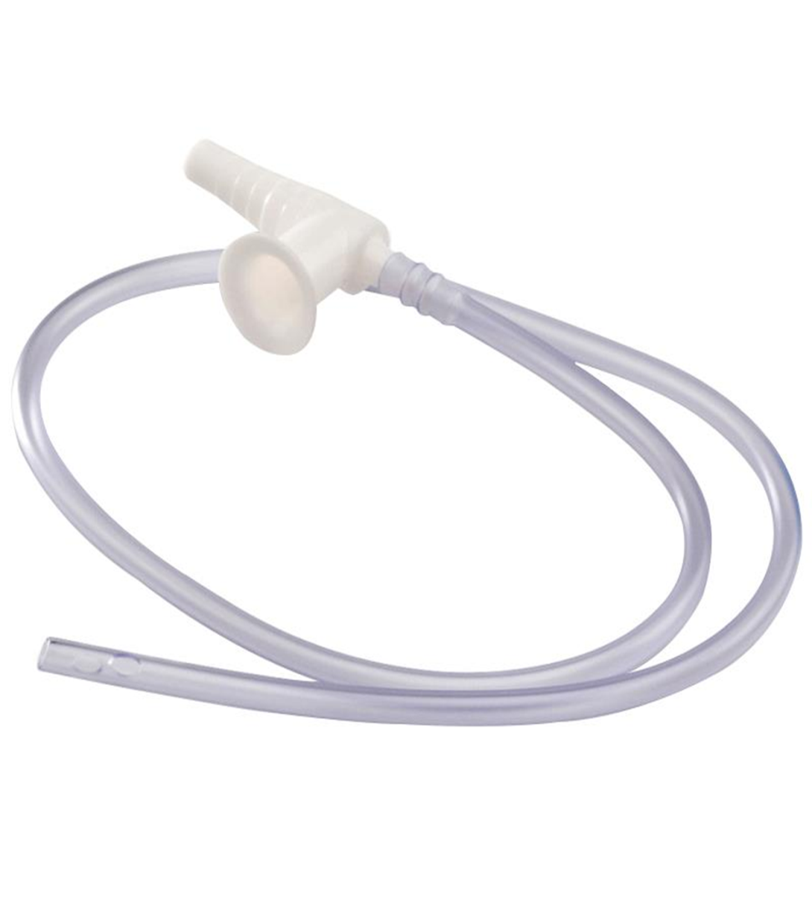
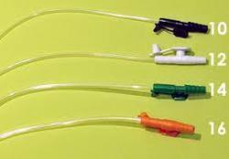
Suction catheter
Different sizes

Slide 9
Mechanism of Action
Negative pressure generator (Electrical or Pneumatic or using venturi principle).
Manual control of the amount of –ve pressure.
Variable 0riffice with a float assembly.
Receiver of sufficient capacity.
Suction tubing:
-transparent.
-flexible& firm.
-sufficient diameter.

Slide 10
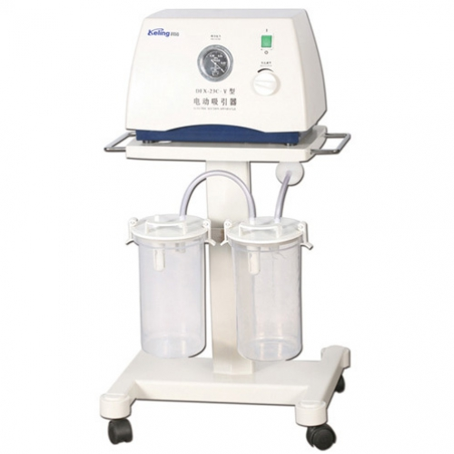
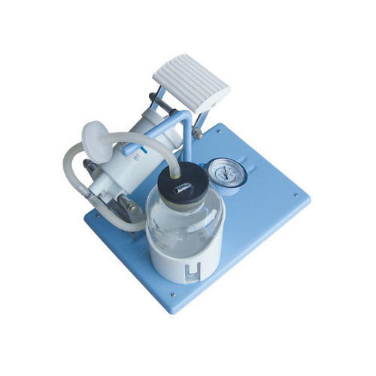
Negative pressure generator
Electrical
Pneumatic (Mechanical)

Slide 11
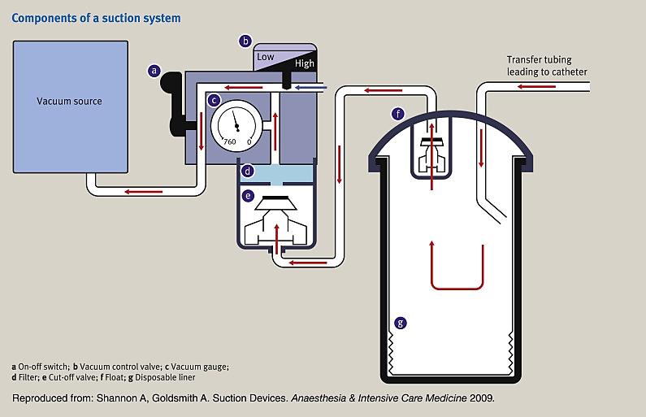
Illustration of vacuum system

Slide 12
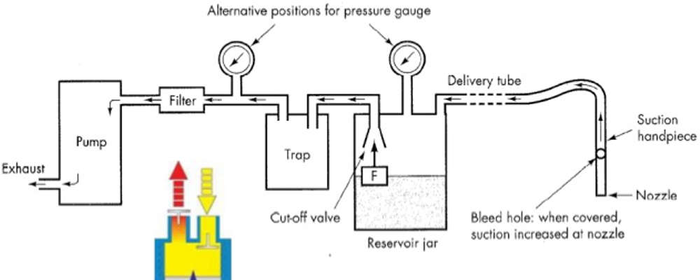
Illustration of Suction apparatus

Slide 13
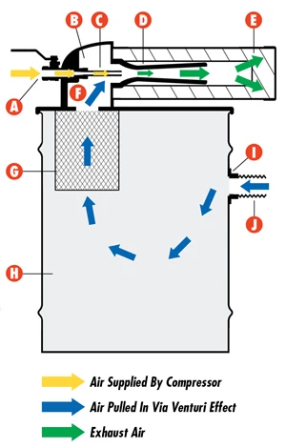
Venturi Negative pressure generator

Slide 14
Testing the efficacy
( check-up) of central-piped Vacuum systems before use
A negative pressure of at least(-400 mmHg) to be maintained at the outlet.
Withstand a free flow of at least (40L/min) at the outlet.
Should take no longer than 10 sec. to generate a vacuum of (-500 mmHg) with (25L/min) air displacement.

Slide 15
Thank you

