Slide 1
Cultural Aspects of Translation
Cihan University
College of Language
Translation departmanet
2023-2024
Lecturer: Nawroz Muhammed

Slide 2
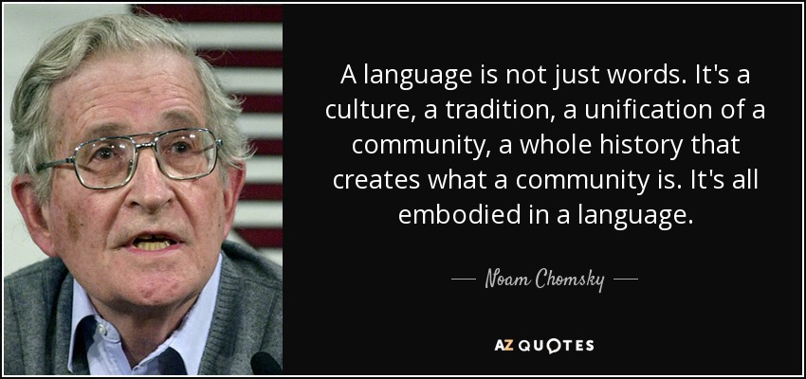

Slide 3
Cultural Aspects
Cultural aspects refer to the various elements and characteristics that define and shape a particular group's way of life, including their beliefs, values, traditions, customs, language, social norms, art, cuisine, and other shared practices and expressions.

Slide 4
The Importance of Cultural aspects in Translation
Understanding cultural aspects is crucial in translation. Translators need to grasp not just language but also cultural nuances, like idioms and humor, to convey messages accurately. Neglecting these can lead to misunderstandings or offense. Cultural sensitivity is key for effective translation.

Slide 5
Key Points
Cultural Context: Every language is embedded in a specific cultural context. When translating a text, it's crucial to understand not only the words and grammar but also the cultural nuances, references, and implications that might not have a direct equivalent in the target language.

Slide 6
Cultural context refers to the environment or circumstances that surround a particular culture, including its beliefs, values, customs, and social norms. It shapes the way people communicate, behave, and understand the world around them. In translation, understanding this context is essential to accurately convey meaning and intent from one language to another, considering the cultural nuances that impact communication.
"a piece of cake"

Slide 7
For instance, a handshake with direct eye contact in Western cultures signifies confidence and professionalism, while in Japan, a bow and maintaining humility are valued. These differences underscore the significance of cultural context in communication and social interactions, illustrating how misunderstandings can arise when individuals from diverse backgrounds fail to recognize and respect these cultural nuances, making it essential for global society to cultivate cultural sensitivity and cross-cultural understanding.

Slide 8
Practice yourself
"Kimonos are special clothes from Japan. They are like long, pretty robes that people wear for important events or celebrations. They can be made from silk and have many different designs like flowers, animals, or shapes. Kimonos are tied with a big sash called an obi around the middle. Depending on the person's age or the occasion, they wear different kinds of kimonos. When translating information about kimonos, it's important to talk about their designs and why they're important in Japanese culture."

