Slide 1
Cultural Aspects of Translation
Cihan University
College of Language
Translation departmanet
2023-2024
Lecturer: Nawroz Muhammed

Slide 2
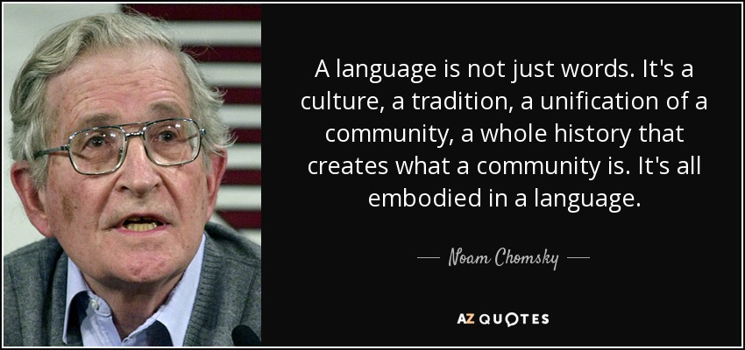

Slide 3
Cultural Aspects
Cultural aspects refer to the various elements and characteristics that define and shape a particular group's way of life, including their beliefs, values, traditions, customs, language, social norms, art, cuisine, and other shared practices and expressions. These aspects are the manifestations of a group's culture and influence how its members think, behave, and interact within their cultural context.

Slide 4
The Importance of Cultural aspects in Translation
Cultural aspects are of paramount importance in translation as they influence the accuracy and effectiveness of conveying a message from one language to another. Translators must not only understand the linguistic nuances but also the cultural context, including idioms, humor, and references, to ensure that the intended message is accurately and appropriately conveyed to the target audience. Neglecting cultural aspects can lead to misunderstandings, offense, or the loss of essential subtleties, making cultural sensitivity a fundamental skill for skilled translators.

Slide 5
Key Points
Cultural Context: Every language is embedded in a specific cultural context. When translating a text, it's crucial to understand not only the words and grammar but also the cultural nuances, references, and implications that might not have a direct equivalent in the target language.

Slide 6
For instance, a handshake with direct eye contact in Western cultures signifies confidence and professionalism, while in Japan, a bow and maintaining humility are valued. These differences underscore the significance of cultural context in communication and social interactions, illustrating how misunderstandings can arise when individuals from diverse backgrounds fail to recognize and respect these cultural nuances, making it essential for global society to cultivate cultural sensitivity and cross-cultural understanding.

Slide 7
Practice yourself
"During the annual Diwali celebration, families gather to light oil lamps, or 'diyas,' and exchange 'sweets' such as 'gulab jamun' and 'jalebi.' This Hindu festival is a time of spiritual reflection and the victory of light over darkness. In Japan, the 'sakura' season brings an array of vibrant cherry blossoms, which is celebrated through 'hanami' picnics beneath the blooming trees. Meanwhile, in Mexico, 'Dia de los Muertos,' or the 'Day of the Dead,' is a colorful and lively commemoration of deceased loved ones with intricately decorated 'calavera' sugar skulls and 'ofrendas' or altars."

Slide 8
Idioms and Expressions
Many languages have unique idioms and expressions that are deeply rooted in their culture. Translators must find culturally appropriate equivalents or explanations for these idiomatic expressions.
Example
Piece of cake
زەڵاتەیە
Speak of the devil
بەسەر باسی خۆیدا هات
That's the last straw
سەبرم نەما

Slide 9
Humor and wordplay often rely on cultural references and language-specific puns. Translators may need to adapt jokes and wordplay to make them accessible and funny in the target culture. "Why don't we ever tell secrets on a farm? Because the potatoes have eyes, the corn has ears, and the beans stalk."
Humor and Wordplay

Slide 10
Taboos and Sensitivities
What is considered acceptable or offensive can vary greatly between cultures. Translators need to be aware of cultural taboos and sensitivities and make sure their translations are culturally sensitive and appropriate.
Greetings and Gestures

Slide 11
Names and Titles
Names of people and places, as well as titles and honorifics, can pose challenges in translation. Different cultures have different conventions for addressing individuals and referring to locations.
Mr., Mrs., Ms., Miss, Dr., Prof., Sir, Madam
خاتوون، کاک، دکتۆر، پرۆفیسۆر، بەرێز
Formal vs. Informal Address
"Your Excellency," "Your Honor," "Sir," "Ma'am"

Slide 12
Many texts contain references to religious beliefs, historical events, and cultural figures. Accurate translation requires an understanding of these references in both the source and target cultures. -- group discussions
Religious and Historical References

Slide 13
Practice
"At the special place of worship, the faithful people came wearing their traditional clothes. The religious leader started the ceremony, singing prayers in a beautiful way, asking for blessings for everyone there. The air smelled of a nice scent from the special stuff they burned. Songs filled the room, making the people feel good, as they looked for help and peace from a higher power."

