Slide 1
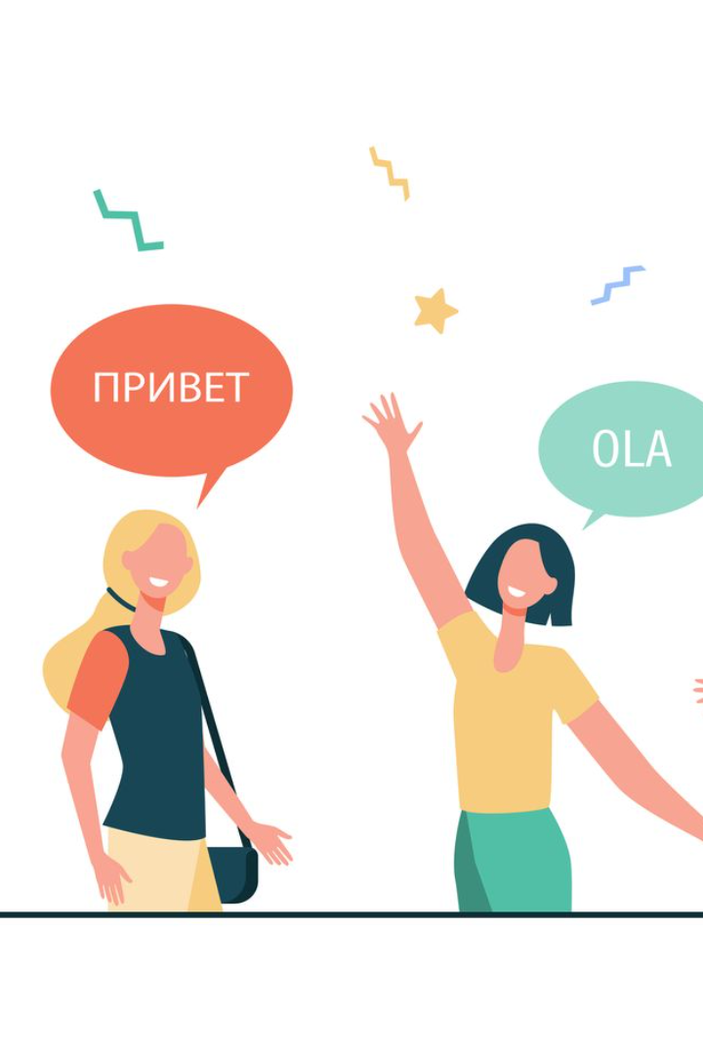
Exploring the Diversity of Languages
The world is a rich tapestry of cultures and languages, each with its own unique beauty and value. In this presentation, we will explore the rich diversity of two important languages: English and Sorani Kurdish.
by Nawroz Mohammed

Slide 2

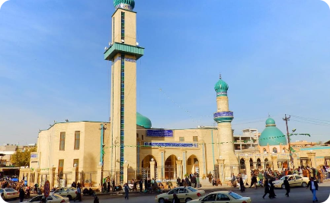
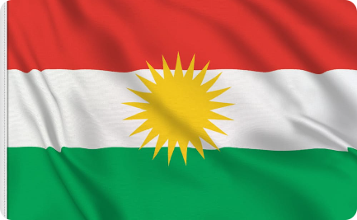
Background on English language and Sorani Kurdish
History of English
History of Sorani Kurdish
Cultural Significance
With roots in Germanic and Romance languages, English has evolved over time to become the most widely spoken language in the world, with over 1.5 billion speakers.
Sorani Kurdish is one of the two main dialects of Kurdish, spoken in Iraqi Kurdistan and parts of Iran. It has a rich history that dates back thousands of years.
Both English and Sorani Kurdish are important languages that play a significant role in the intellectual and cultural life of their respective communities.

Slide 3
Phonetics and Alphabet
English Alphabet
Sorani Kurdish Alphabet
Phonetics Comparison
The English alphabet has 26 letters, and is written from left to right. It also uses various accents to indicate pronunciation.
English and Sorani Kurdish have different phonetic features and pronunciation rules. For example, Sorani Kurdish has six vowel sounds, whereas English has over 20 depending on dialect.
Sorani Kurdish uses a modified Arabic script with 33 letters. It is also written from right to left.

Slide 4
Grammar and Sentence Structure
1
English Grammar
English grammar is known for its complex sentence structures, with a variety of rules for tense, mood, and voice. Nouns are inflected for number and case, and there are eight parts of speech, such as (noun, verb…etc)
Sorani Kurdish Grammar
2
Sorani Kurdish has a similar system of noun inflection, but uses agglutination to create complex verbs. It has five cases for nouns, and uses suffixes to indicate various aspects of the verb system.

Slide 5
Vocabulary and Expressions
English Vocabulary
Sorani Kurdish Vocabulary
Comparison
With its rich history and literature, English has a vast vocabulary of over 170,000 words, and is constantly evolving. English also has many idiomatic expressions that can be difficult for non-native speakers to understand.
Despite the differences in their vocabulary and expressions, both languages offer rich opportunities for conveying complex ideas and emotions. Mastery of the vocabulary and expressions of a language is key to fluency and effective communication.
Sorani Kurdish has a smaller vocabulary than English, but is equally expressive. It includes many loanwords from Arabic and Persian, and has many unique expressions and proverbs.

Slide 6
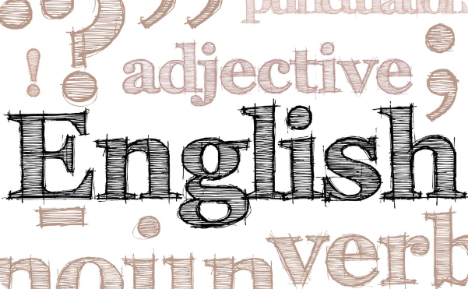
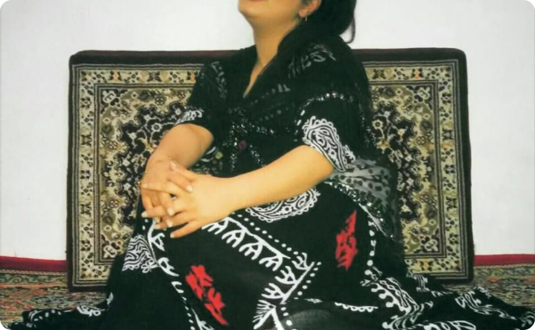
The Differences of English and Sorani Kurdish with Examples
Example of English
Example of Sorani Kurdish
"The quick brown fox jumps over the lazy dog" is a sentence often used to demonstrate English language typing skills. It includes all 26 letters of the alphabet, and demonstrates the use of many common idiomatic expressions.
"شێوازی بابەتەکە" (shewazi babetakê) is a Sorani Kurdish expression that means "the style of the topic." It demonstrates the agglutinative nature of Sorani Kurdish, which combines root words and suffixes to create new words and expressions.

Slide 7
References
Crystal, D. (2015). Language diversity and its importance to globalisation. Language and Intercultural Communication, 15(1), 1-9.
Dabir-Moghaddam, M., & Jafary, K. (2014). Causative Verbs in Kurdish. Persian Gulf Studies, 65(30), 25-46.
Jones, B. W. (2017). English Language. The Wiley Blackwell Encyclopaedia of Race, Ethnicity, and Nationalism.
Mackenzie, L. (2019). Sorani Kurdish. The Wiley Blackwell Encyclopaedia of Race, Ethnicity, and Nationalism.

