Slide 1



Introduction to Translation
Translation is the art of bridging language barriers and facilitating communication between people from different cultures. Explore the importance, methods, challenges and career opportunities in this fascinating field.
by Nawroz Muhammad

Slide 2
Definition of Translation
The process of converting written or spoken content from one language to another

Slide 3

Importance of Translation in a Globalized World
1
Preservation of Cultural Heritage 🗺️
2
Facilitating Global Communication 🌍
Translation allows us to appreciate and understand literature, history, and cultural nuances from around the world.
Translation enables effective communication and collaboration between individuals, businesses, and governments across borders and languages.
3
Breaking Down Language Barriers 🚧
Translation promotes inclusivity and eliminates language barriers, fostering mutual understanding and empathy.

Slide 4
Translation Methods and Techniques
Literal Translation
Localization
Transcreation
Adapting the content to the target audience's cultural, linguistic, and regional specifications.
Adapting the message and creative elements of the text to ensure cultural relevance and emotional impact.
Translating the text word-for-word, preserving the original structure and meaning.

Slide 5
Challenges in Translation
1
Idiomatic Expressions 🔄
2
Cultural Nuances 🧩
3
Technical Terminology ⚙️
Translating phrases that have a different meaning when interpreted literally.
Translating cultural references and nuances that may not have direct equivalents in other languages.
Translating specialized terms accurately and maintaining consistency across the document.

Slide 6
Machine Translation vs Human Translation
Machine Translation 🤖
Human Translation 👨‍💻
Speed and efficiency but may lack accuracy and nuance.
Attention to detail, cultural understanding, and the ability to handle complex texts.

Slide 7
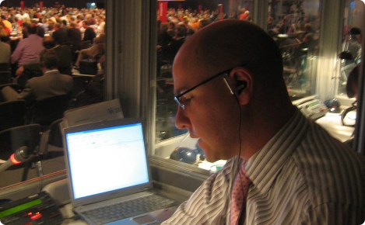
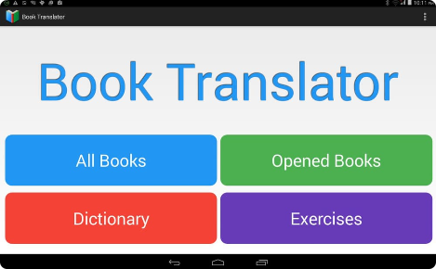


Career Opportunities in Translation
Interpreter
Book Translator
Provide real-time oral translation during conferences and meetings.
Translate literary works to make them accessible to readers worldwide.
Audiovisual Translator
Website Localization Specialist
Translate subtitles, dubbing, and voice-overs for films, TV shows, and other media.
Adapt and translate websites to cater to international audiences and increase global reach.

Slide 8

Conclusion and Key Takeaways
1
Translation is a Bridge
2
Precision and Cultural Sensitivity
Translation enables meaningful communication and connection across different languages and cultures.
Effective translation requires linguistic precision and a deep understanding of cultural nuances.
3
Endless Possibilities
From business to literature, technology to entertainment, the demand for professional translators will continue to grow.

Slide 9
References
1. Smith, J. (2021). The Art of Translation: A Comprehensive Guide. Translation Gazette.
2. Johnson, A. (2020). Lost in Translation: Challenges and Solutions in the 21st Century. Language Journal.
3. Chen, L. (2019). Breaking Down Language Barriers: The Role of Translation in a Globalized World. Global Communication Review.

