Slide 1
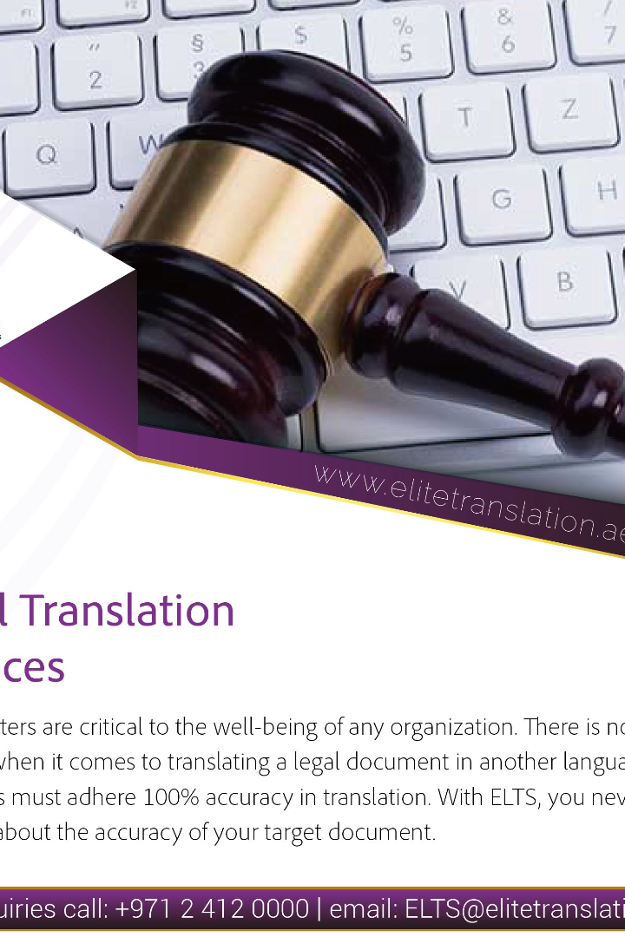

Introduction to Legal Translation
Legal translation is the specialized field of translating legal texts such as contracts, laws, and court documents. It requires linguistic expertise as well as a deep understanding of legal systems.
by Nawroz Muhammad

Slide 2
Definition of Legal Translation
Accurate Transfers
Precision & Clarity
Contextual Adaptation
Transferring legal concepts and terminology accurately from one language to another.
Maintaining the clarity and precision of legal texts while adapting to cultural and linguistic differences.
Taking into account the legal systems and cultural backgrounds of both the source and target languages.

Slide 3

Importance of Legal Translation
1
Global Communication
2
Legal Compliance
Ensures legal compliance and understanding of rights and obligations across borders.
Enables effective communication between legal professionals from different countries.
3
Preserving Intent
Preserves the original intent of legal texts, maintaining legal precision and certainty.

Slide 4
Challenges Faced in Legal Translation
Complex Terminology
Cultural Nuances
Legal Systems
Translating legal concepts while preserving cultural nuances requires deep cultural understanding.
Each legal system varies, and translators must navigate these differences accurately.
The intricate and technical legal terminology often poses challenges for translators.

Slide 5
Key Skills Required for Legal Translators
Linguistic proficiency in both source and target languages
Legal knowledge and understanding
Attention to detail and accuracy
Research and analytical skills
Cultural competency and sensitivity

Slide 6
Ethical Considerations in Legal Translation
1
Confidentiality
Upholding the privacy and confidentiality of legal documents and information.
Impartiality
2
Remaining impartial and unbiased during the translation process.
3
Accuracy
Prioritizing accuracy and precision to maintain the integrity of legal texts.

Slide 7


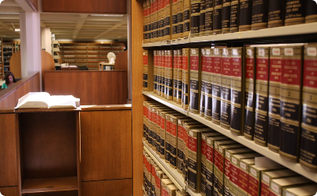
Tools and Resources for Legal Translators
Legal Dictionaries
Translation Software
Law Libraries
A comprehensive reference for legal terminology in different languages.
Computer-assisted translation tools to improve efficiency and consistency.
Access to legal resources, such as books, articles, and databases.

Slide 8

Conclusion and Key Takeaways
Legal translation is a highly specialized field requiring linguistic expertise, legal knowledge, and cultural competence. It plays a crucial role in facilitating global communication, legal compliance, and preserving the integrity of legal texts.
By understanding the challenges, developing the necessary skills, and utilizing the right tools, legal translators can provide accurate and reliable translations that support the international legal community.

Slide 9
References:
Smith, J. (2019). Legal Translation: An Overview. Translation Journal, 23(1).
Duarte, S. (2018). Challenges and Skills of Legal Translation. MonTI, 10, 391-410.

