Slide 1
Obesity General medicine Theory 3

Slide 2
Introduction
Obese patients with significantly overweight are at increased risk for a variety of health conditions, including heart disease, cancer, diabetes, and stroke.

Slide 3
One of the biggest concerns is that being overweight makes you more likely to have a condition called sleep apnea, which causes you to temporarily stop breathing while you sleep. This can make anesthesia riskier, especially general anesthesia, which causes you to lose consciousness.

Slide 4
How does sleep apnea affect anesthesia?
Anesthesia, especially general anesthesia, can be dangerous for people with obstructive sleep apnea. The condition makes anesthesia riskier because it slows down breathing and can make you more sensitive to its effects. Sleep apnea also can make it more difficult to regain consciousness and take a breath after surgery.

Slide 5
If there is overweight, patient may also have medical conditions that are caused or made worse by the extra weight, and they can increase your risk during surgery. For example, your blood pressure may be higher than normal. You may have diabetes or GERD (gastroesophageal reflux disease).

Slide 6
being significantly overweight can lead to challenges with a number of anesthesia-related processes:
Locating veins to deliver anesthesia and life-saving emergency medications intravenously
Determining the right dose of medications
Ensuring you get enough oxygen and airflow, especially if you have sleep apnea
Adding to the time it takes to regain consciousness after surgery and your recovery time
Increasing the risk of breathing problems with narcotics and other pain medicines
Placing a breathing tube

Slide 7
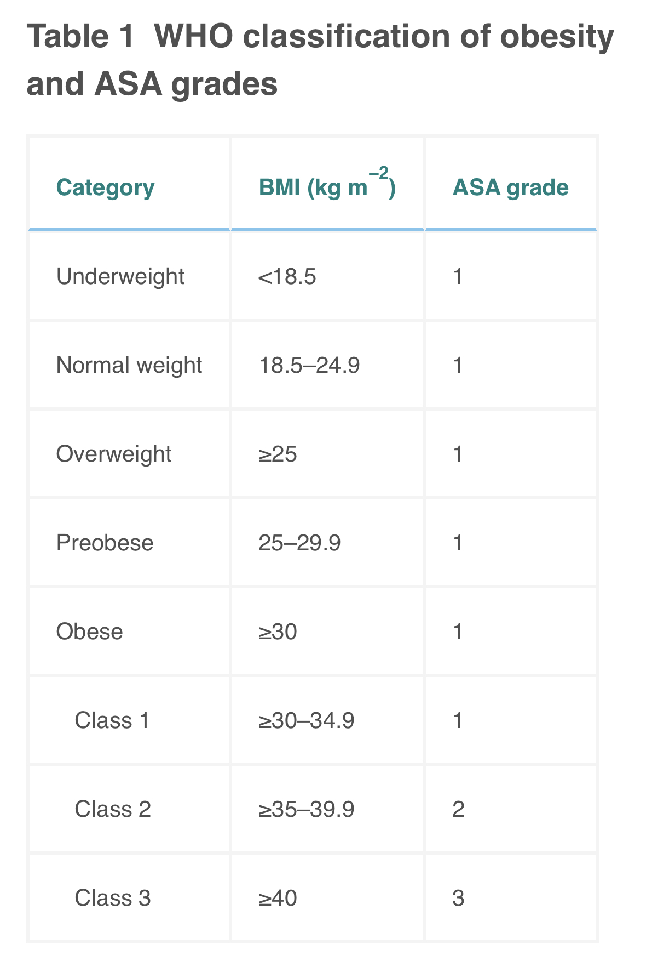

Slide 8
Health conditions associated with obesity, suggestive features and the perioperative actions required. ABG, arterial blood gas; BiPAP, bilevel positive airway pressure; CPET, cardiopulmonary exercise testing; DM, diabetes mellitus; ECHO, echocardiogram; HDL, high-density lipoproteins; HDU, high dependency unit; LFTs, liver function tests; METS, metabolic equivalents; NAFLD, non-alcoholic fatty liver disease; NASH, non-alcoholic steatohepatitis; OHS, obesity hypoventilation syndrome; OSA, obstructive sleep apnoea; SBP, systolic BP; SDB, sleep disordered breathing

Slide 9
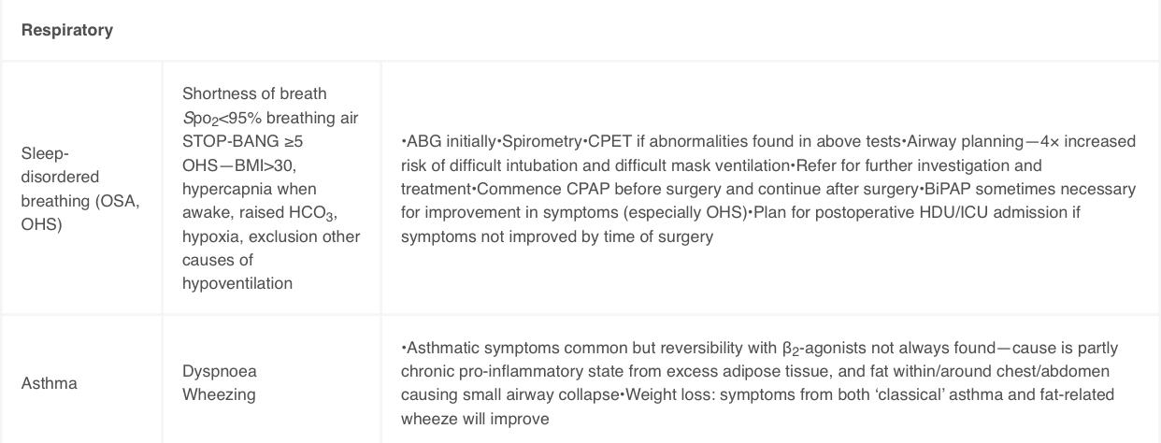

Slide 10
