Slide 1
Anesthesia for Ear, Nose and Throat Surgery General Medicine Theory 2

Slide 2
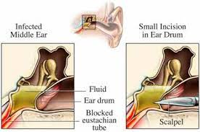
EAR SURGERY
Procedures on the ear include myringotomy for middle ear effusion resulting in conductive hearing loss

Slide 3
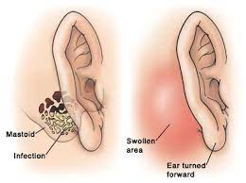
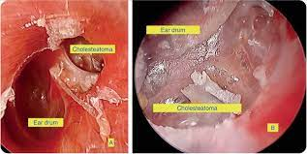
EAR SURGERY
Procedures on the mastoid process for mastoiditis that may occur as a result of untreated or failed antibiotic response to chronic otitis media.

Slide 4
Important considerations
Positioning during ear surgery usually involves a slight elevation of the head (to reduce bleeding) and turning the patient’s head to the contralateral side. The patient’s normal range of head movement should be assessed before surgery.
Access to the airway may be limited during long procedures. The endotracheal must be carefully secured.
In procedures such as stapedectomy and mastoidectomy, facial nerve monitoring may be performed, so it is important that neuromuscular paralysis has worn off. The need for the patient to be immobile in operations on the ossicles requires deep anesthesia.
Emergence from anesthesia needs to be smooth so that there is no increase in venous pressure.
After mastoidectomy, a head bandage will be applied and there can be much movement of the head resulting in coughing and bucking on the endotracheal tube. This is not desirable due to the risk of bleeding, so a deep plane of anesthesia is maintained until the bandage has been applied.
Postoperative nausea and vomiting can disrupt grafts and prostheses and needs to be controlled.

Slide 5
Important considerations
The fact that many of the patients are pediatric, upper respiratory tract infection is common and that postoperative nausea and vomiting are frequent.
Ear surgery may involve dissection and preservation of the facial nerve, which has a long intra-osseous course and may be vulnerable to injury.
The pressure in the middle ear may become raised leading to conduction deafness in the chronic situation and tympanic membrane rupture if the pressure rises acutely.

Slide 6
Important considerations
Nitrous oxide can diffuse into air filled cavities including the middle ear and cause expansion of the cavity, leading to an increase in middle ear pressure.
At the end of the anesthetic, there is rapid absorption of the nitrous oxide, which can result in profound negative pressure. These changes in middle ear pressure can result in a decline in hearing, tympanic membrane rupture, graft disruption and nausea and vomiting.

Slide 7
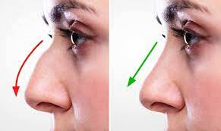
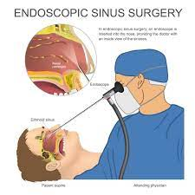
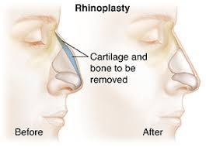
NASAL SURGERY

Slide 8
Important considerations
Nasal and sinus surgery carries the risk of bleeding into the airway and aspiration of blood. It is usually performed under general anesthesia with an endotracheal tube and a throat pack, but some procedures can be carried out under local anesthesia.
When a throat pack is used the anesthetist must be certain that it has been removed at the end of surgery.
Local anesthesia and vasoconstrictors are commonly used to reduce bleeding even with general anesthetic techniques. Surgeons may infiltrate with adrenaline and apply cocaine. (The maximum cocaine dose should not exceed 1.5 mg/kg). Both these drugs will cause tachycardia, hypertension and dysrhythmias especially when used with halothane. Patients must be monitored with an ECG.

Slide 9
Important considerations
The nasal operations are not usually very painful. After the procedure, a direct laryngoscopy is performed and the pharynx is suctioned under vision.
There may be some blood in the nasopharynx, so the head is lifted and the nasopharynx is suctioned after turning the Yankauer sucker through 180 degrees to suction behind the uvula and soft palate.
Some surgeons will pack the nose after surgery, which can be distressing to the patient after emergence. A Guedel airway will encourage the patient to breathe through the mouth at this time.
Mask ventilation may be difficult on emergence, as the surgeon will not want pressure on the nose, particularly after rhinoplasty.

Slide 10
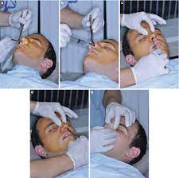
Nasal Fracture

Slide 11
Important considerations
Reduction of a nasal fracture is a brief procedure can be performed under brief but deep general anesthesia.
This can be achieved in the slight head up position after adequate pre-oxygenation using fentanyl for analgesia and a bolus dose of propofol and allowing the surgeon to do his reduction.
If there is expected to be blood loss, the airway needs to be protected with either a laryngeal mask or endotracheal tube.

Slide 12
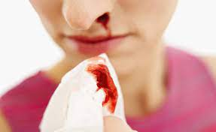
Sever Epistaxis

Slide 13
Important considerations
Patients with severe epistaxis may present for internal maxillary artery ligation.
They may have lost a substantial amount of blood and commonly have other co-existing disease, particularly hypertension.
Adequate preoperative hydration is important and it is assumed that they have a full stomach (rapid sequence induction).

Slide 14
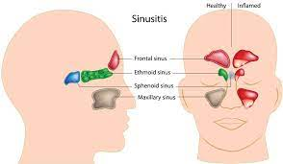
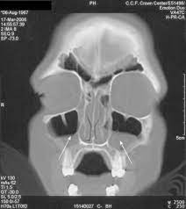
Severe Sinusitis

Slide 15
Important considerations
The nasal sinuses may require drainage and this sometimes requires a surgical approach.
The important considerations are the risks of hemorrhage, eye injury, venous air embolism, cerebrospinal fluid leak and permanent neurologic injury.

