Slide 1
Complicated surgery in diabetic patients General Medicine Theory 1

Slide 2
Perioperative challenges in management of diabetic patients
Diabetic patients are at higher risk for postoperative morbidity and mortality after non-cardiac surgery, both short-term (21 d after surgery) and long-term (7 years), due to associated cardiac, renal, neurologic, metabolic, and endocrine complications.
Careful preoperative evaluation, optimization of preoperative comorbidities, and meticulous management of patients with diabetes during the perioperative period is essential to reduce perioperative mortality and morbidity.

Slide 3
Preoperative management algorithm for diabetic patients undergoing non cardiac surgery.

Slide 4
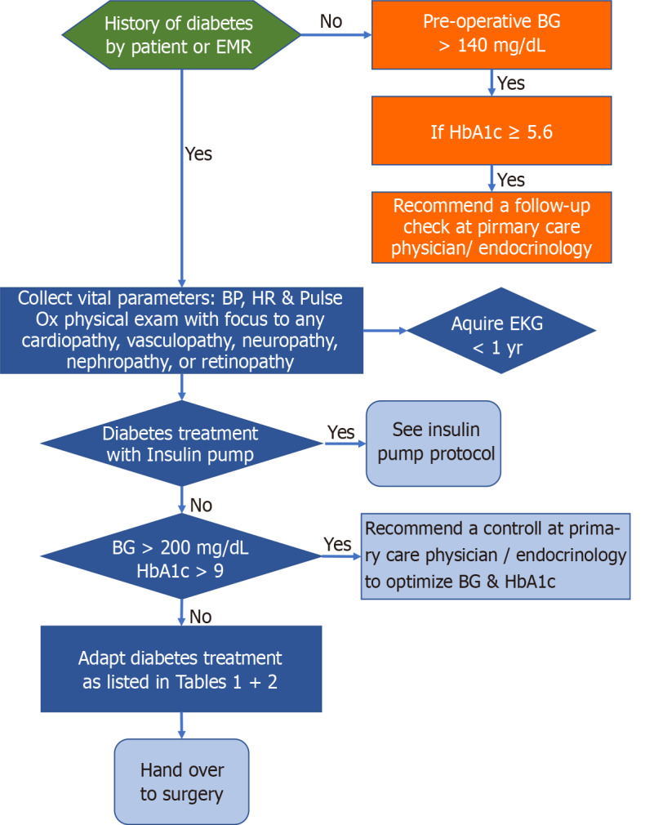

Slide 5
Specific assessment of the different organ systems

Slide 6
Cardiovascular
Cardiovascular death is a major source of morbidity and mortality in the diabetic patient. Up to 50% of the type 2 diabetic patients have unrecognized myocardial infarction events.
Another major cardiovascular concern is cardiac autonomic neuropathy (CAN).
Diabetes is a risk factor for myocardial injury after non-cardiac surgery. Elective troponin screening on the day of surgery and the first three days after surgery should therefore be considered.

Slide 7
The reference ranges for the troponin test, according to the American Board of Internal Medicine, are measured in nanograms per milliliter (ng/mL).
They are:
Troponin I: 0 - 0.04 ng/mL.
Troponin T: 0 - 0.01 ng/mL.

Slide 8
Airway and respiratory tract
Diabetic and obese patients are anecdotally considered to be at high risk for difficult intubation.
Diabetic patients are also susceptible to postoperative respiratory infections. This is further exacerbated by obesity and history of smoking if these risk factors coexist.

Slide 9
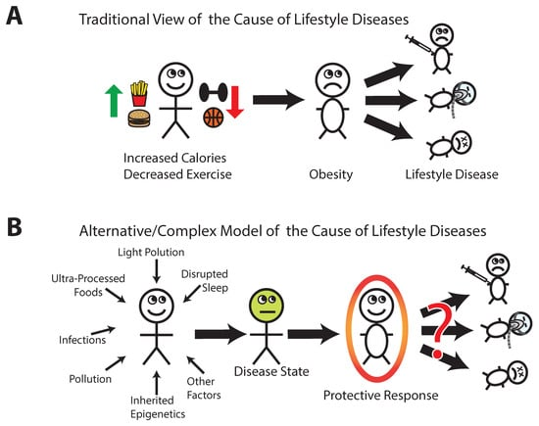

Slide 10
Sleep disorders in people with type 2 diabetes and associated health outcomes

Slide 11
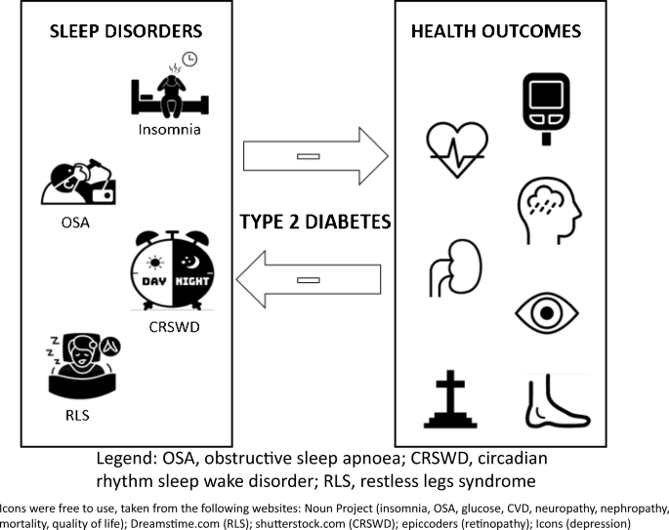

Slide 12
Renal
Diabetes is one of the most common causes of kidney disease and subsequently end-stage renal failure. Therefore, renal function should be assessed with serum creatinine concentration and GFR (glomerular filtration rate) in all patients having moderate-to major non-cardiac surgery.

Slide 14
Gastrointestinal
Gastroparesis is a major consideration for anesthesiologists, which is defined by a delayed emptying of the stomach, although there is often no anatomical outlet obstruction.
Gastroparesis can result in regurgitation and pulmonary aspiration of gastric content during the intubation process.
It may be prudent to perform a rapid sequence intubation and to premedicate with famotidine, metoclopramide and sodium citrate in diabetic patients with suspected gastroparesis.

Slide 17
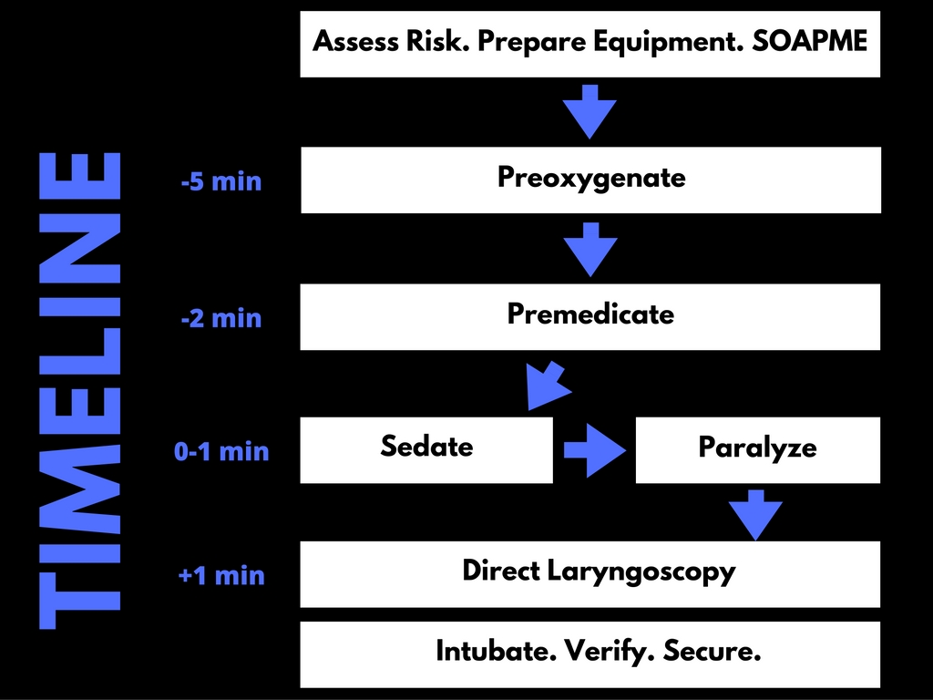

Slide 20
Peripheral neuropathy
More than half of diabetic patients develop some type of peripheral neuropathy during their lifetime. It occurs due to a damage of peripheral nerves.
Most diabetics with peripheral neuropathy suffer from polyneuropathy.
An existing peripheral neuropathy must be adequately documented, especially if regional anesthesia, extreme positioning or placement of an arterial line is considered.

