Slide 1
General Anesthetics drugs Theory 3

Slide 3
Introduction
Anesthetics are a diverse group of drugs that are used in the management of pain.
The administration of anesthetics is necessary to provide inhibition of individual pain pathways (local anesthesia) or to render a patient unconscious so that surgical procedures can be carried out (general anesthesia).

Slide 5
Local Anesthetics
Local anesthetics act by causing a reversible block to conduction along nerve fibers Scholz (2002). They act on any part of the nervous system and on every type of nerve fiber, causing both sensory and motor paralysis. The drugs used in local anesthesia vary widely in their potency, toxicity, and duration of action.

Slide 6
General Anesthetics
General anesthetics are agents that produce a drug-induced absence of perception. Depths of anesthesia that are required for the maintenance of surgical anesthesia can be achieved by a wide variety of drugs either alone or in combination. General anesthesia can be administered by a variety of routes, with inhalation and intravenous routesbeing the preferred methods. The variety of agents that can produce general anesthesia is very diverse; inhalation agents can be a simple as xenon and nitrous oxide, or the more complicated halogenated compounds. Intravenous anesthetics, as a group, include agents as diverse as the barbiturates, benzodiazepines, opioids, ketamine and alpha-2 adrenoceptor agonists

Slide 7
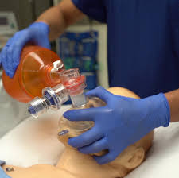

Slide 8
Developmental Brain Toxicity
Namely, commonly used intravenous anesthetics(e.g., ketamine, propofol, barbiturates, and benzodiazepines) and inhalational anesthetics (e.g., isoflurane, sevoflurane) have been shown to be damaging to the immature and developing neurons in the brains of young animals. More importantly, emerging animal and human data suggest an association between early exposure to general anesthesia and long-term impairments of learning and memory.

Slide 9
Blood-Brain Barrier (BBB)
Anesthetics influence the BBB via a multitude of different mechanisms and roles. While some anesthetics appear to have a negative effect on BBB permeability, others can provide protection to the BBB and decrease inflammation. Molecular mechanisms of anesthetic influences on the BBB tailoring anesthesia to specific needs and personalization of anesthetics to individual patients undergoing a specific procedure are all areas of future research. The bulk of evidence points to a neuroprotective and antiinflammatory effect of anesthetics on the brain. There is a limitation in comparing studies with a lack of standardization of experimental practices. Once standardization is achieved, the true nature and impact of anesthesia on the BBB and inflammation may be revealed.

Slide 10
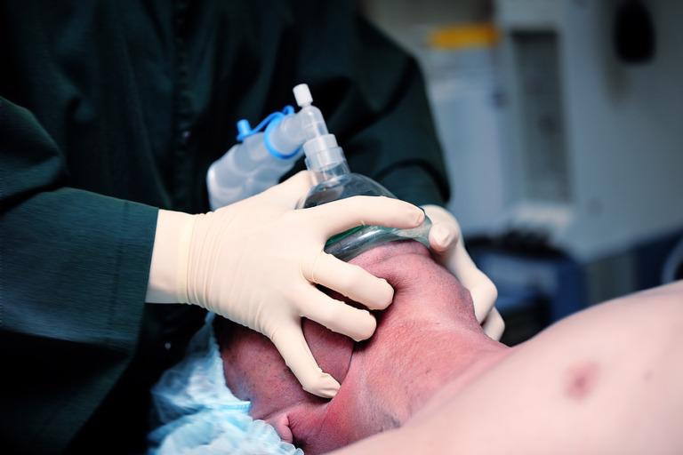

Slide 11
Anesthetic emergencies
Anesthetic emergencies such as prolonged apnea following administration of succinylcholine, malignant hyperthermia following exposure to volatile anaesthetics, and life-threatening acute porphyria after thiopentone use have catalyzed pharmacogenetic evolution since the early 1950s. In current anesthetic practice, there is wide interindividual variability in drug response, partly explained by genetic variation in drug-metabolizing enzymes or drug targets. The ultimate goal of pharmacogenomics research is to understand the molecular basis that underlies variability in drug metabolism, efficacy, and side effects, in order to tailor therapy and minimize risk. This chapter addresses the basic principles of pharmacogenomics and their application to drugs used in anaesthetic practice.

