Slide 1
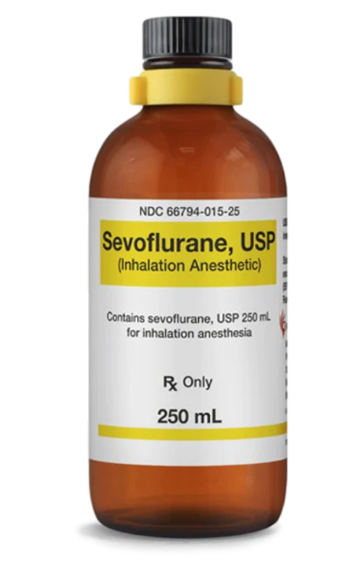
General anesthetics drugs Theory 2 Sevoflurane The most commonly used inhalational agent

Slide 2
Minimum Alveolar Concentration (MAC)
MAC is defined as the concentration of inhaled anesthetic within the alveoli at which 50% of people do not move in response to a surgical stimulus.
It is a useful and reproducible metric across all volatile anesthetics, making it the standard for comparison of volatile anesthetic potency.
MAC provides a correlation between anesthetic dose and immobility.

Slide 5
Physiological Factors
Factors such as species, sex, hypothyroidism, hyperthyroidism, or duration of anesthesia do not affect MAC; however, the age of the patient does influence the minimum alveolar concentration. MAC peaks at 6 months of age, and then decreases by approximately 6% per decade, regardless of volatile anesthetic.
MACage is the MAC at a given age and MAC40 is the MAC value at age 40

Slide 6
Clinical Significance
Both minimum alveolar concentration (MAC) and lipid solubility vary among different volatile anesthetics.
The most commonly used anesthetics follow the order of
nitrous oxide > desflurane > sevoflurane > isoflurane > halothane, for highest to lowest MAC.

Slide 7
Introduction
Sevoflurane is a halogenated inhalational anesthetic that is FDA approved for the induction and maintenance of general anesthesia in adults and pediatric patients for inpatient and outpatient surgery.
Sevoflurane is a volatile anesthetic that provides hypnosis, amnesia, analgesia, akinesia, and autonomic blockade during surgical and procedural interventions.

Slide 8
Clinical Uses
Inhalational induction of general anesthesia in neonatal and pediatric patients secondary to inadequate pre-induction intravenous access.
Inhalational induction of general anesthesia in adult patients whose clinical condition necessitates spontaneous respirations during induction.
It may be used for complete maintenance of general anesthesia or concurrently with intravenous anesthetics to maintain general anesthesia in adult and pediatric patients.

Slide 9
Dosing
Adults MAC Values for Surgical Levels of Anesthesia
Age 25 years: Sevoflurane in oxygen: 2.6%
Age 40 years: Sevoflurane in oxygen: 2.1%
Age 60 years: Sevoflurane in oxygen: 1.7%
Age 80 years: Sevoflurane in oxygen: 1.4%
Pediatric MAC Values for Surgical Levels of Anesthesia
Newborn to 1-month-old full-term neonates: Sevoflurane in oxygen: 3.3%
One to younger than six months: Sevoflurane in oxygen: 3%
Six months to younger than one year: Sevoflurane in oxygen: 2.8%
One to younger than three years: Sevoflurane in oxygen: 2.8%

Slide 10
Metabolism and Clearance
Sevoflurane undergoes minimal hepatic metabolism or renal excretion.
The clearance of sevoflurane and the termination of its anesthetic effects depend on the same factors that influence the agent’s uptake.

Slide 11
Adverse Effects
Cardiovascular
Sevoflurane induces a dose-dependent reduction in blood pressure and cardiac output primarily by reducing systemic vascular resistance.
Respiratory
Like all volatile anesthetic agents, sevoflurane is an airway irritant and may precipitate coughing, apnea, and laryngospasm.
Central Nervous System
Sevoflurane causes dose-dependent vasodilation of cerebral vasculature, thereby increasing cerebral blood flow and intracranial pressure.

Slide 12
Contraindications
Sevoflurane is contraindicated in patients with known hypersensitivity to sevoflurane or any other halogenated anesthetics.
The agent is also contraindicated in any patient with known or suspected susceptibility to malignant hyperthermia.

Slide 13
Monitoring
During the administration of sevoflurane for general anesthesia, there should be continuous monitoring following the recommendations of the American Society of Anesthesiologists (ASA).
Standard ASA monitors include continuous pulse oximetry, electrocardiography, a noninvasive blood pressure device, temperature monitor, measurement of end-tidal carbon dioxide, inspired oxygen concentration, the use of low oxygen concentration, and ventilator disconnect alarms, and the continuous presence of a qualified anesthesia provider. The ASA also encourages the quantitative monitoring of the volume of expired anesthetic gas.

