Slide 1
Organization behavior Lecture Blesa Ibrahim Stage two 2022-2023

Slide 2
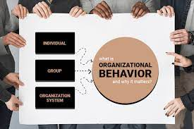
What is organization behavior
Organizational behavior (OB) is the study of how people interact within groups and its principles are used to make businesses operate more effectively.
Organizational Behavior is the study of human behavior in the workplace, the interaction between people and the organization with the intent to understand and predict human behavior.

Slide 3

What is organization behavior and how ob focuses on individuals ?
The study of organizational behavior focuses on individuals':
- Perceptions
- Values
- Learning capacities
- Actions

Slide 4
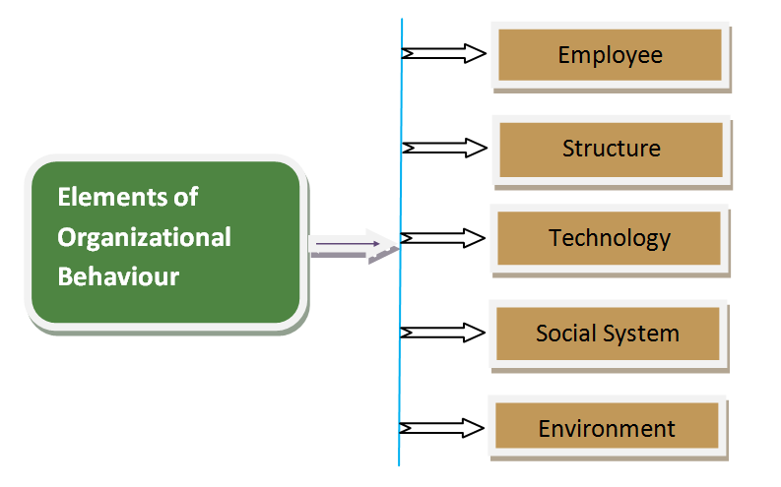
What are the fundamental elements of organization behavior ?

Slide 5
why organizational behavior is important for a company?
managing people effectively predicts success in organizations.
A positive work environment.
employees are well-behaved, leads to increased morale.
organizational behavior analyzes the effect of social and environmental, factors that affect the way employees or teams work.
people interact, communicate, and collaborate is key to an organization’s success
organizational behavior to improve the effectiveness and efficiency of your work place.

Slide 6
What are the benefits of organizational Behavior?
Improve customer service.
Facilitate effective teamwork.
Encourage creativity and innovation.
Promote effective leadership.
Ensure ethical behavior among staff and management.
Evaluate employee job performance.
Create a positive atmosphere for employees.

Slide 7
Why It Is Important for Managers to Understand Organizational Behavior?
Managers understand the organizational impacts of individual and group behaviors.
Managers are more effective in motivating their subordinates.
Relationships are better between management and employees.
Managers are able to predict and control employee behavior.
The organization is able to make optimally efficient use of human resources.

Slide 8
What are the goals of OB?
(1) To describe systematically how people behave under variety of conditions
(2) To understand why people behave as they do
(3) Predicting future employee behavior
(4) Control at least partially and develop some human activity at work

Slide 9
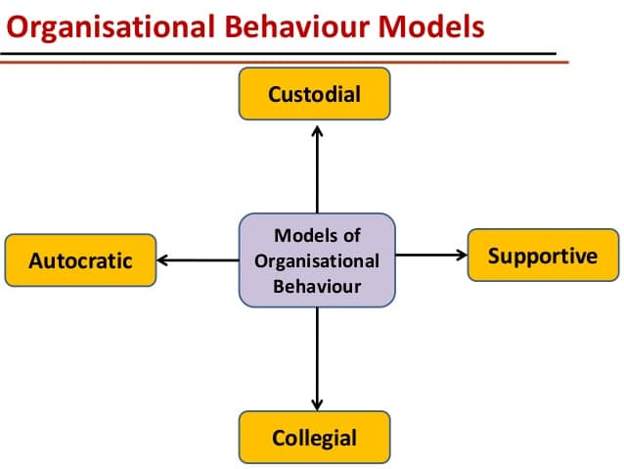
Organizational behavior model

Slide 10
What are the main challenges and opportunities of ob ?
1)Improving peoples skills.
2)Improving quality and productivity.
3)Total quality management (TQM)
4)Managing workforce diversity.
5) Responding to globalization.
6) Stimulating innovation and change.

Slide 11
What are the factors that impacts of OB? describe only one
1) Organizational Culture
Organizational culture consists of values and motives that contribute to the environment within an organization. It influences the way people work and interact with each other. Employees become more responsible when they feel respected and become an integral part of the team. Based on a of the study 20,000 employees conducted by HBR and Christine Porath, results show that employees are more engaged with work when they are treated with respect. They will feel more committed to their work and align their goals with the company.
2) Incentive System
Employees tend to feel more motivated when there is a solid reward system. Once this effective system is established, it is necessary to reward employees who perform well. They should be consistently applied within the company. A study from the Human Resource Journal proposes that there are three types of contingent pay: performance-related pay, profit-related pay and share ownership. Through interviews conducted in 1,293 private-sector workplaces across the United Kingdom, only performance-related pay was associated positively with job satisfaction, commitment, and loyalty among employees. Organizational behavior proposes that incentives are motivational factors that are crucial for employees to perform well.

Slide 12
3)Decision Making
Organizational behavior changes the way people make decisions. Businesses that are able to encourage risks in decision making within the company culture can enhance innovation and creativity. Effective communication allows managers and employees to understand the business context and provides the opportunity for employees to get involved.
It is essential to focus on the types of organizational behaviour that you would like to modify or maintain. Eliminating the negative elements that slow down employee productivity can generate a more efficient and positive organizational culture.

Slide 13
What are the factors affecting the organizational behavior?
the company's structure
policies and procedures
management effectiveness
interactions between colleagues.
changes the way people make decisions, Businesses that are able to encourage risks in decision making
the company's structure, policies and procedures, management effectiveness and interactions between colleagues.

Slide 14
What are three areas that affect organizational Behavior? Describe only one
1) micro (the individual level),
2) meso (the group level),
3) macro (the organizational level).

Slide 15

1)micro level In business management, micromanagement is a management style whereby a manager closely observes, controls, and/or reminds the work of their subordinates or employees. Micromanagement is generally considered to have a negative connotation, mainly because it shows a lack of freedom and trust in the workplace.

Slide 16
2) meso level of analysis include group decision-making; managing work teams for optimum performance (including maximizing team performance and communication); managing team conflict (including the effects of task and relationship conflict on team effectiveness); team climate and group emotional tone; power, organizational politics, and ethical decision-making; and leadership, including leadership development and leadership effectiveness.

Slide 17

3) Macro management is a style of leadership that is hands-off or from afar, allowing employees to have more freedom and control over their own work, while employers may shift focus to strategic long-term goals.

Slide 18
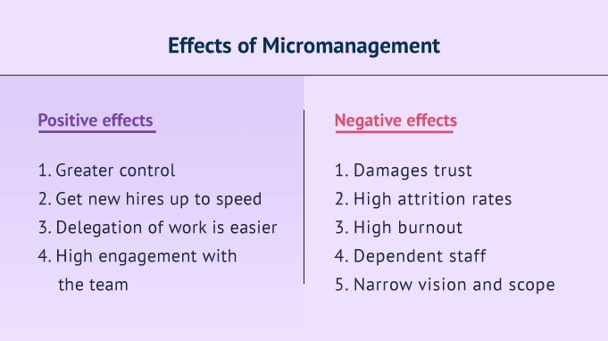
What are the positive and negative effects of micromanagement ?

Slide 19
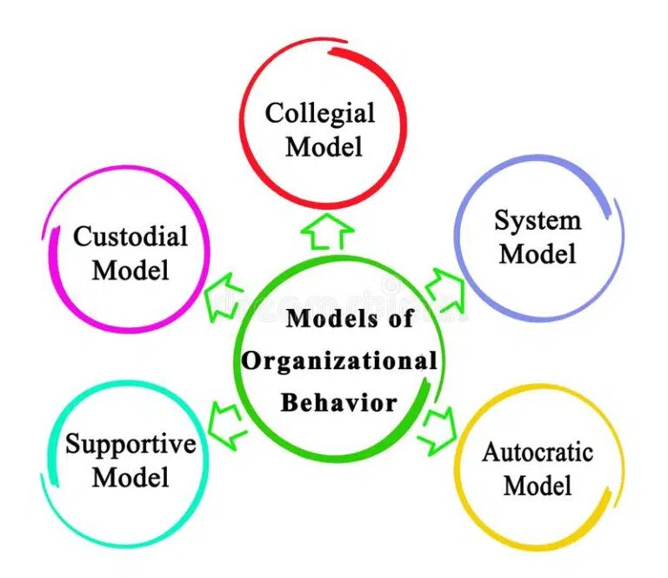
What are the types of Organizational Behavior Model?

Slide 20
What are the types of Organizational Behavior Model? Describe one
Autocratic Model: –
The autocratic model is the model that relies on strength, power and formal authority. The autocratic model depends on power. Managers see authority as the only means to get the things done and employees are expected to follow orders. So it results in the higher dependence on the boss.
In an autocratic organization, the people (management/owners) managing the functions in an organization have formal authority to control the employees working under them. These lower-level employees have little control over the job assignments. His ideas and innovations are generally not welcomed, as major decisions are made at the top management level.

Slide 21
Custodial Model: –
Workers being managed under the autocratic model often feel insecure and disappointed. They may also show aggression towards their boss and their family and neighbors. So progressive managers felt that something must happen ways to develop better employee relations so that insecurities and frustrations could be removed. The custodial approach induces employees now to show their dependency and loyalty towards the company and not to the boss or managers, or supervisors. The employees in this environment are more psychologically contended and preoccupied with their rewards, but it is not necessary they would be strongly motivated to give the performance.

Slide 22
Supportive Model: –
The basic idea behind this theory is that leadership drives people to work not the power of money as in the custodial model. Through leadership Management provides an environment to help employees develop and fulfil the interests of the organization, rather than the only things to support employee benefit payment as per custodial approach.
It works in the public sector organization which is dependent on effective leadership. Here, it is assumed that workers are self directed and creative. Importance in this model is given to psychological needs, self esteem, job satisfaction and friendly relations between superior-subordinate.

Slide 23
Collegial Model: –
A useful extension of the supportive model is the collegial model. This word collegial means a body of individuals with a common purpose. The collegial model, which embodies a term concept, first achieved widespread applications in research laboratories and similar work environments. This is a best model based on the partnership between workers and management in which both work together as a team and respect each other. Workers are satisfied by their job and they are committed to the organisation.
The collegial model traditionally was used theory is based on the principle of mutual contribution by employer and employees. Each employee should develop a feeling that he is a part of the whole and contributing something to the whole and recognizes the others contribution. Management is supported to be joint contribution and not the boss.

